Slide 1
Chapter 6
Part 2
Digital Baseband Communication

Slide 2
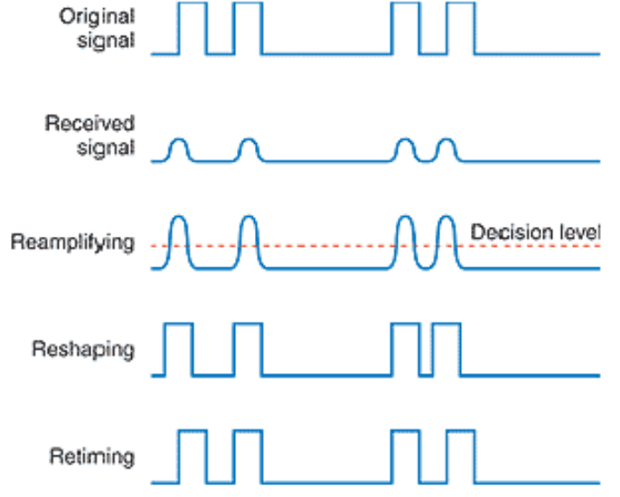
Analog vs. Digital Communication
Analog communication (baseband and modulated) is subject to noise.
Pulse modulations (PAM, PWM, PPM) represent analog signals by analog variations in pulses and are also subject to noise.
Long distance communication requires repeaters, which amplify signal and noise. Each link adds noise.
Digital communication suppresses noise by regenerating signal.

Slide 3
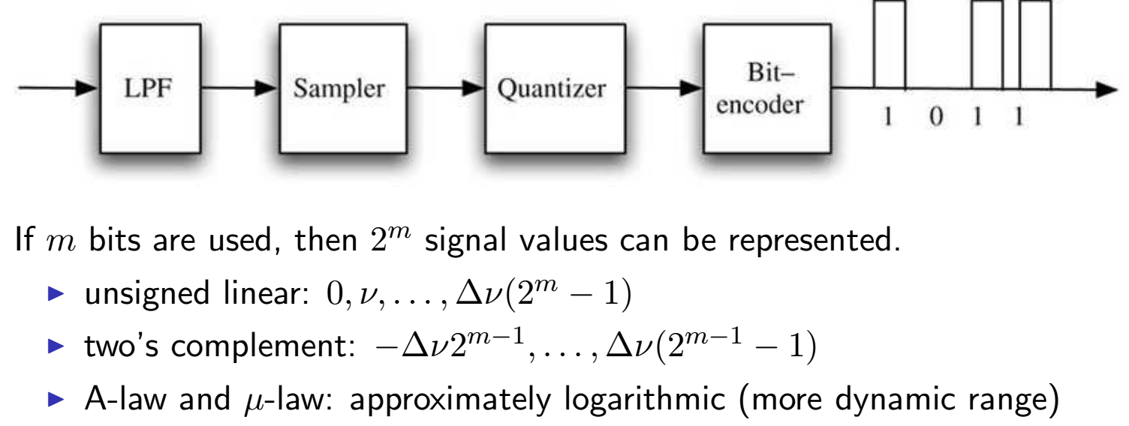
Pulse Code Modulation (PCM)
In PCM, a signal value is represented by a sequence of pulses (digits).
Width and spacing of pulses is constant.
Value of pulse is chosen from a small number of values.
Usually PCM uses only two pulse values, which represent 0 and 1.
Notes:
μ-Law, the original. Bell System, 1950s US Digital Telephony.
A-Law, later and simpler, International Telephone systems

Slide 4
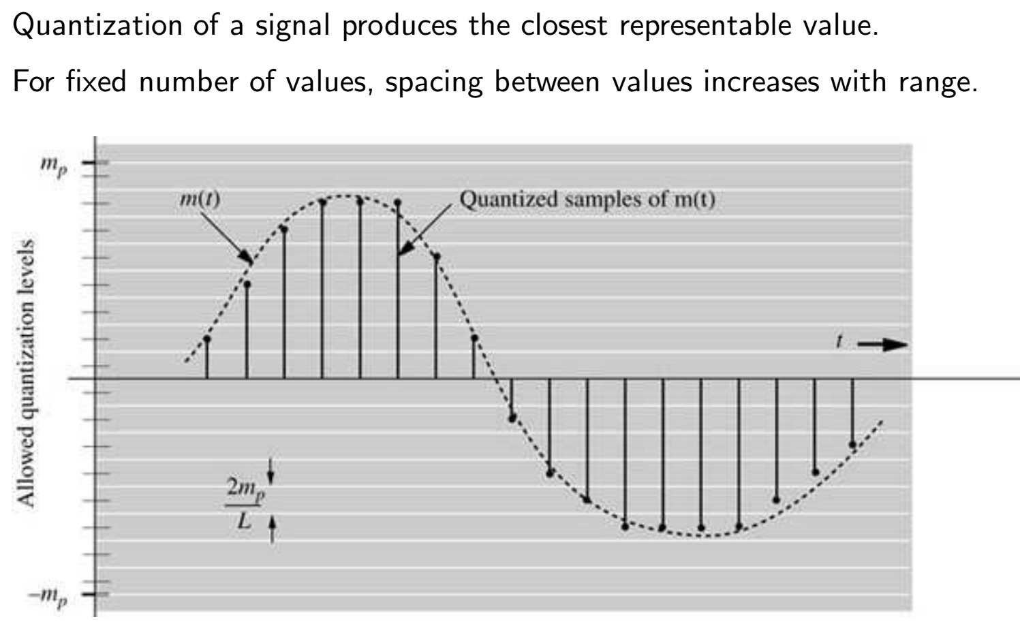
PCM and Quantization

Slide 5
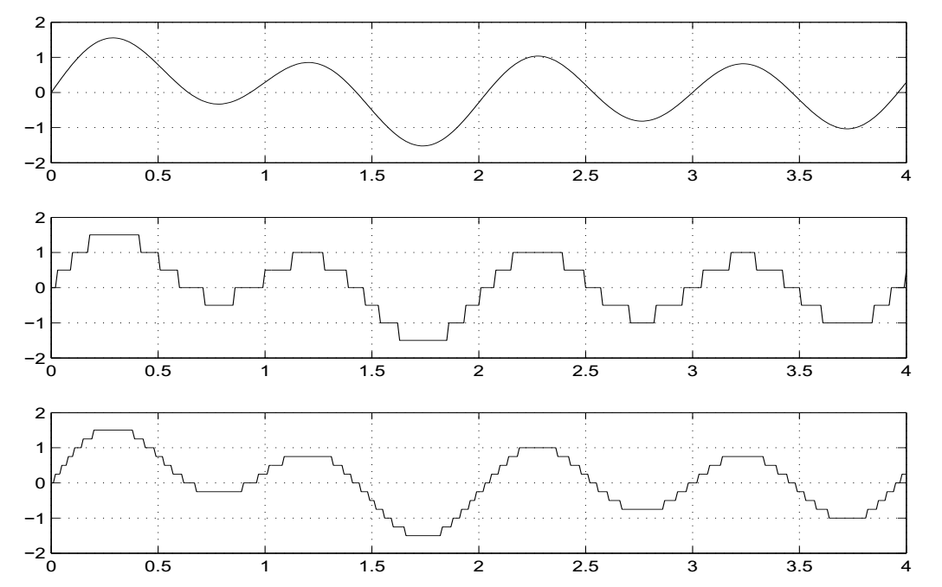
PCM Tradeoffs
Signal bandwidth determines minimum sample rate
Desired signal fidelity determines precision of reproduced signal
Signals are quantized using digital-to-analog converter (DAC)

Slide 6
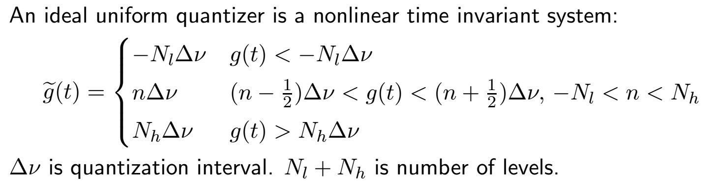
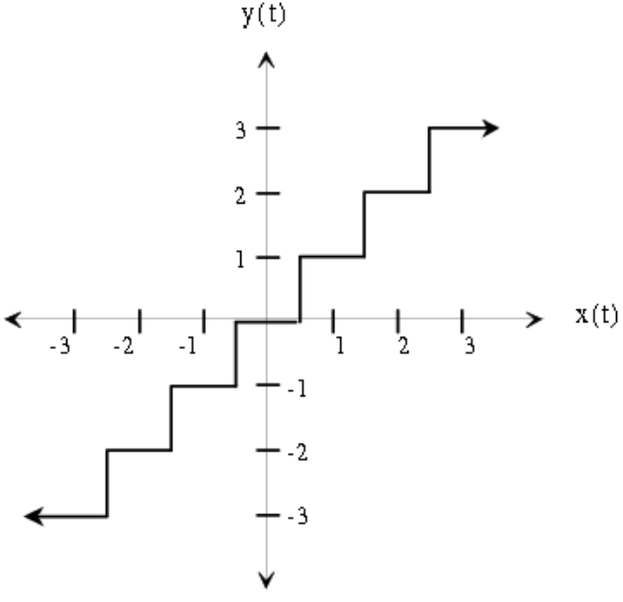
Uniform Quantization

Slide 7
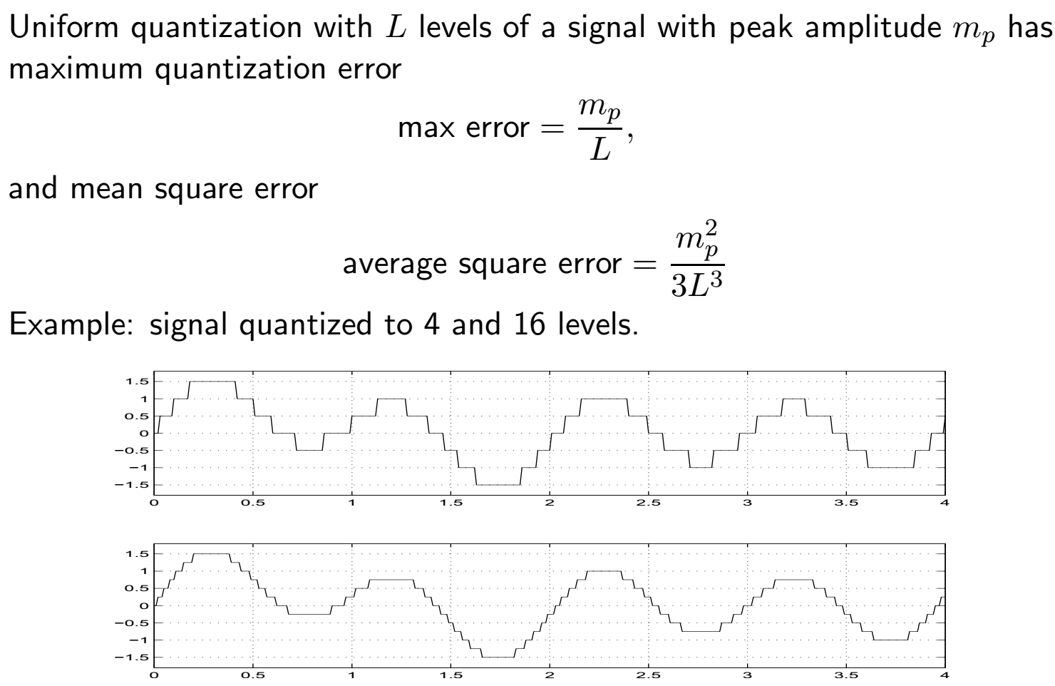
Quantization Error

Slide 8
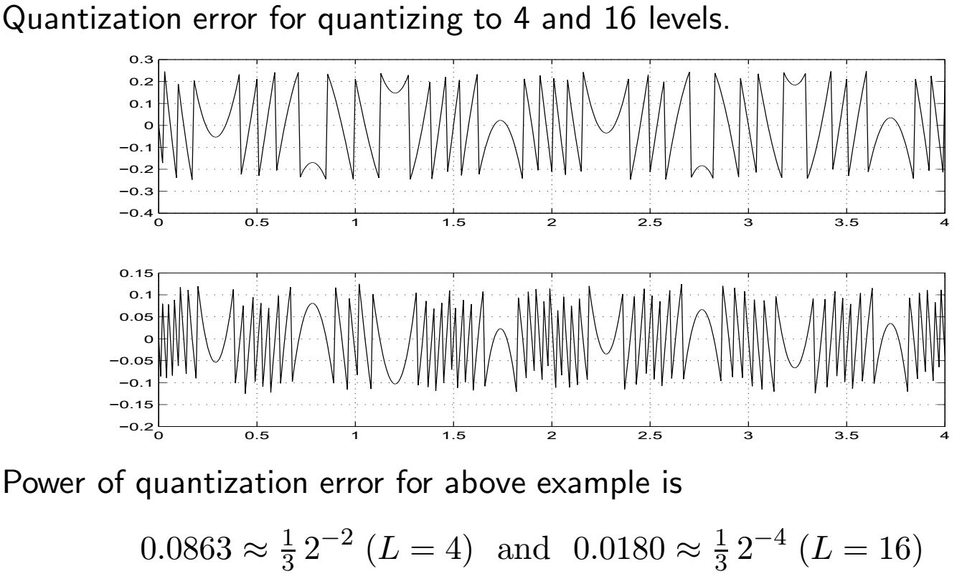
Quantization Error 2

Slide 9
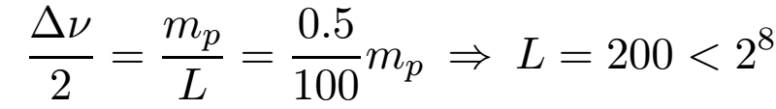

Bandwidth vs. Quantization Error
What bandwidth is needed to transmit a PCM encoded signal?
Example: suppose that we want maximum error 0.5%mp for a 3 kHz signal (analog telephone BW)
At Nyquist sample rate use 8 kHz for margin
We need 8000 · 8 = 64,000 bits/sec which is the digital telephony rate.

Slide 10
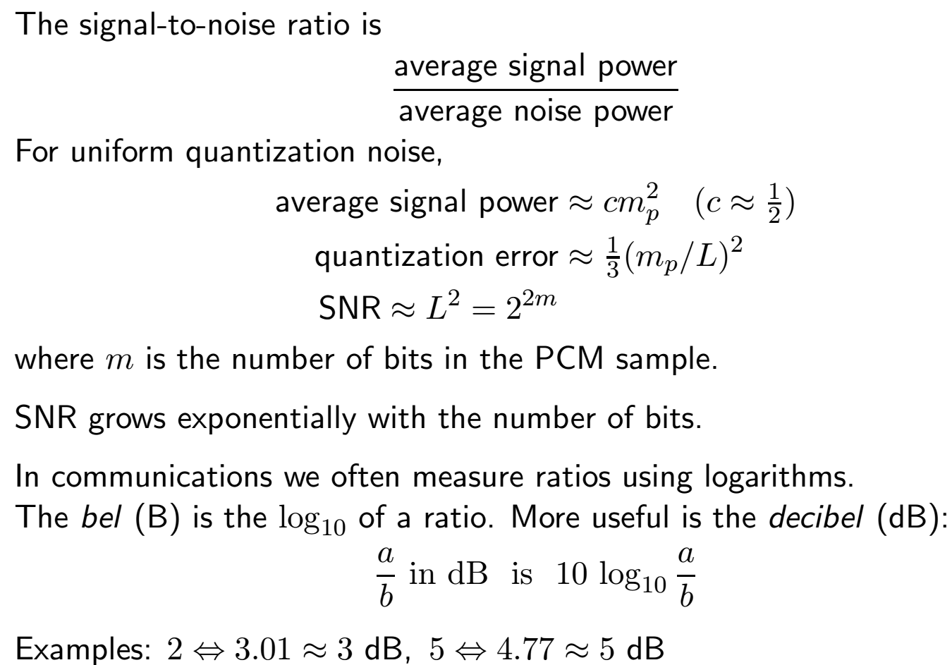
Logarithmic Units

Slide 11
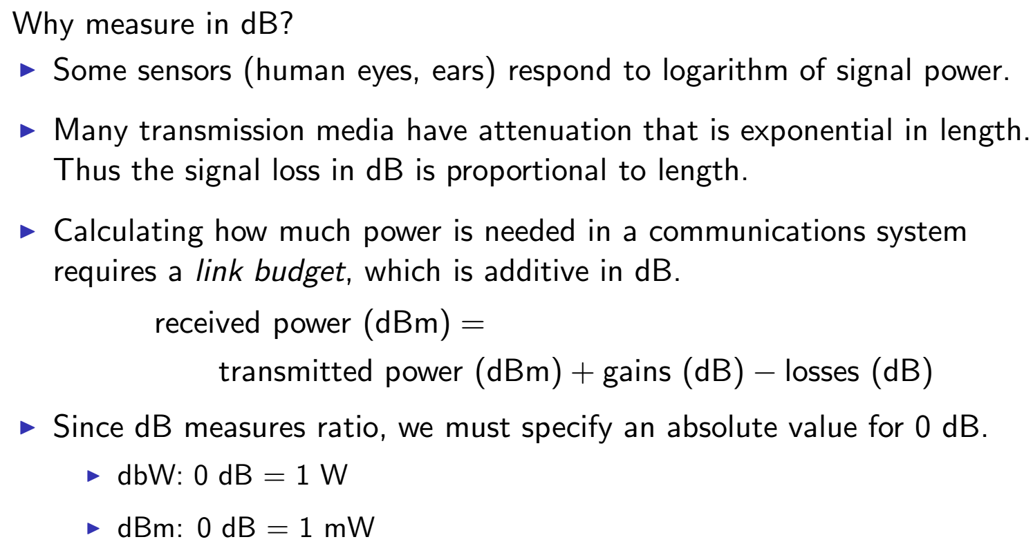
Logarithmic Units 2

Slide 12
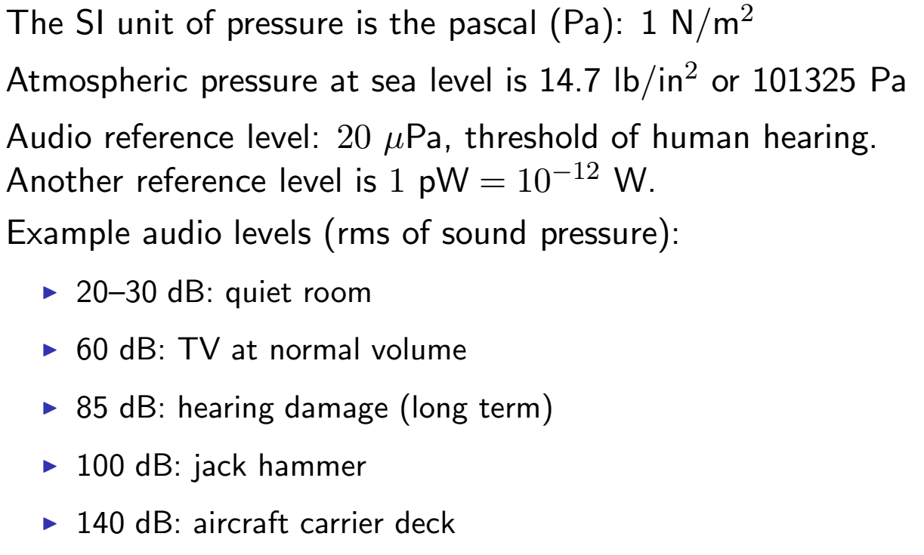
Audio Volume (Sound Pressure)
Notes:
These are actually dBA readings, pass the sound through ab A-weighted filter before measuring to simulate the performance of an average, good, human ear vs frequency at high sound levels.
dBC readings match the performance of a human ear at the threshold of hearing.

Slide 13
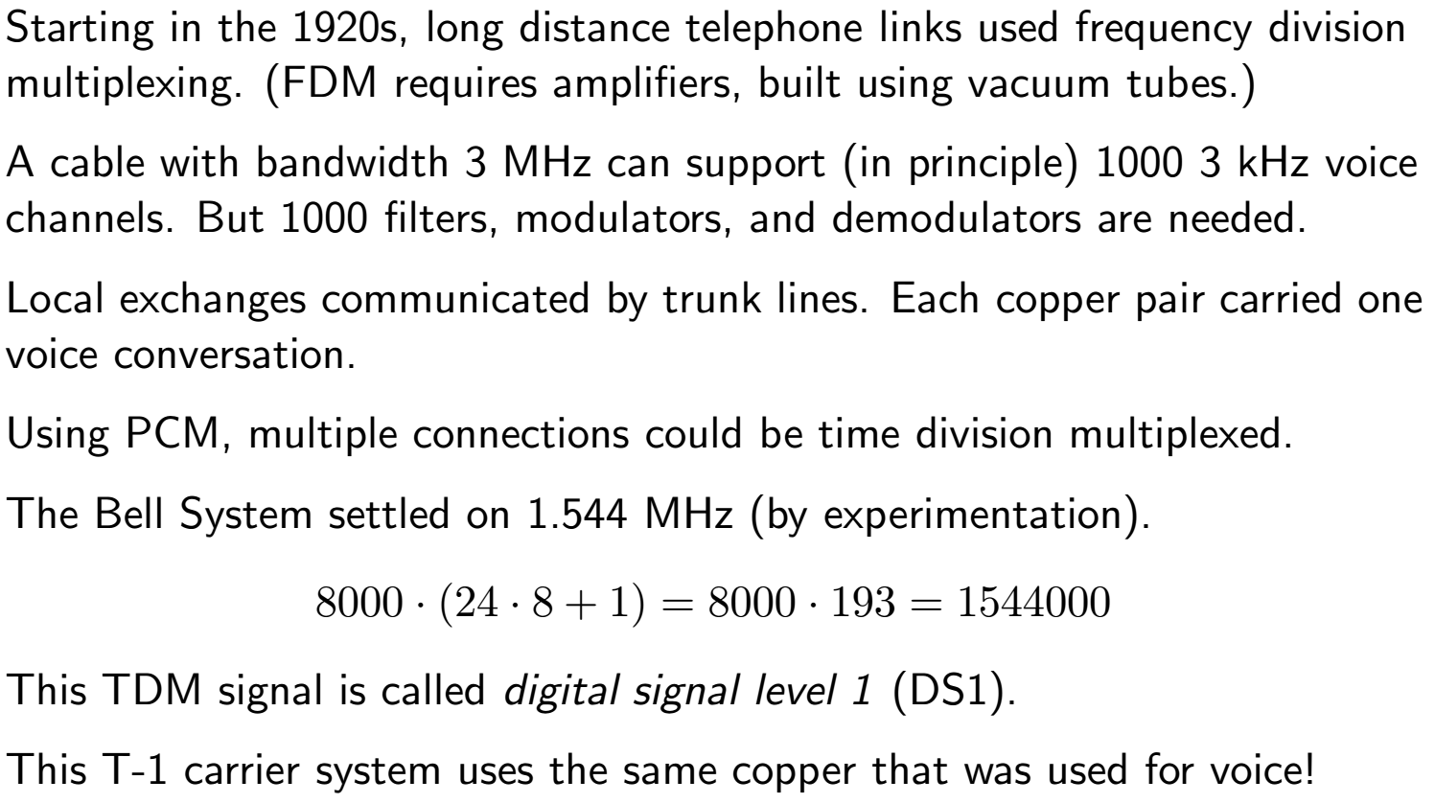
PCM in the Bell System
Notes:
PCM is credited to Bernard Oliver and Claude Shannon (patent 2 801 281, 1946)

