Slide 1
Chapter 5
Angle Modulation and Demodulation
Part 2

Slide 2
Angle Modulation 2
Lecture topics
US Broadcast FM
Narrowband FM Modulation
Wideband FM Modulation
Narrowband FM Demodulation
Wideband FM Demodulation
FM Advantages over AM
Noise and FM

Slide 3
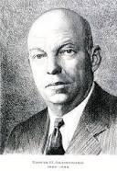
US Broadcast FM
US Monaural FM bandwidth specifications:
  Frequency range: 88.0–108.0 MHz
  Channel width: 200 KHz (100 channels)
  Channel center frequencies: 88.1, 88.3, . . . , 107.9
  Frequency deviation: ±75 KHz
  Audio 50 Hz – 15kHz
Signal bandwidth: 400 kHz allocated for stereo broadcast and other services using composite audio:
  Muzak (elevator music) (1936) – NB FM sub-channel at 67 or 92 kHz
  FM Stereo
    Frequency Domain View - sum and difference of L/R audio channels via DSB-SC at 38 kHz
    Time Domain View – alternate left and right channels at 38 kHz sample rate
  Digital stereo HD with compressed CD quality sound
Notes:
Coronel Edwin Howard Armstrong made FM broadcast practical in 1939 with multiple inventions, but was bankrupted by CBS colluding with the FCC to make all of his installed base obsolete by moving FM from the 42–50 MHz band to its current 88-108 MHz. Armstrong committed suicide in 1954.

Slide 4
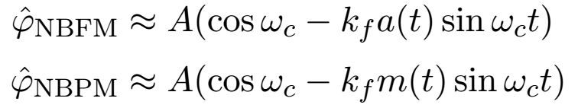
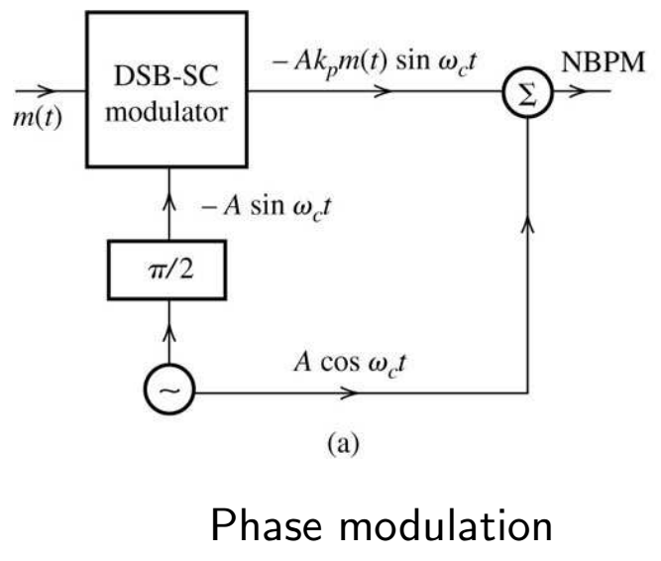
NBFM Modulation
For narrowband signals, |k_{f} a(t)| ≪ 1 and |k_{p}m(t)| ≪ 1,
We can use a DSB-SC modulator with a phase shifter.
m(t)*sin(ω_{c}t)
m(t)*(-1)
m(t)*1
cos(ω_{c}t)
Notes:
a(t) is the integral of m(t).
Armstrong used this method to produce NB FM and then distorted it and filtered out a high harmonic to get WB FM. Note a bit of AM too.

Slide 5
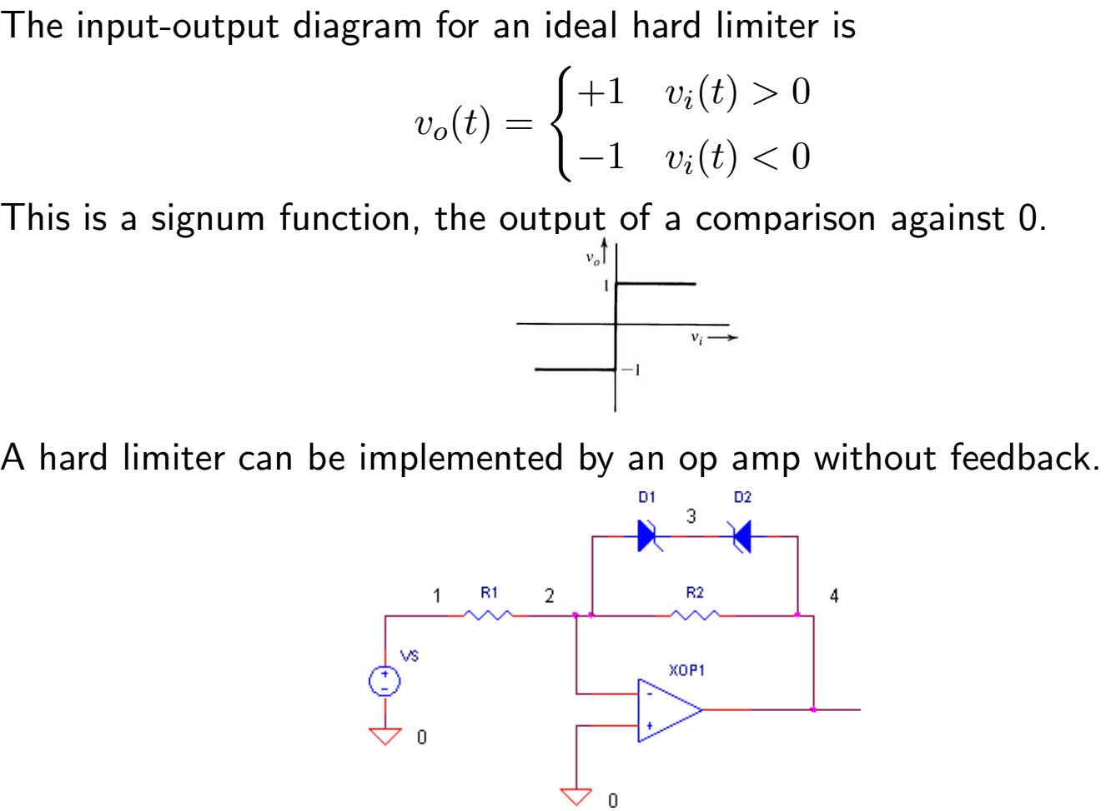
Hard Limiter to Remove AM from an FM Signal

Slide 6
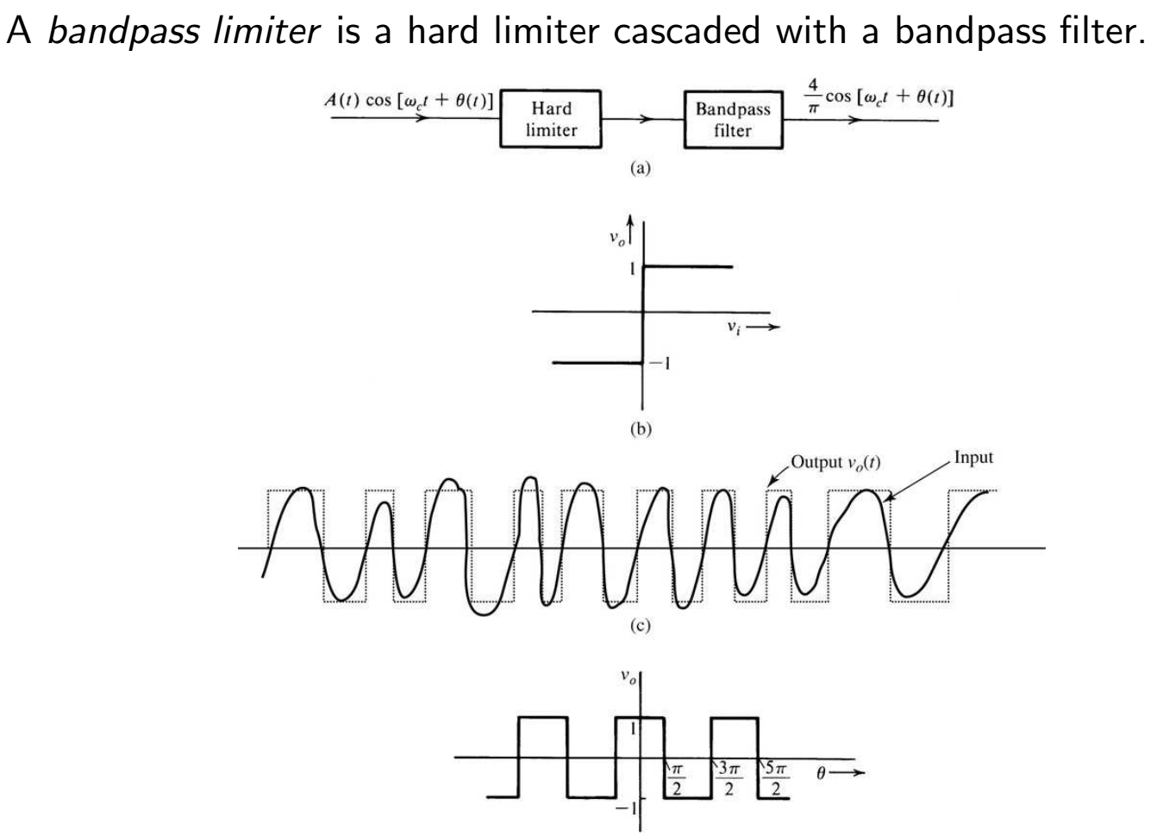
Bandpass Limiter

Slide 7
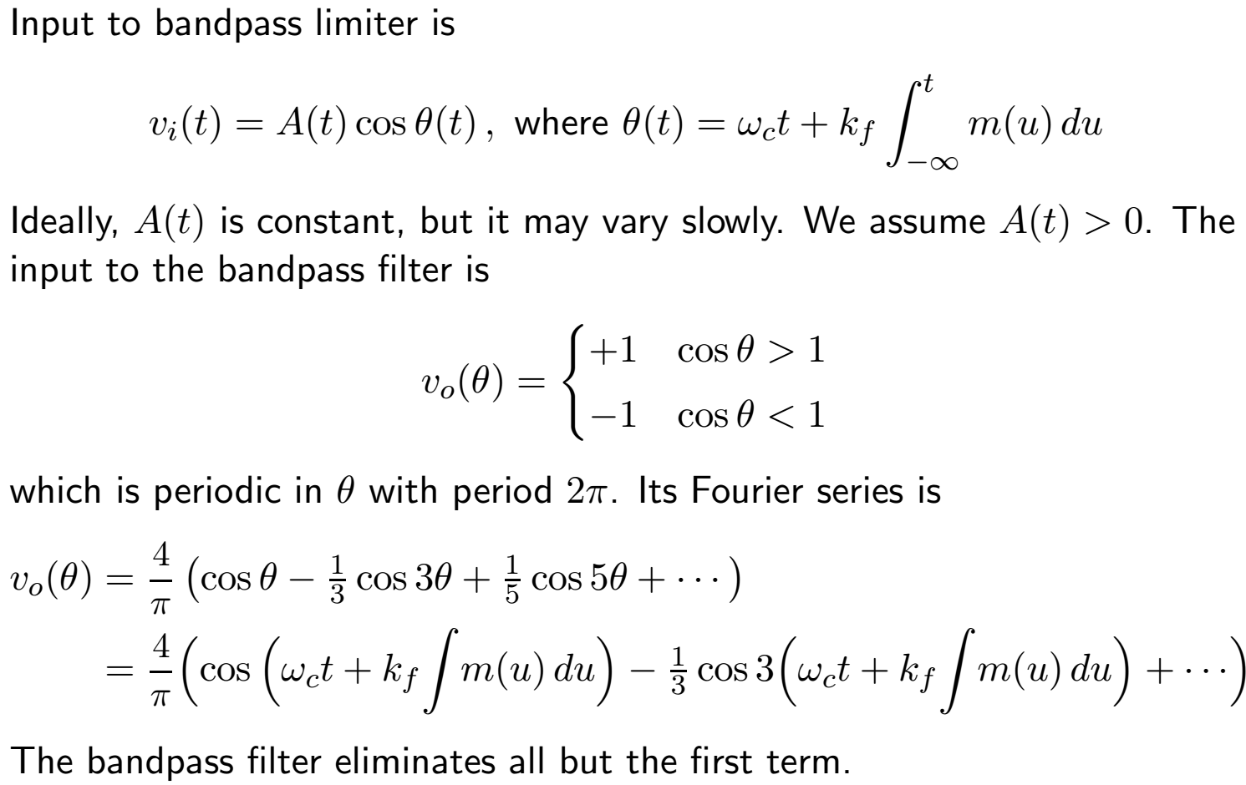
Bandpass Limiter 2

Slide 8
WBFM Modulation: Direct Generation Using VCO
A voltage controlled oscillator (VCO) generates a signal whose instantaneous frequency proportional to an input m(t):
ω_{i}(t) = ω_{c} + k_{f}m(t)
The signal with frequency ω_{i}(t) is bandpass filtered, then used in a
modulator.
VCO can be constructed by using input voltage to control one or more circuit parameters:
R: mosfet
L: saturable core reactor
C: reverse-biased semiconductor diode (Varactor)
In all cases, feedback is used to control the average frequency.

Slide 9
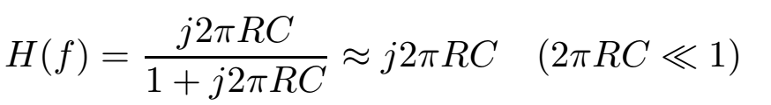
FM Demodulation
Frequency-selective filter
  RC high-pass filter
  RLC circuit with carrier frequency ω_{c} < ω₀ = 1/root(LC)
Differentiator (multiplies by jωc in the frequency domain)
Slope detection
Zero-crossing counter
Phase-locked loop (not discussed today)
DoctorD’s Power Mean Frequency Detector*
Notes:
* "The Power Mean Frequency Estimator: Another Approach to the FM Detector," IEEE Transactions on Broadcast and Television Receivers, BTR-20, No. 3, (August 1974).

Slide 10

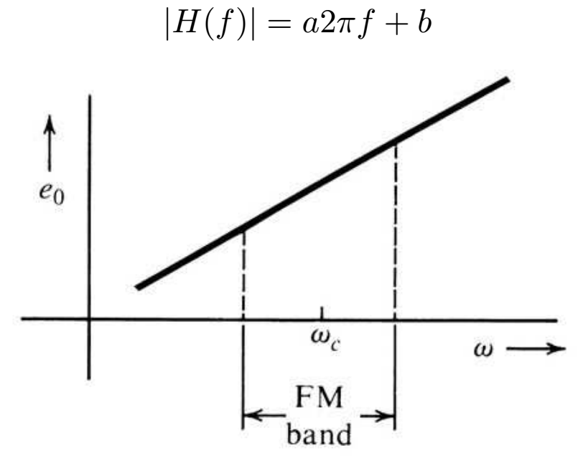
Slope-Detecting Filter
Information in an FM signal is contained in the instantaneous frequency,
We can convert FM to AM and then use an envelope detector

Slide 11
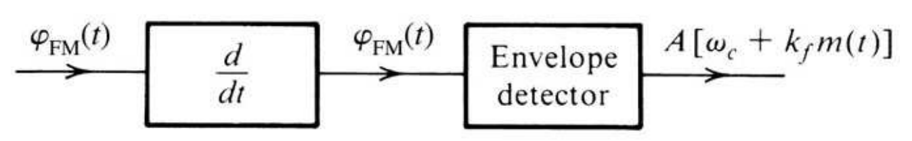
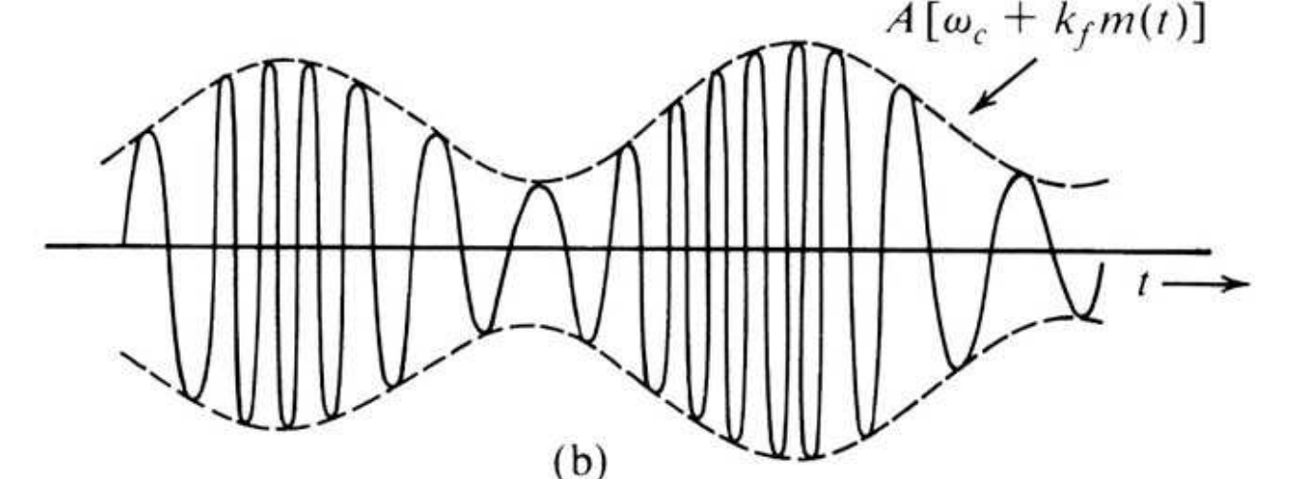
FM Demodulator and Differentiator
Notes:
It is important that A is constant (no AM)

Slide 12
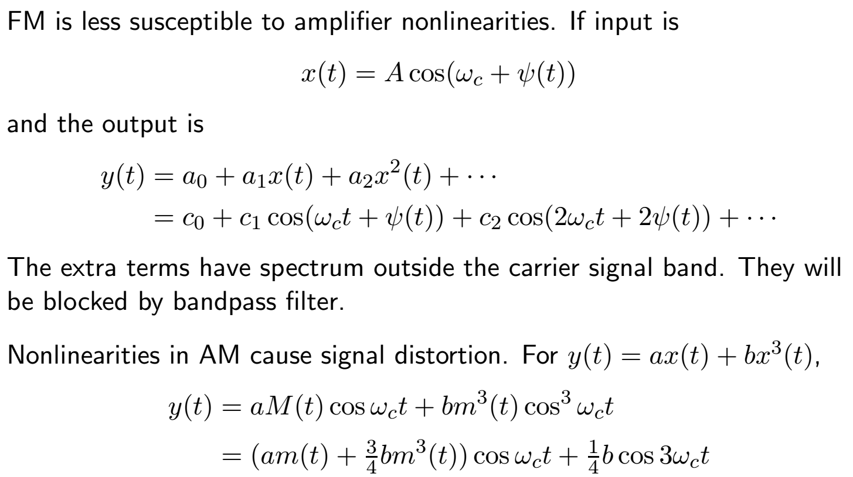
Advantages of FM

Slide 13
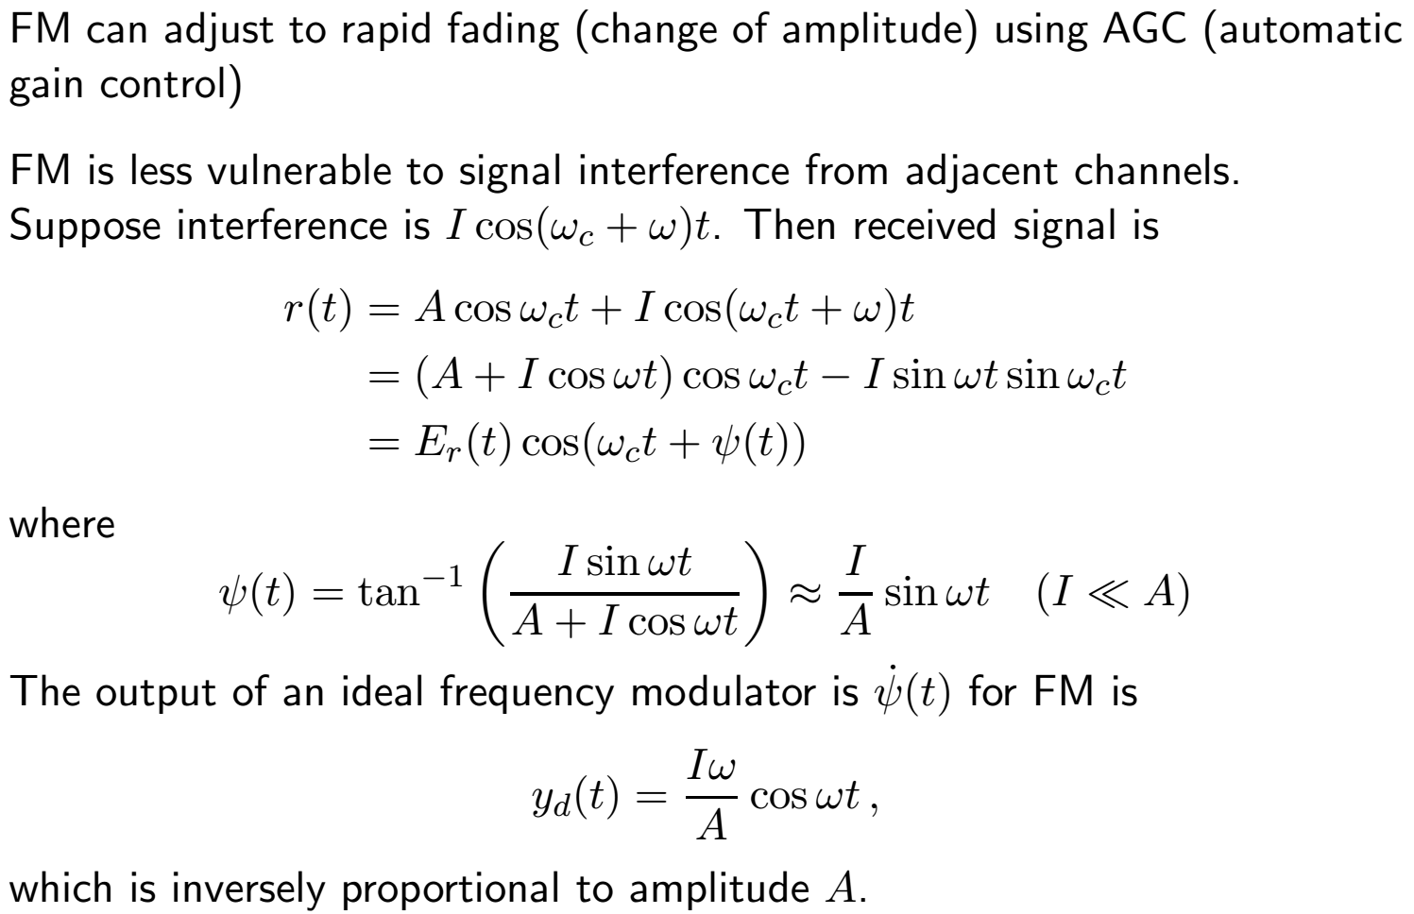
Advantages of FM 2

Slide 14
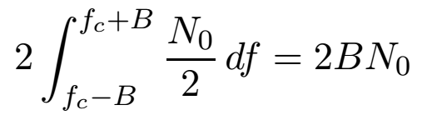
Noise and FM
Assume that the power spectrum of noise is flat over an FM channel.
e.g., white noise has constant power spectrum = N₀/2
The power of the noise in a frequency band of width 2B is
The transfer function for FM demodulator satisfies |H(f)| = af + b. This filter increases noise at higher frequencies.
We can reduce high frequency noise by using
pre-emphasis / de-emphasis filters
Notes:
N/2 to take into account negative and positive frequencies

Slide 15

Noise and FM – 2
FM signal with interfering sinusoid – Phasor analysis
The “Noise” Phasor is rotating at the difference between the two frequencies.
  Phase modulation of the Received signal by the “Noise”
  Becomes FM modulation when the amplitude of the “Noise” becomes larger than the signal.
“FM Capture Ratio”
is the ratio between the wanted and unwanted signal to give a certain reduction (e.g. 30 dB) in level of the unwanted signal at the output.
Received Signal
Noise Signal
FM Signal
Steven O. Rice
Notes:
Received noise by an FM detector is actually impulse noise (Ricean Clicks) caused each time the noise manages to get the resultant signal around the origin.
A good capture ratio can be as low as 0.5 dB and occurs when hard limiting takes place on a wide bandwidth system. It is an indicator of a quality design.

Slide 16
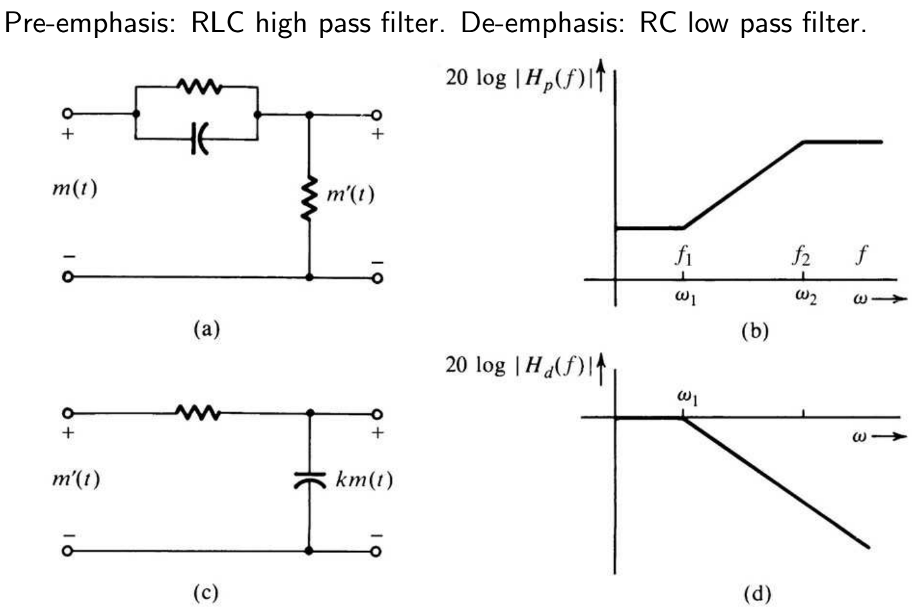
FM Pre-emphasis and De-emphasis

Slide 17
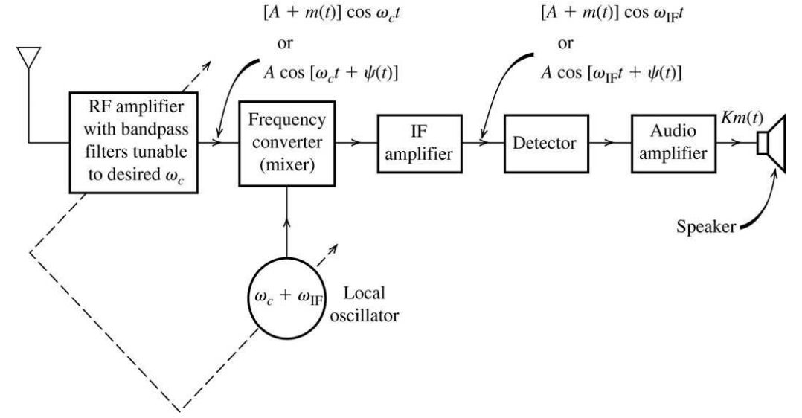
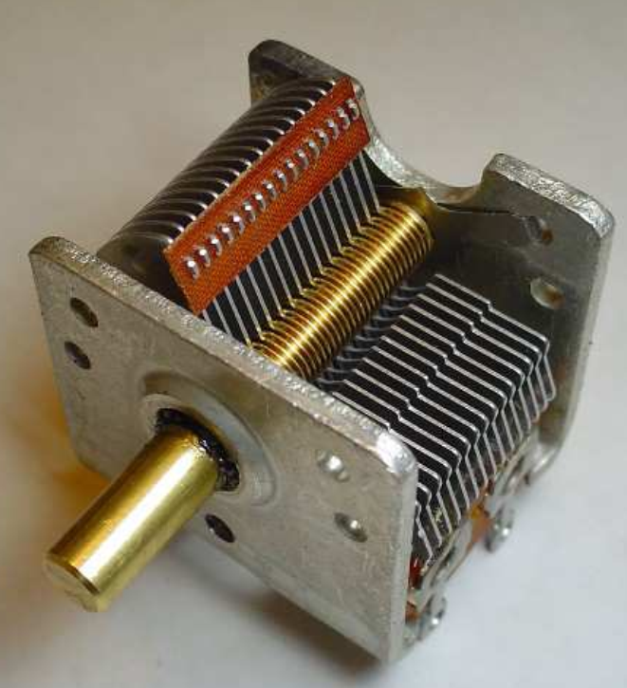
Superheterodyne Analog AM/FM Receivers
RF (radio-frequency) section
frequency converter (local oscillator and mixer)
intermediate-frequency (IF) amplifier with bandpass filter
envelope detector
audio amplifier
Notes:
AM IF is at 455 kHz
FM IF is at 10.7 MHz (no tuned RF for FM)

