Slide 1
Chapter 4
Amplitude Modulation and Demodulation
Part 1

Slide 2
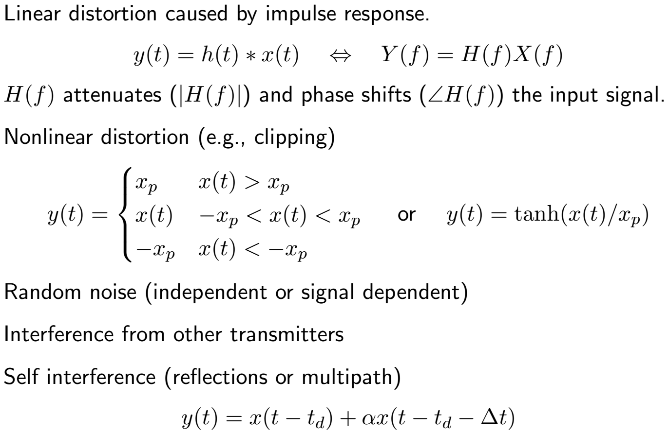
Channel Impairments (Review)

Slide 3
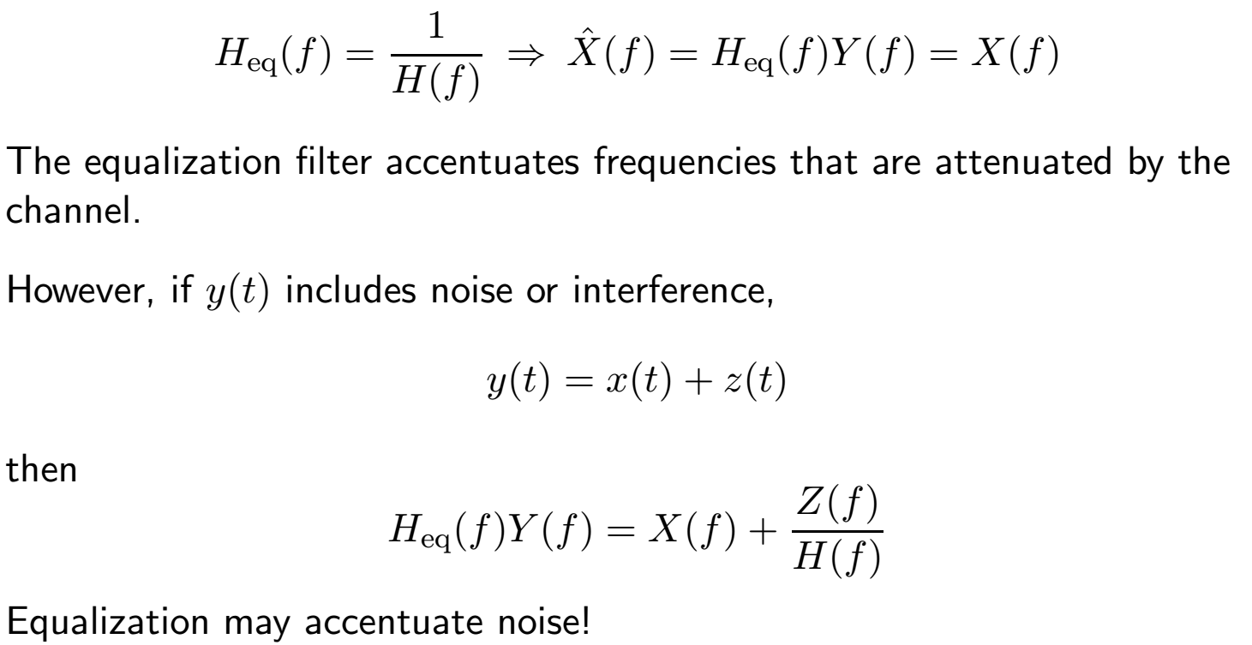
Channel Equalization
Channel phase and amplitude effects can be compensated for by equalization.

Slide 4
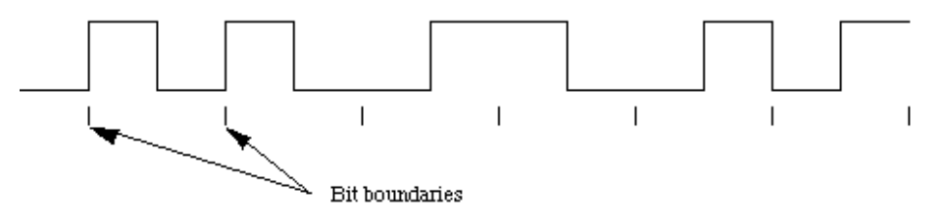
Baseband Communication
The baseband is the frequency band of the original signal.
  Telephones: 300–3300 Hz
  High-fidelity audio: 20–20 KHz
  Television (NTSC) video: 30Hz–4.3 MHz
  Ethernet (10 Mbs): 0–20 MHz
Baseband communication requires wire (single, twisted pair, coax).
Multiple baseband signals cannot share a channel without time division multiplexing (TDM).

Slide 5
Carrier Communication
Carrier communication uses modulation to shift spectrum of signal.
  Wireless communication requires frequencies higher than baseband
  Multiple signals can be sent at same time using different frequencies:
  frequency division multiplexing (FDM)
In carrier communication, the signal modulates a sinusoidal carrier.
The signal modifies the amplitude, frequency, or phase of carrier.
amplitude modulation: A(t) is proportional to m(t)
Frequency and phase modulation are called angle modulation.
  frequency modulation: ω_{c}(t) is proportional to m(t)
  phase modulation: φ(t) is proportional to m(t)

Slide 6
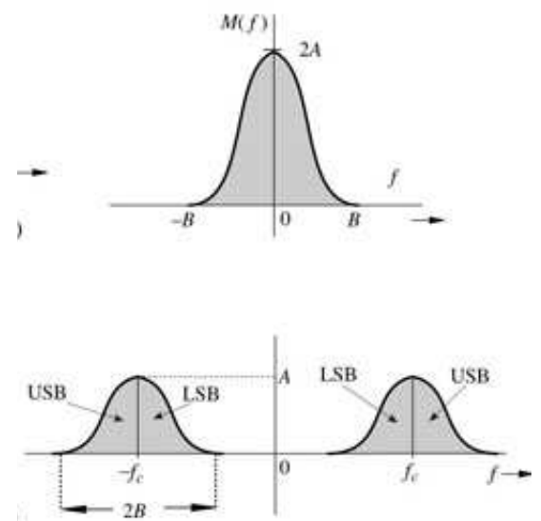
Double-Sideband Amplitude Modulation
The simplest modulation method is multiplication by sinusoid:
x(t) = m(t)cos(ωct + φ) = m(t)cos(2πfct + φ)
We usually set phase φ to 0 to simplify mathematical discussion.
The Fourier transform of the modulated signal is:
X(f) = ½ [M(f + fc) + M(f - fc)]
Notes:
The spectrum becomes obvious if you consider Euler’s Identity that sinusoids consist of two complex exponential terms.

Slide 7
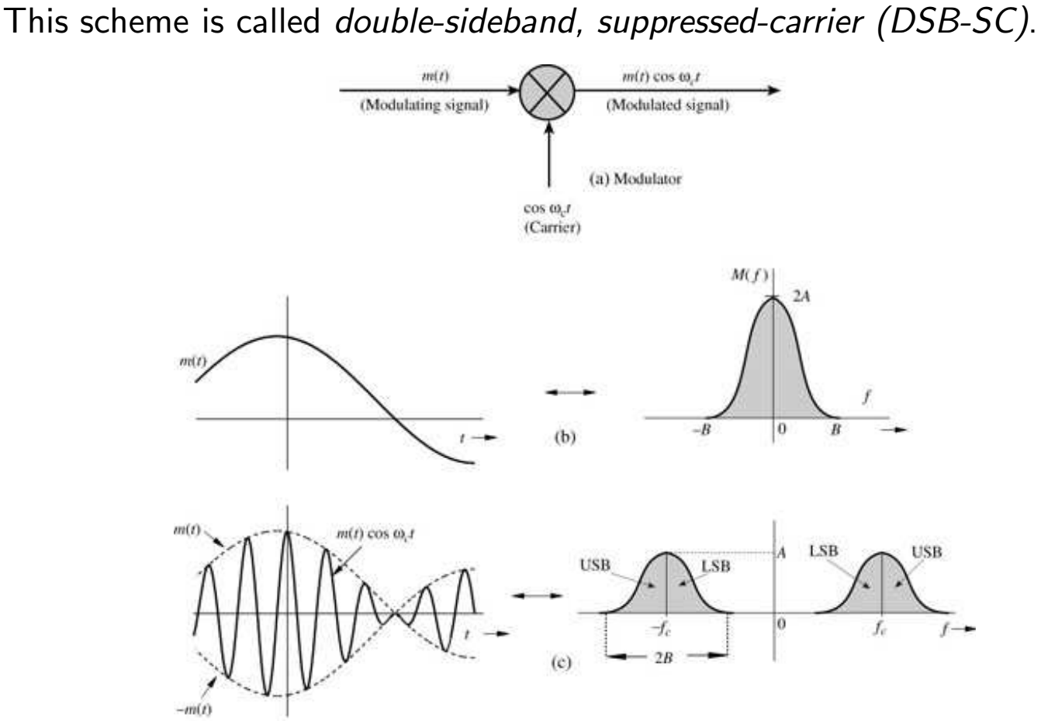
Double-Sideband Amplitude Modulation (cont.)
Phasors and AM
A cos(w_{c}t)
A sin(w_{c}t)
Assume m(t) very slow compared to w_{c}
m(t)cos(w_{c}t)
Note that all of these “Phasors” rotate at the carrier rate, but we just look at the complex envelope.
Notes:
As opposed to broadcast AM which has a strong carrier component.

Slide 8
Signal Bandwidth vs. Carrier Frequency
Transmitters can radiate only a narrow band without distortion. Thus we choose the carrier frequency such that
f_{c} /B ≫ 1
Examples:
  AM radio: B = 5 KHz, 550 ≤ fc ≤ 1600 KHz ⇒ 100 < fc/B < 320
  FM: B = 200 KHz, 87.7 ≤ fc ≤ 108.0 MHz ⇒ 43 < fc/B < 54
  US television: B = 6 MHz, 54 ≤ fc ≤ 862 MHz ⇒ 9 ≤ fc/B ≤ 142
Digital TV uses the original analog UHF TV frequency bands.

Slide 9
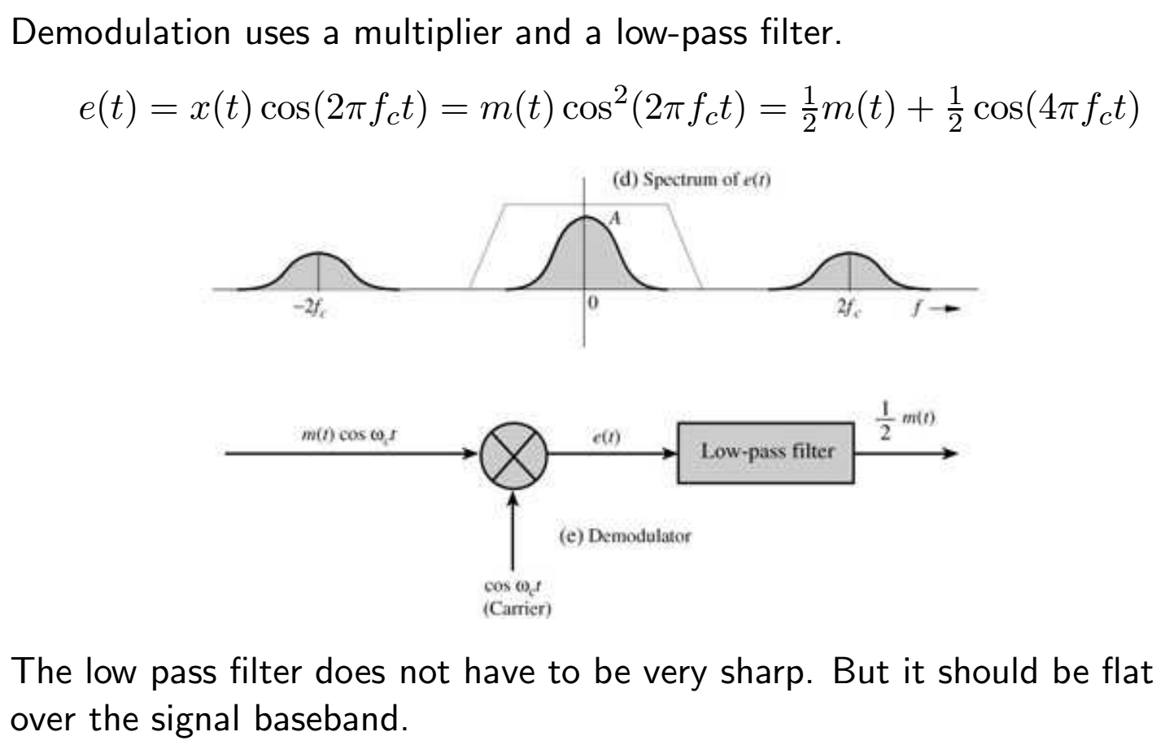
Demodulation of DSB-SC Signals
Notes:
Note that synchronizing the local oscillator to be at the exact frequency and phase of the “Suppressed” carrier. This is difficult since there is no reference in the received signal. Such a receiver is called synchronous, coherent, homodyne.

Slide 10
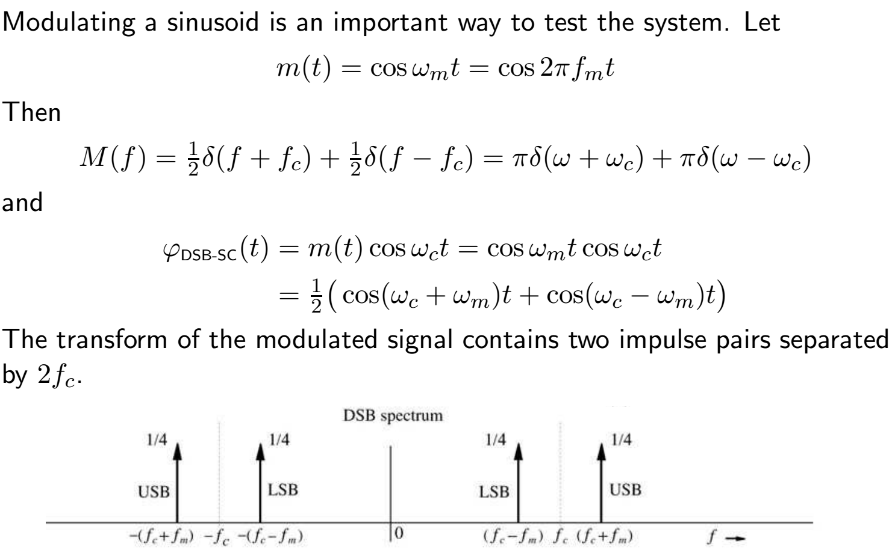
DSB-SC Example

Slide 11
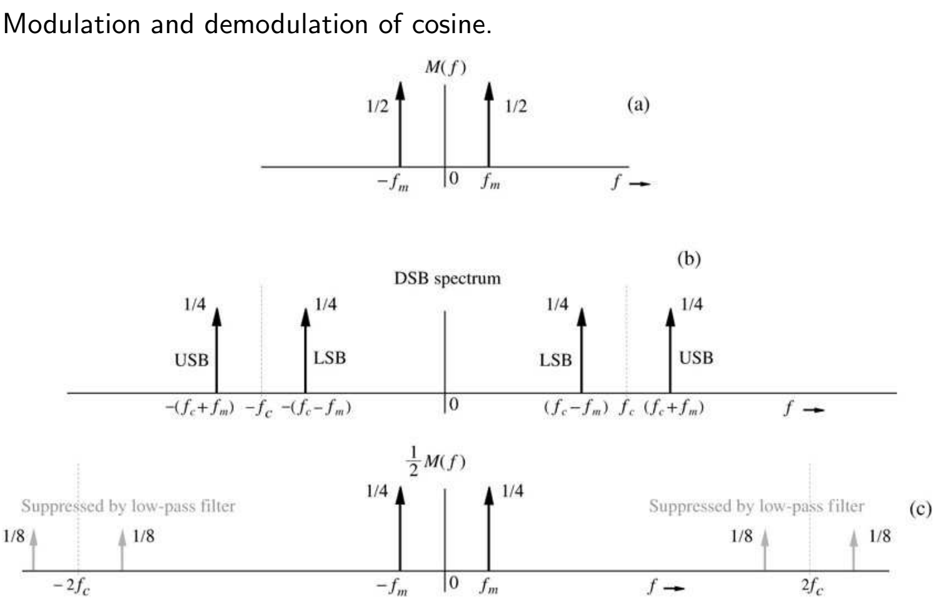
DSB-SC Example: Frequency Domain

Slide 12
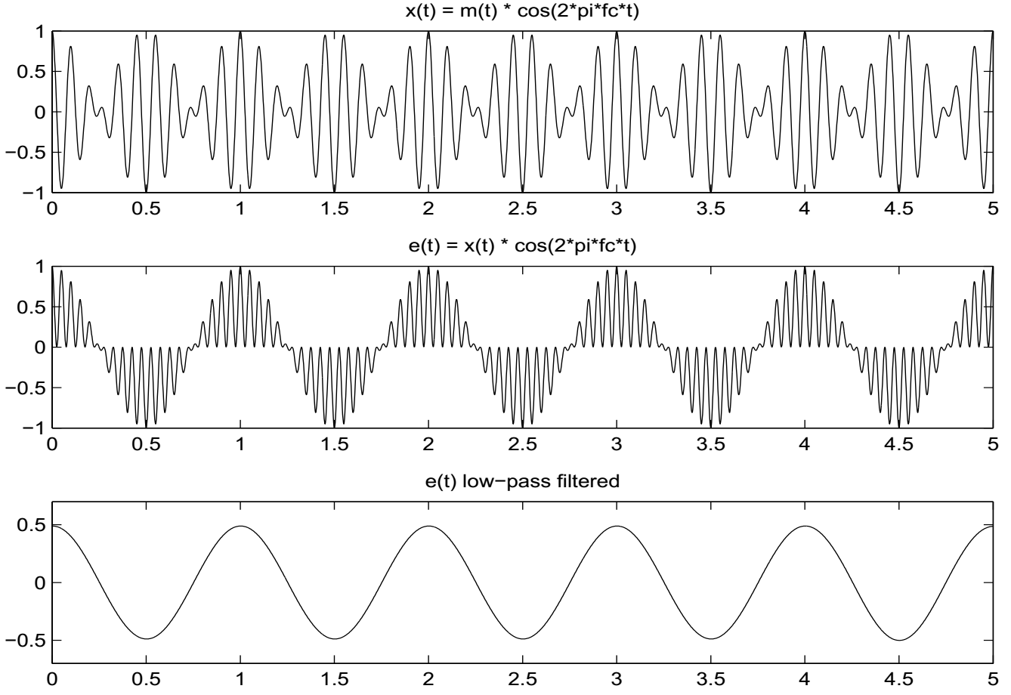
DSB-SC Example: Time Domain
Notes:
Note the high frequency part of e(t) is at 2*f_{c}

Slide 13
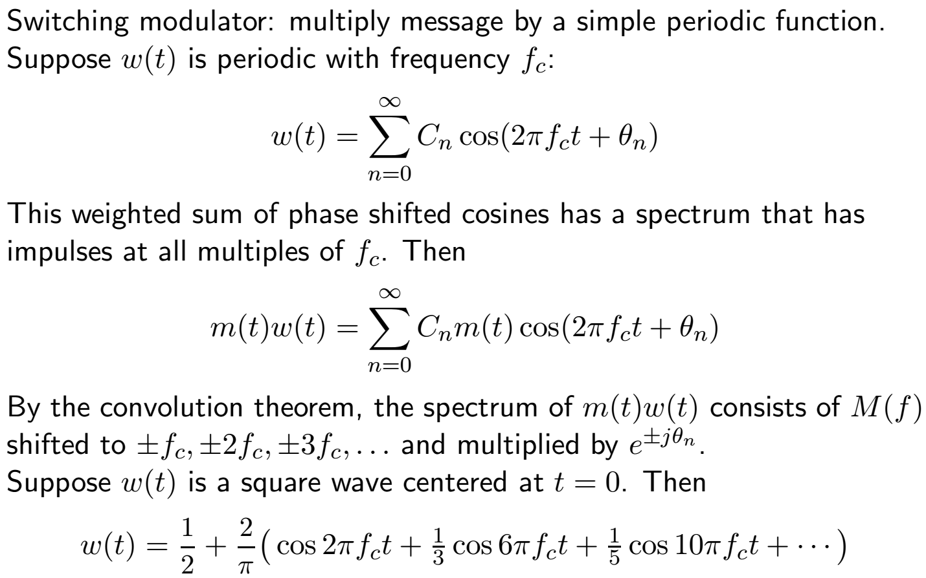
Switching Modulators
Notes:
The coefficients are set by the Fourier series for a 50-50 duty cycle square wave.

Slide 14
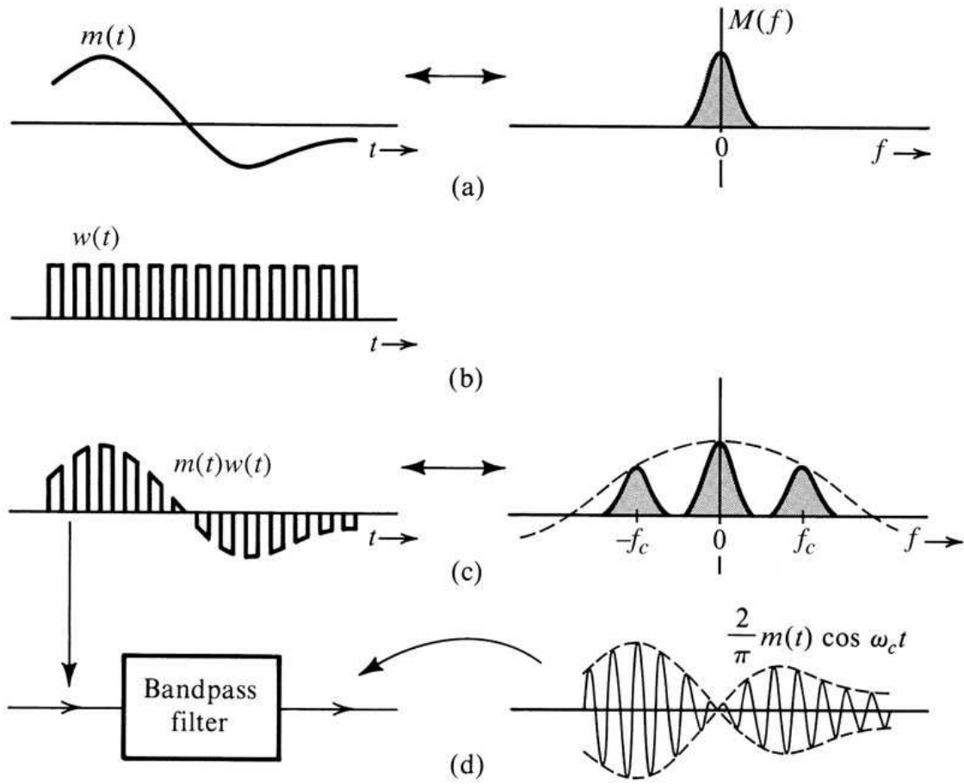
Switching Modulators 2

Slide 15
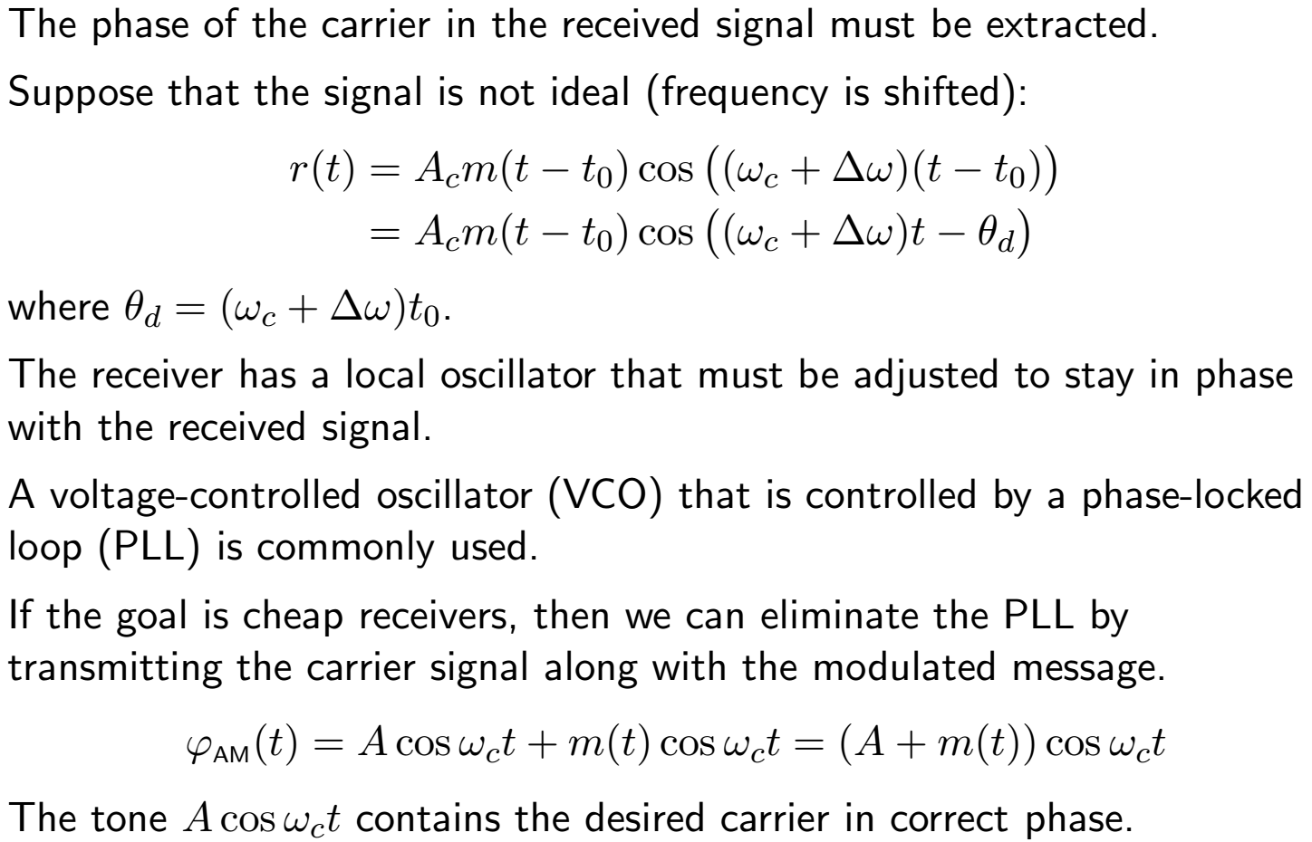
Demodulation of DSB-SC Signals
Notes:
A PLL requires a reference signal so a bit of carrier needs to be added (DSB-RC). An inexpensive receiver requires a strong carrier. A > |m(t)|

