Slide 1
Chapter 3
Signal Analysis and Transmission
Part 1

Slide 2
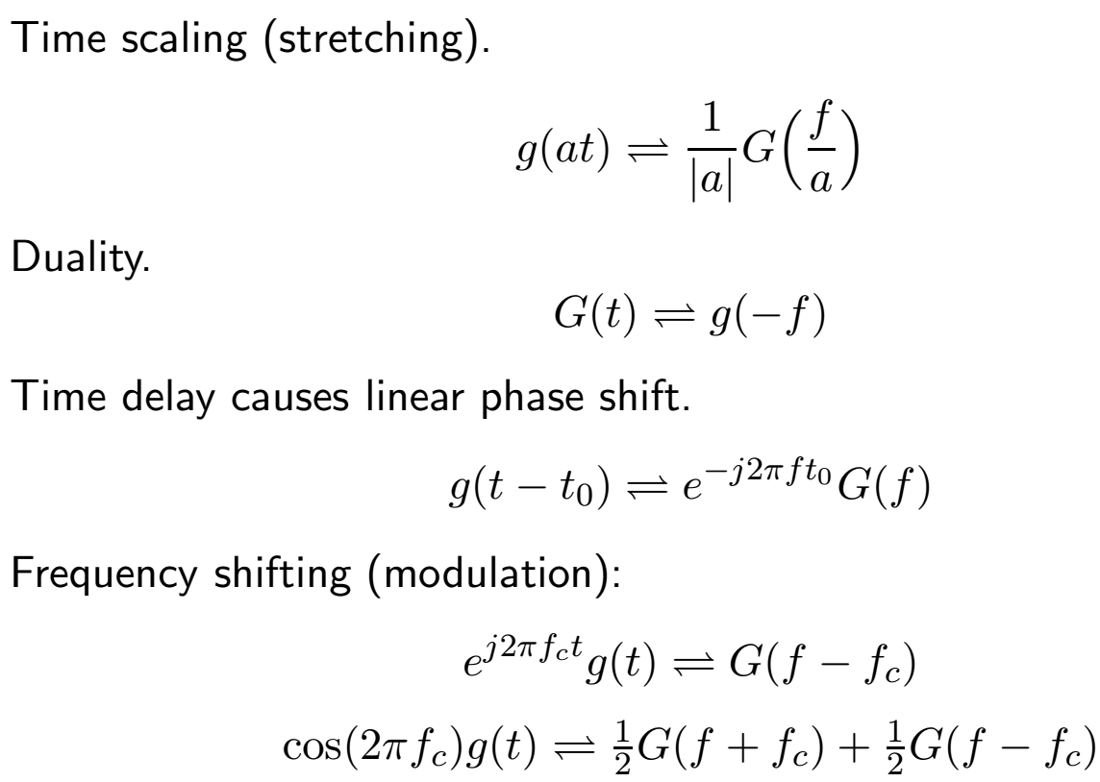
Fourier Transform Properties

Slide 3
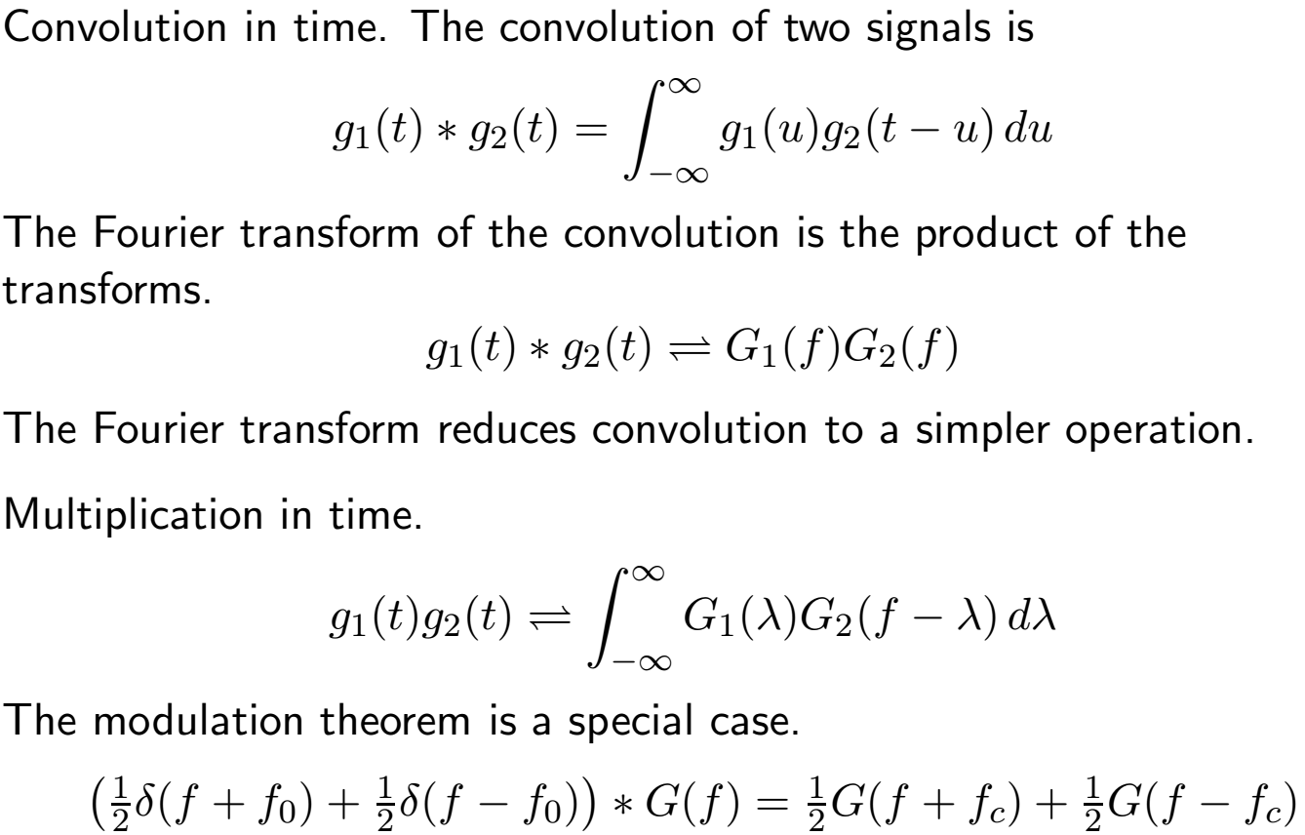
Fourier Transform Properties 2

Slide 4
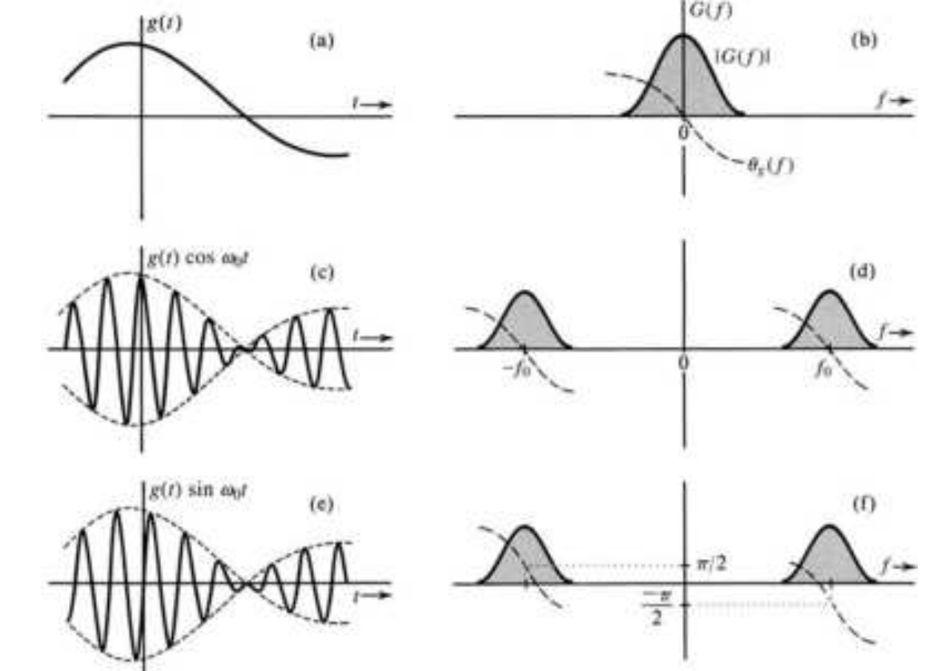
The Modulation Theorem
Notes:
Baseband bandwidth is often defined as the width from DC to the half power frequency. That is one half the bandwidth of the frequency shifted spectra.

Slide 5
Applications of Modulation
For transmission by radio, antenna size is proportional to wavelength.
Low frequency signals (voice, music) must be converted to higher
frequency.
To share bandwidth, signals are modulated by different carrier frequencies.
  North America AM radio band: 535–1605 KHz (10 KHz bands)
  North America FM radio band: 88–108 MHz (200 KHz bands)
North America TV bands: VHF 54–72, 76–88, 174–216, UHF 470–806,
806–890
Frequencies can be reused in different geographical areas.
With digital TV, channel numbers do not correspond to frequencies.
Notes:
The lower VHF frequencies are now re-allocated for other services

Slide 6
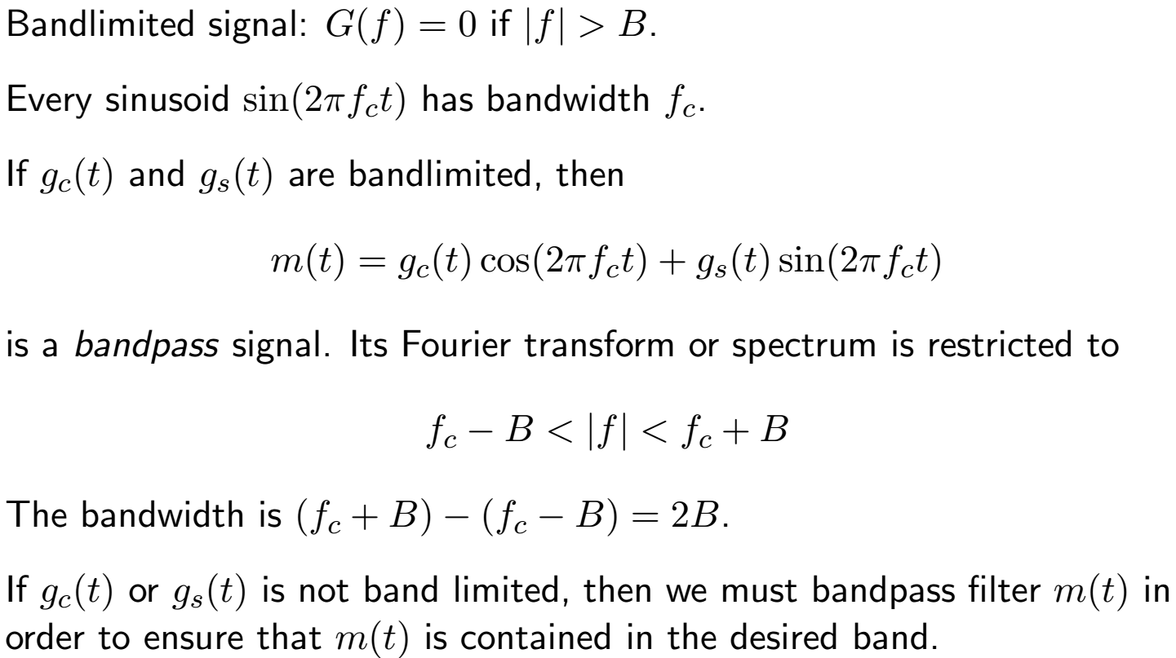
Bandpass Signals
Notes:
Note that in the real world “Band Limited” is an approximation. It means that beyond that range, the energy is small enough to be ignored.

Slide 7
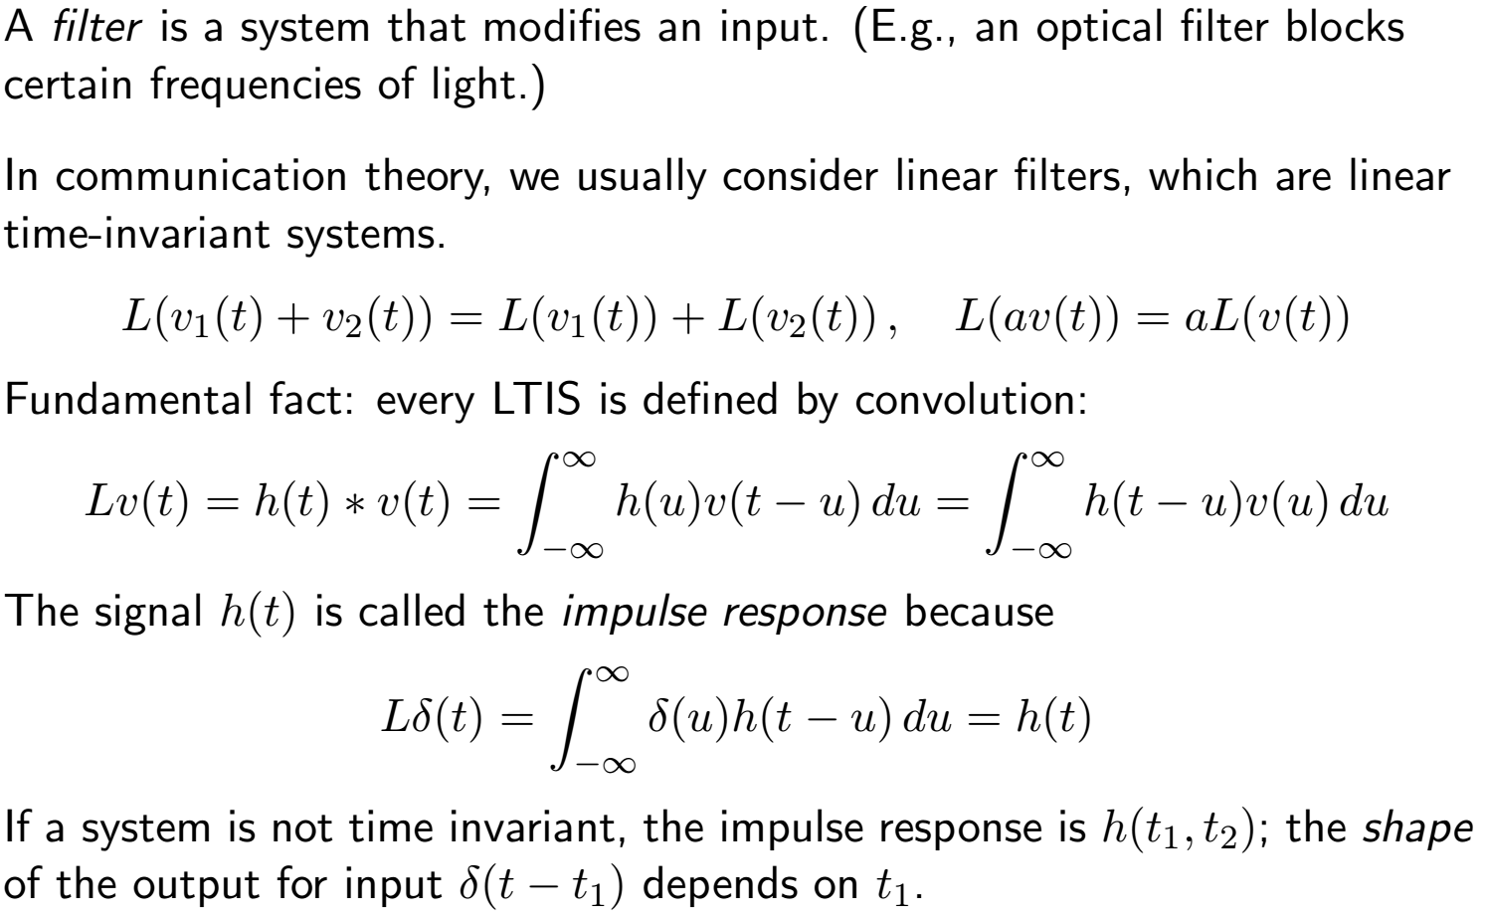
Filters
Notes:
Note that wireless “Channels” tend to be time-varying.

Slide 8
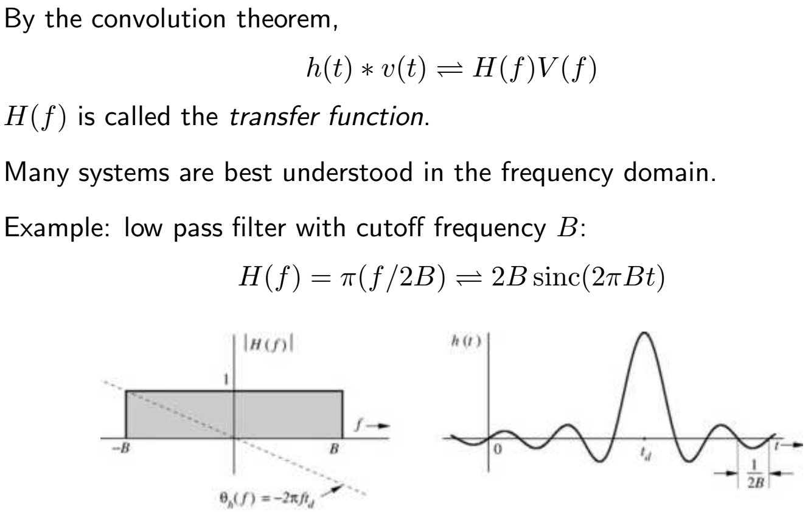
Transfer Function
Notes:
Note that this system is not and cannot be causal. Causality means that the output cannot begin to respond before the input occurs. As the great philosopher Yogi Berra said, “There is only one thing that is hard to predict …… the future.

Slide 9
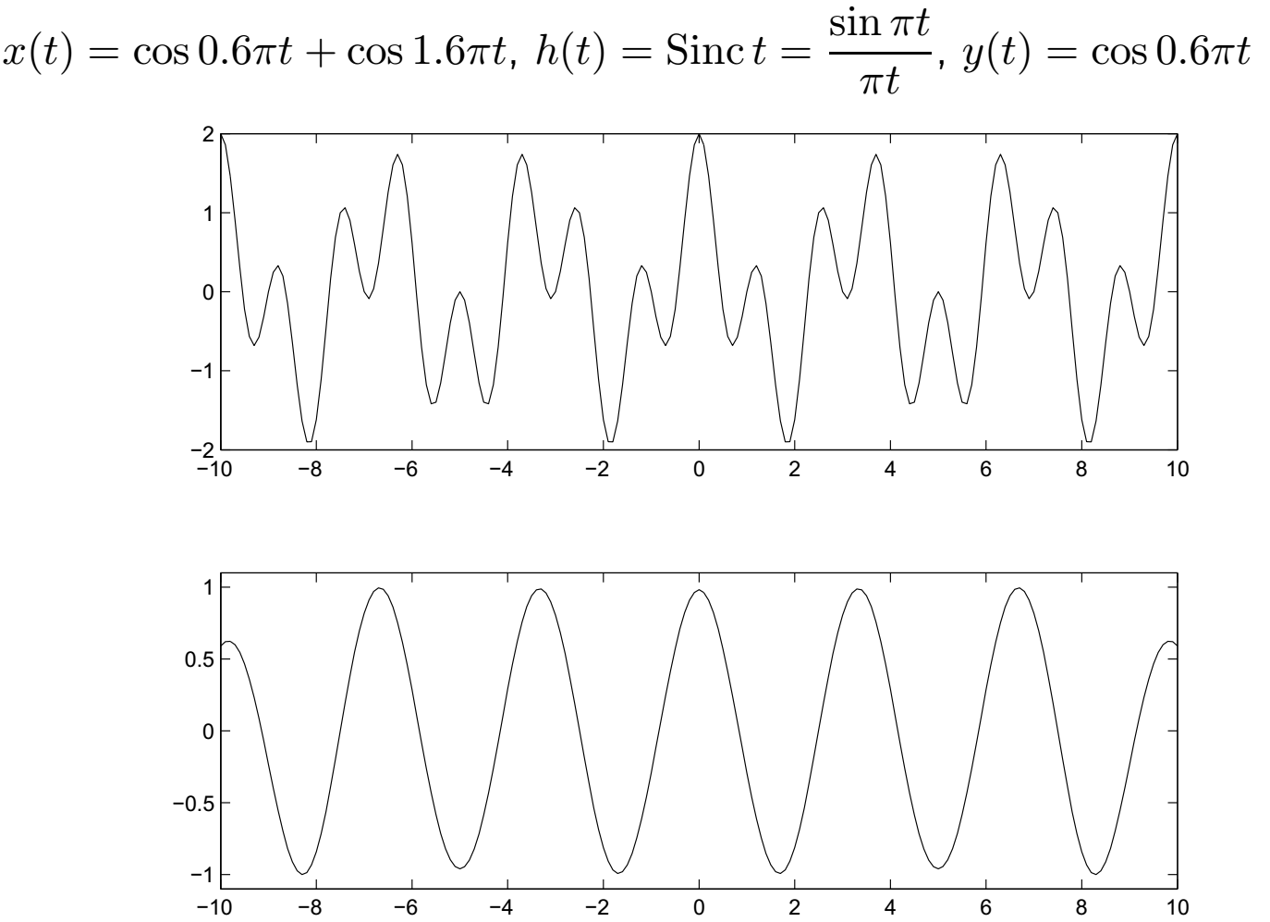
Low Pass Filter Example
Notes:
Remember that this is an unrealizable “Ideal” filter

Slide 10
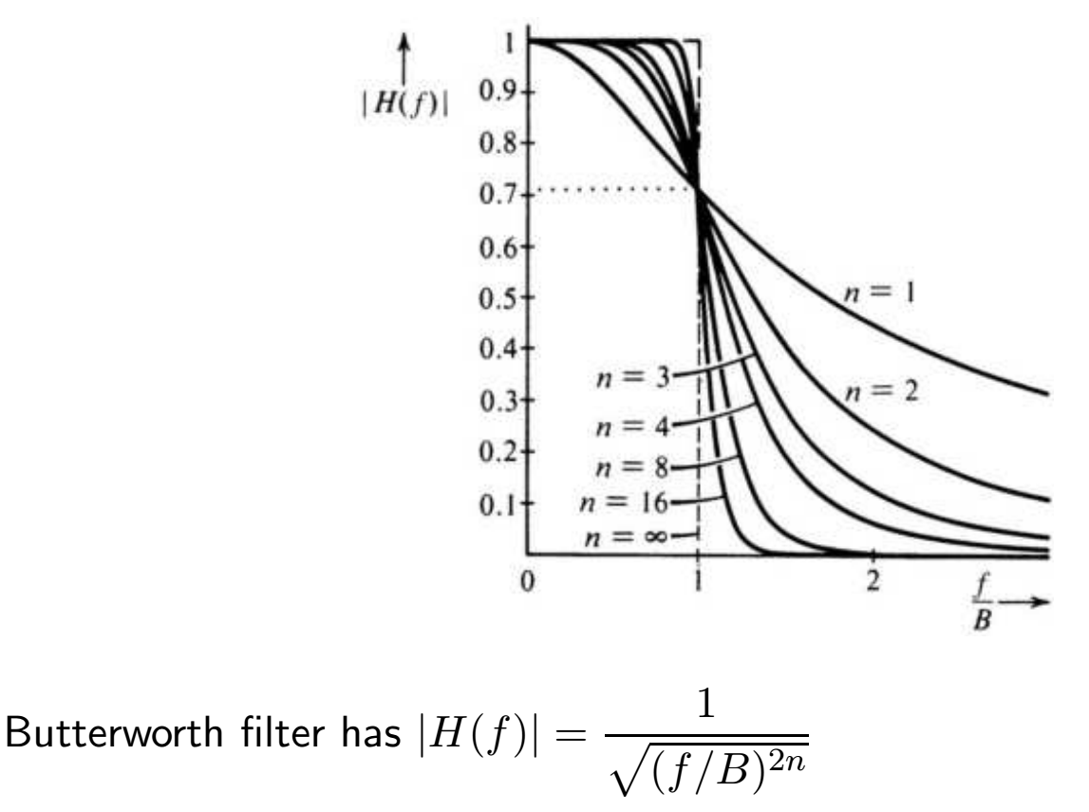
Butterworth Filter: Non-ideal, Low-Pass Filter
Notes:
Non-Ideal, but useful for reasonable order filters (n < 10), It has a smooth phase response, but other filter designs have sharper cutoff characteristics.
See my tutorial on “Filter Approximation Theory” for more choices.

Slide 11
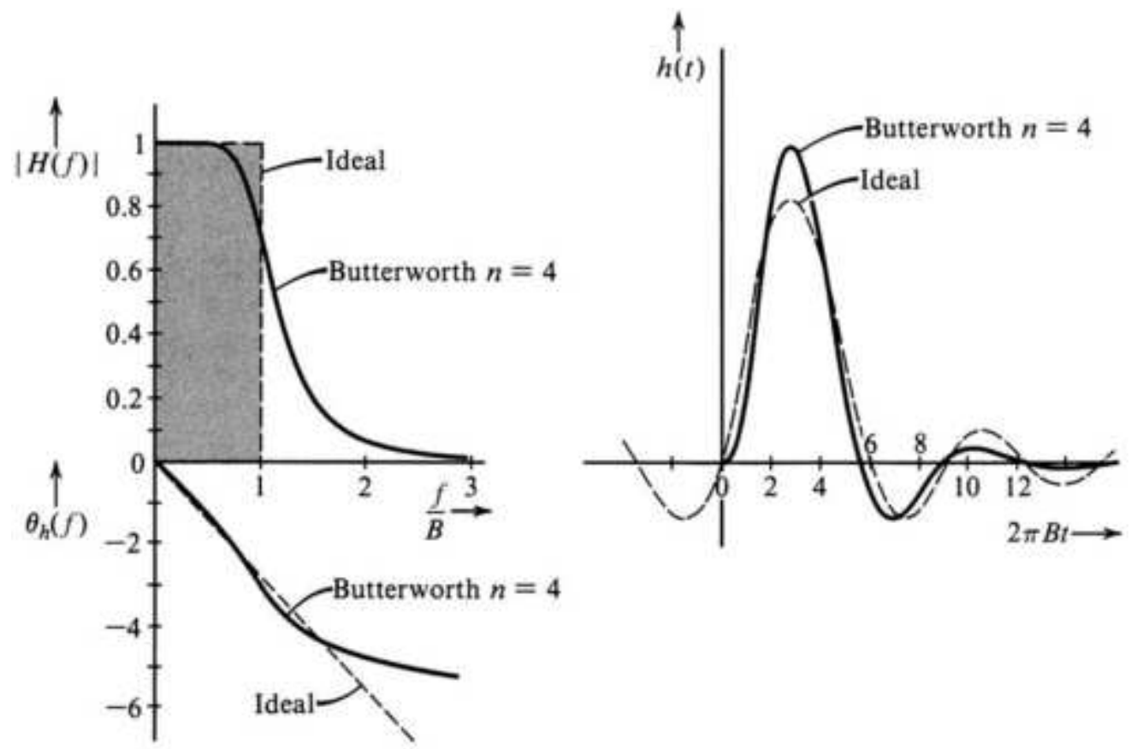
Butterworth Filter vs. Ideal Lowpass Filter
Notes:
Note that the Butterworth filter is causal.

Slide 12
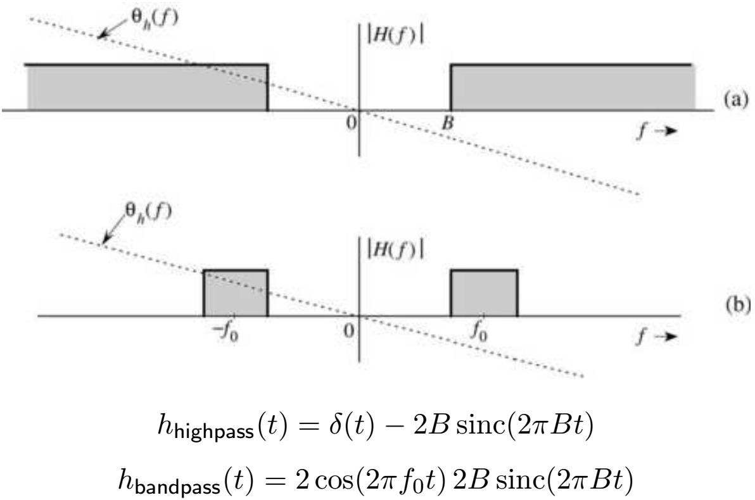
High Pass and Band Pass Filters
Notes:
Note that these ideal filters have linear phase shift. Non-linear phase shift in the pass band is called “Group Delay Distortion” since it smears pulses in time.

Slide 13
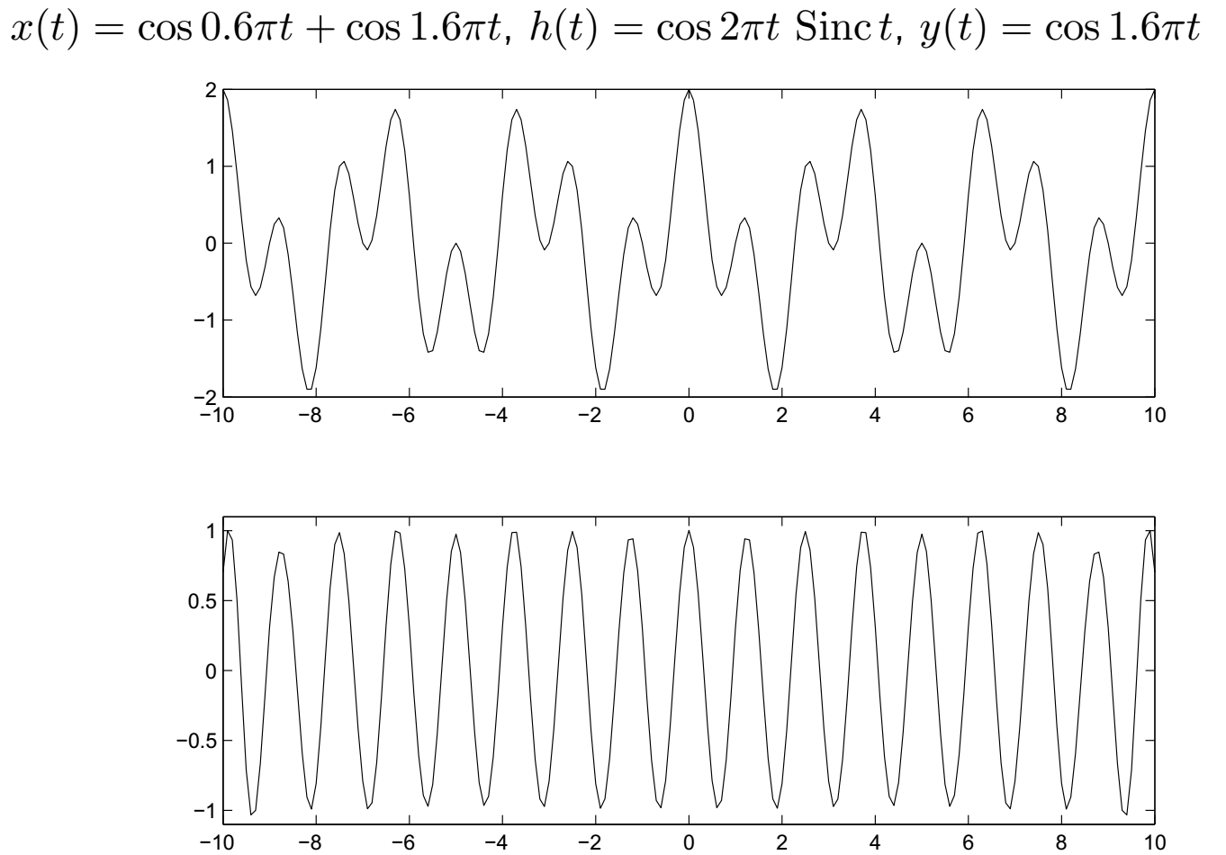
Band Pass Filter Example
Notes:
Note the Transient or “windowing” effect at the beginning and end of the time interval.

Slide 14
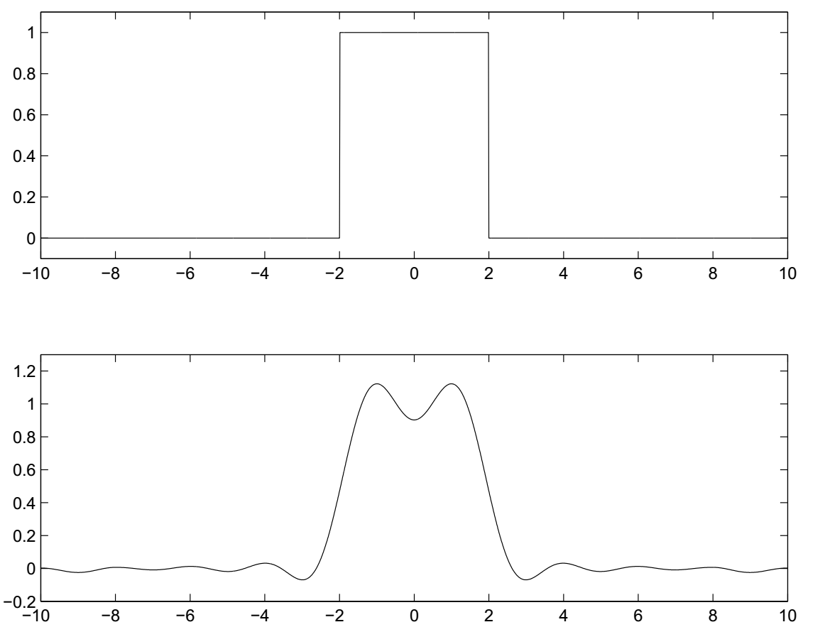
Low Pass Filter: x(t) = Π( 4 t), h(t) = Sinc(t), y(t) = h(t) ∗ x(t)
Notes:
Our author uses an asterisk to .denote convolution. Don’t confuse this with multiply.

Slide 15
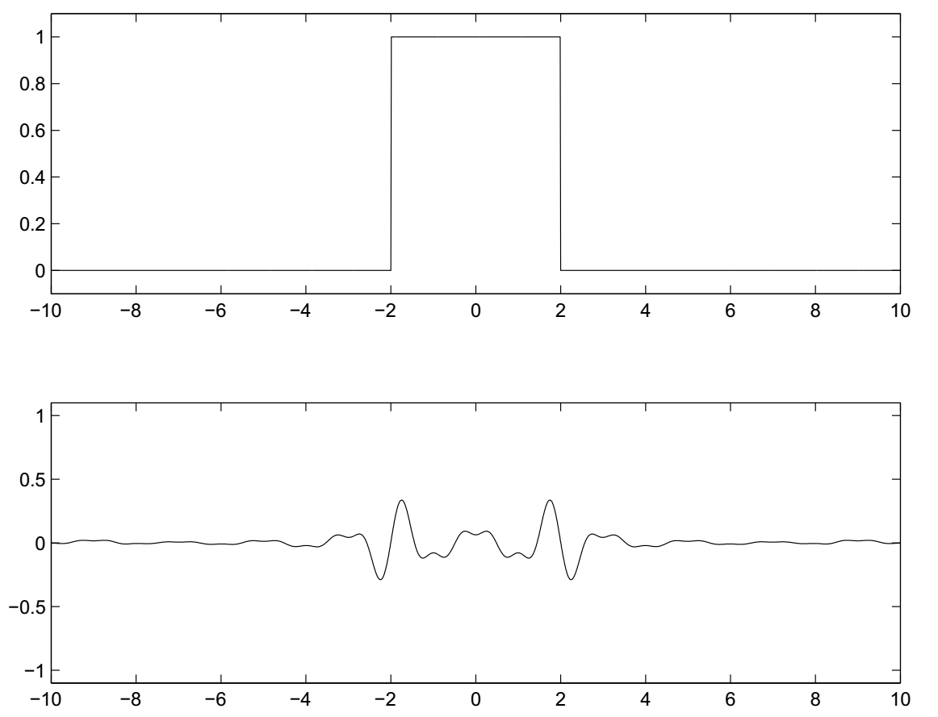
Band Pass Filter: h(t) = cos2πt Sinc t, x(t) = Π( 4 t), y(t) = h(t) ∗ x(t)

Slide 16
Examples of Communication Channels
wires (PCD trace or conductor on IC)
optical fiber (attenuation 4dB/km)
broadcast TV (50 kW transmit)
voice telephone line (under -9 dbm or 110 µW)
walkie-talkie: 500 mW, 467 MHz
Bluetooth: 20 dBm, 4 dBm, 0 dBm
Voyager: X band transmitter, 160 bit/s, 23 W, 34m dish antenna
Notes:
http://science.time.com/2013/03/20/humanity-leaves-the-solar-system-35-years-later-voyager-offically-exits-the-heliosphere/

Slide 17
Communication Channel Distortion
The linear description of a channel is its impulse response h(t) or equivalently its transfer function H(f).
y(t) = h(t) ∗ x(t) ⇔ Y (f) = H(f)X(f)
Note that H(f) both attenuates (|H(f)|) and phase shifts (∠H(f)) the input signal.
Channels are subject to impairments:
  Nonlinear distortion (e.g., clipping)
  Random noise (independent or signal dependent)
  Interference from other transmitters
  Self interference (reflections or multipath)

Slide 18
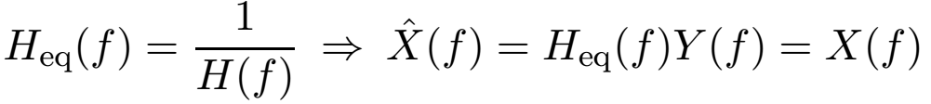

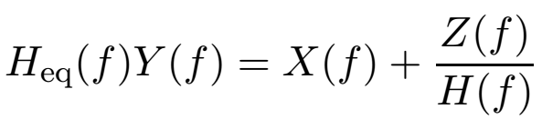
Channel Equalization
Channel attenuation/phase shift can be compensated for by equalization.
The equalization filter accentuates frequencies that are attenuated by the channel. However, if y(t) includes noise or interference,
then
Equalization may accentuate noise!
Notes:
Note inverting a realizable transfer function yields a non-realizable filter so real world equalization is an approximation.

