Slide 1
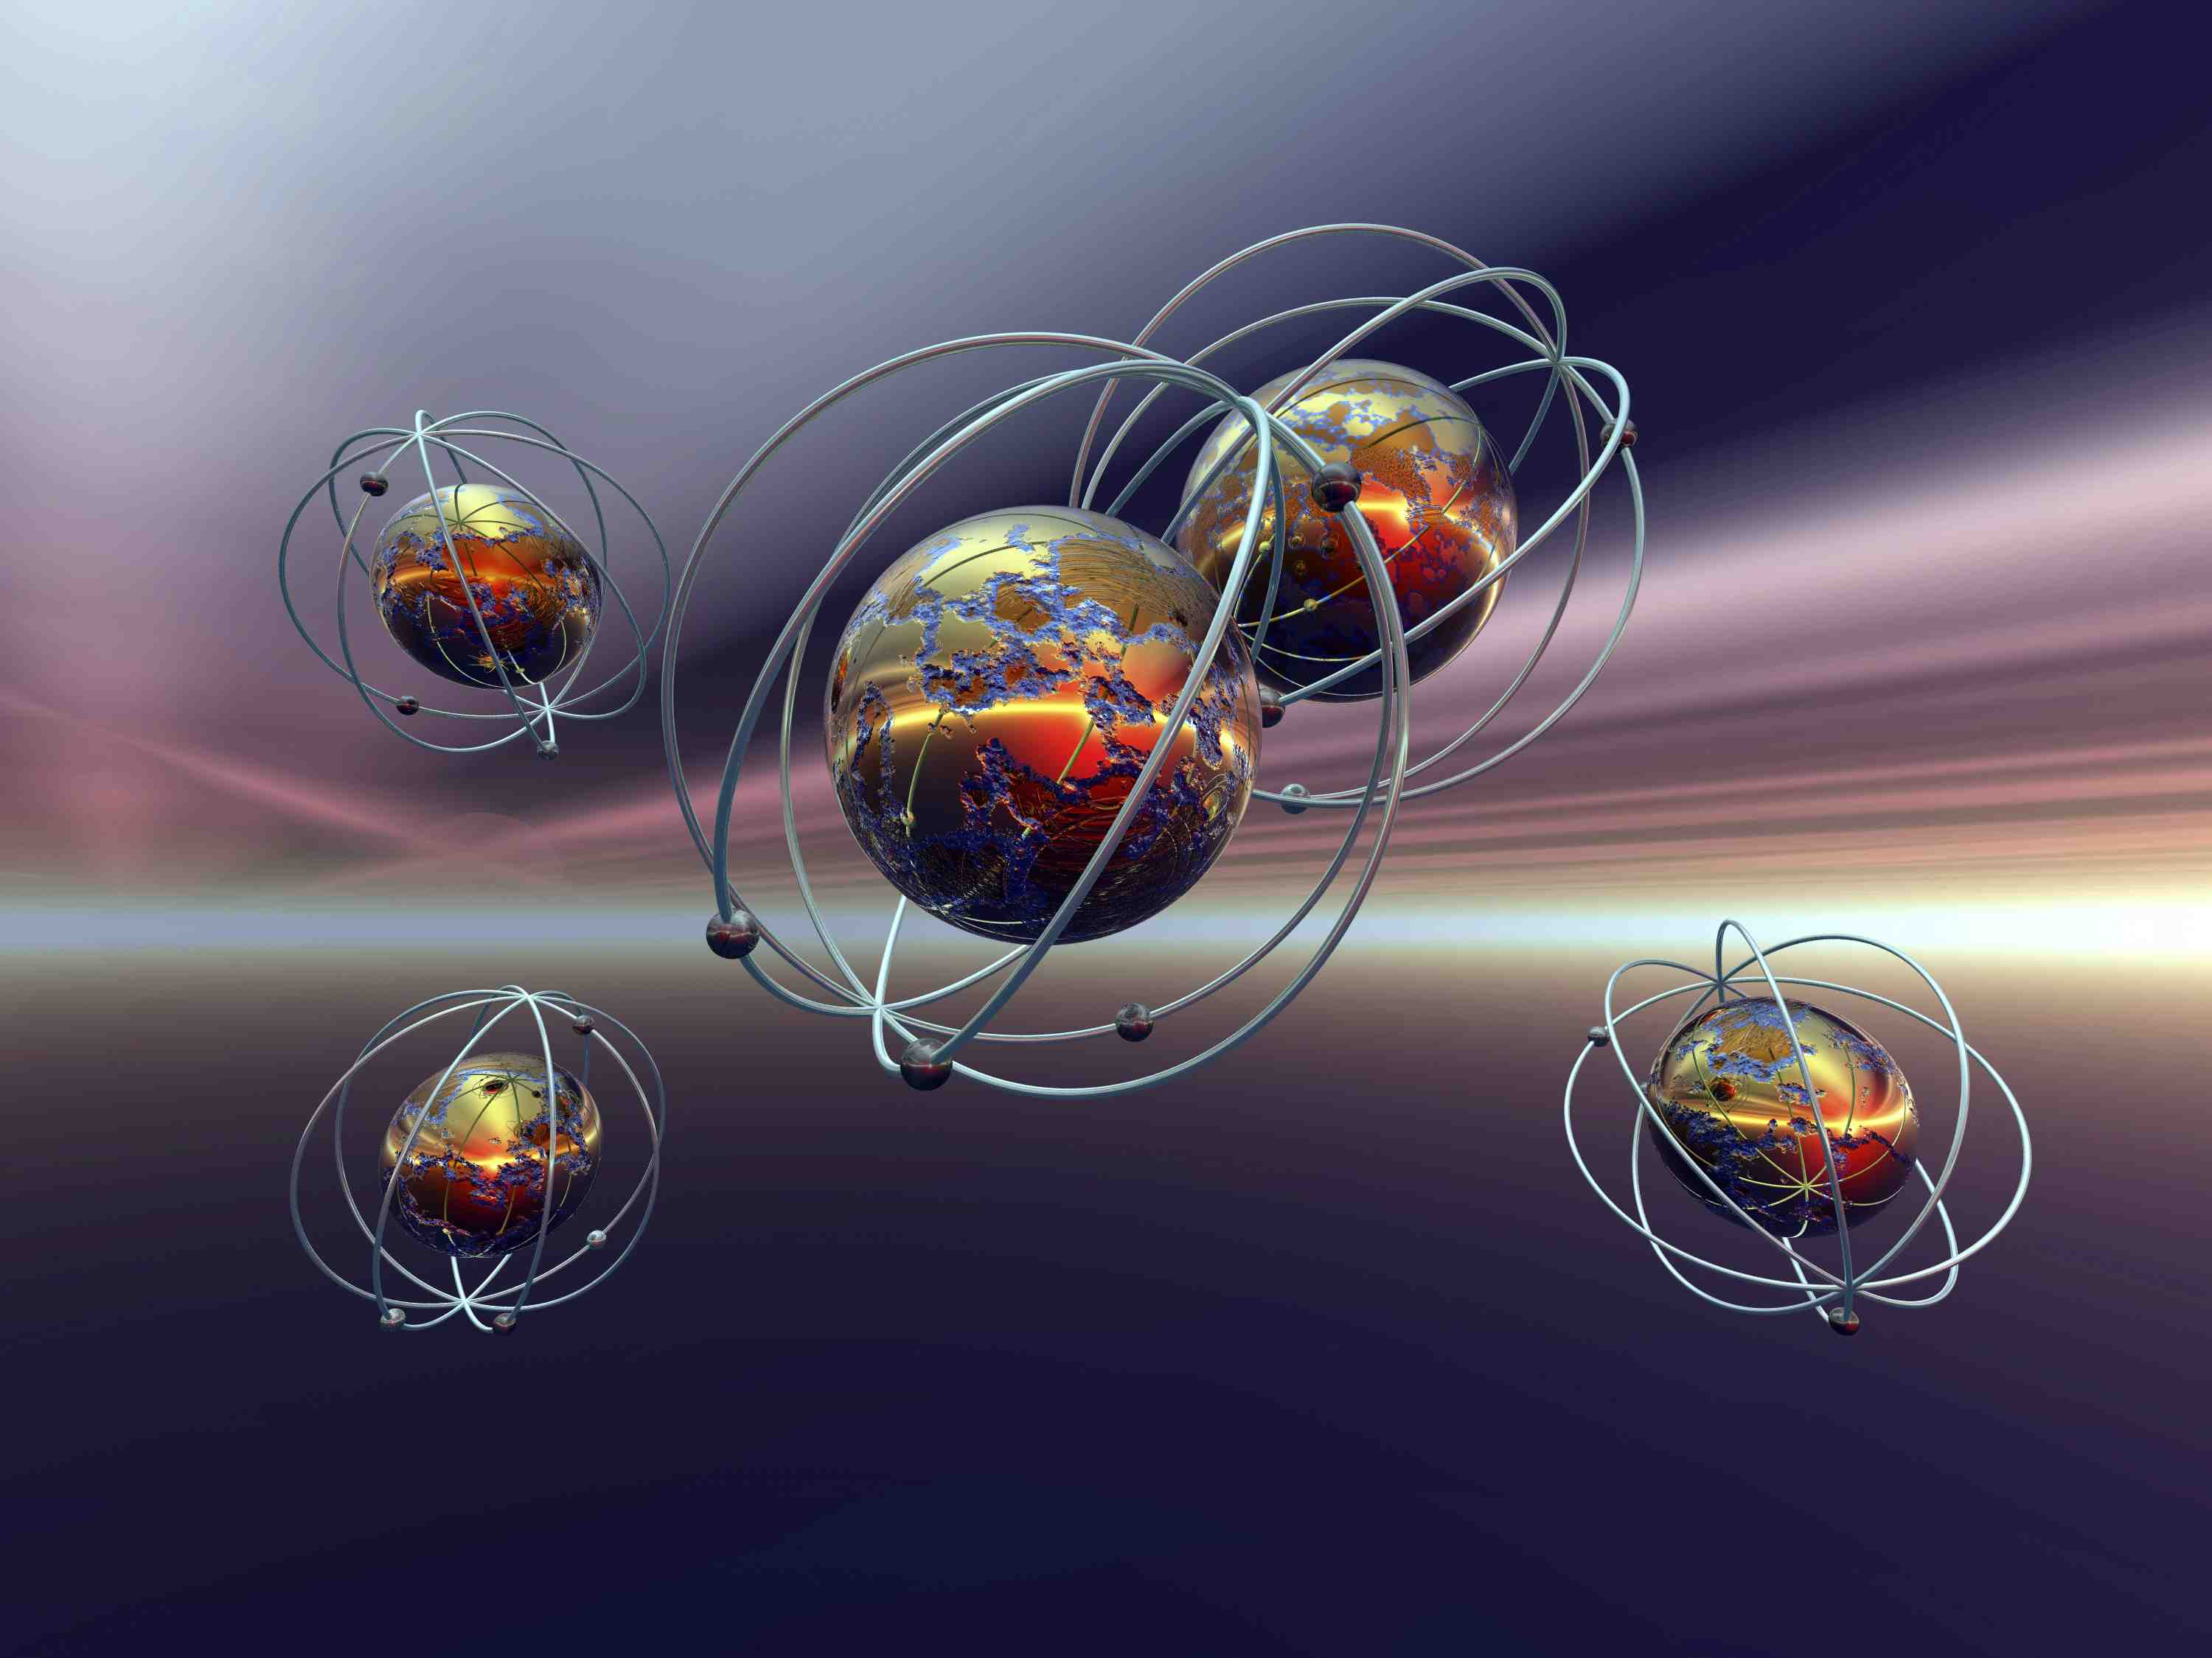
EE 315/ECE 451 Nanoelectronics I
Ch 2 Classical Particles, Classical Waves, and Quantum Particles
Notes:
Derived from lecture created by Dr. Ryan Munden in 2011

Slide 2
Outline
2.1 Comparison of Classical and Quantum Systems
2.2 Origins of Quantum Mechanics
2.3 Light as a Wave, Light as a Particle
2.4 Electrons as Particles, Electrons as Waves
2.5 Wavepackets and Uncertainty

Slide 3
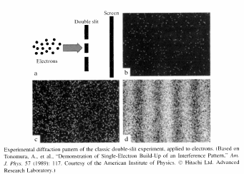
Introduction

Slide 4
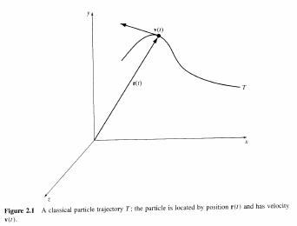
2.1 Comparison of Classical and Quantum Systems
Classical Particles obey Newtonian Mechanics

Slide 5
2.1 Comparison of Classical and Quantum Systems
In classical physics we can determine, with certainty, physical quantities such as force, momentum, position, etc.
In quantum physics many of these quantities become probabilistic.
That means what we once viewed as definite, is only the most likely outcome
There is uncertainty in the measurement of these quantities

Slide 6
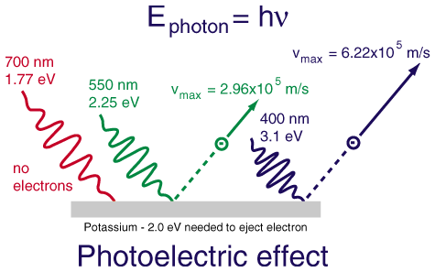
2.2 Origins of Quantum Mechanics
Quantum mechanics arose from experiments in the late 1800’s and early 1900’s that could not be explained by classical physics
Blackbody radiation (UV catastrophe)
Photoelectric Effect
Notes:
“Key to the development of quantum theory were experiments in the 1890s that showed that the specific heat, and thermal blackbody radiation, could not be explained by classical thermodynamics.”
“if light is incident on a metal, some energy carried by light can be transferred to electrons at the metal’s surface and then they may have enough energy to escape from the metal.”
Hanson p.19

Slide 7
2.3 Light as a Wave, Light as a Particle
Originally people assumed light was a particle, such as Newton corpuscles
Eventually Young demonstrated interference proving that light is a wave, much as sound is a wave
Notes:
Light (and electrons) were actually found to act as both particles and waves

Slide 8
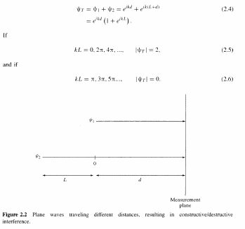
2.3.2 Interference
Plane Waves
Constructive
Destructive
Notes:
Have you ever noticed a “rainbow” in a puddle? It is the result of alternating constructive/destructive interference between plane waves reflecting off the surface of a thin oil film and another from the surface of the water under the oil film.

Slide 9
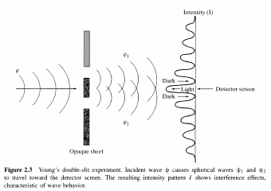
Wave Interference

Slide 10
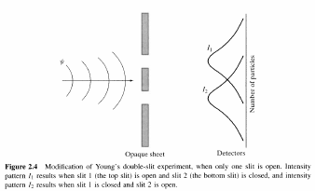
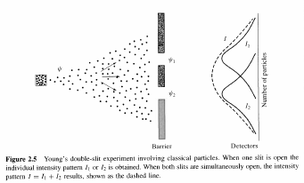
Light as a Quantum Particle

Slide 11
Light as a Quantum Particle
In fact we see the wave interference pattern even for “slow” light

Slide 12
2.4 Electrons as Particles, Electrons as Waves
Originally everyone assumed electrons were simply small charged particles
From photons deBroglie hypothesized that all particles would behave as waves as well
Notes:
h – Planck’s constant, λ - Wavelength, p – Momentum, k – Wave Number

Slide 13
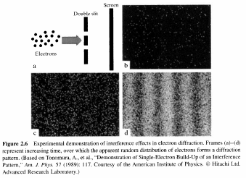
Double Slit Electron Diffraction

Slide 14
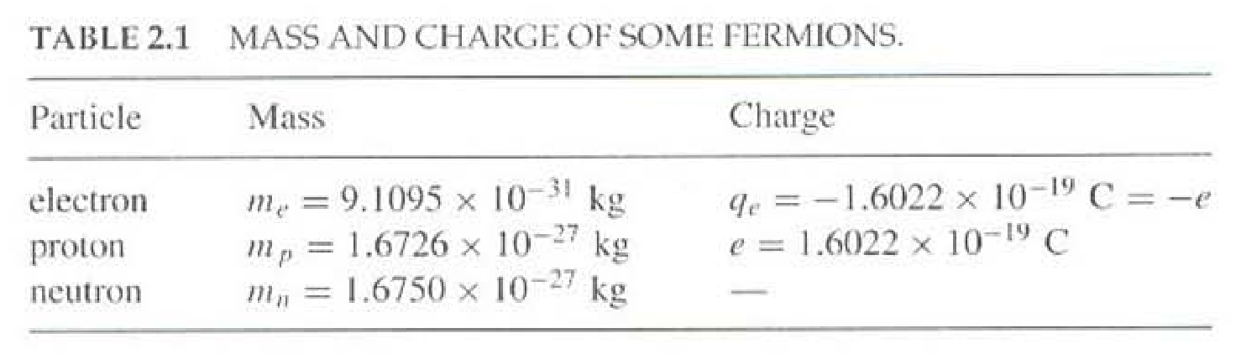
2.5 Wavepackets and Uncertainty
Schrödinger and Heisenberg developed a system of wave mechanics, known as quantum mechanics (1925 – 1927)
Heisenberg Uncertainty Principle
Notes:
You cannot measure either momentum (p) or location accurately without affecting the other!

