Slide 1
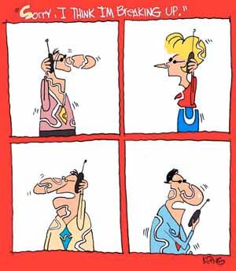
EE383 – Lecture 2 Outline
Review of Last Lecture
Signal Propagation Overview
TX and RX Signal Models
  Complex baseband models
Path Loss Models
  Free-space Path Loss
  Ray Tracing Models
  Simplified Path Loss Model
  Empirical Models

Slide 2
Lecture 1 Review
Course Information
Wireless Vision
Technical Challenges
Multimedia Requirements
Current Wireless Systems
Spectrum Regulation and Standards

Slide 3

Propagation Characteristics
Path Loss (includes average shadowing)
Shadowing (due to obstructions)
Multipath Fading
Slow
P_{t}
P_{r}/P_{t}
Fast
P_{r}
Very slow
v
d=vt
d=vt

Slide 4
Path Loss Modeling
Maxwell’s equations
  Complex and impractical
Free space path loss model
  Too simple
Ray tracing models
  Requires site-specific information
Simplified power falloff models
  Main characteristics: good for high-level analysis
Empirical Models
  Don’t always generalize to other environments

Slide 5
Free Space (LOS) Model
d=vt
Path loss for unobstructed LOS path
Power falls off :
  Proportional to 1/d²
  Proportional to λ² (inversely proportional to f²)

Slide 6
Ray Tracing Approximation
Represent wavefronts as simple particles
Geometry determines received signal from each signal component
Typically includes reflected rays, can also include scattered and defracted rays.
Requires site parameters
  Geometry
  Dielectric properties

Slide 7
Two Path Model
Path loss for one LOS path and 1 ground (or reflected) bounce
Ground bounce approximately cancels LOS path above critical distance
Power falls off
  Proportional to d² (small d)
  Proportional to d⁴ (d>d_{c})
  Independent of λ (f)

Slide 8

General Ray Tracing
Models all signal components
  Reflections
  Scattering
  Diffraction
Requires detailed geometry and dielectric properties of site
  Similar to Maxwell, but easier math.
Computer packages often used

Slide 9
Simplified Path Loss Model
Used when path loss dominated by reflections.
Most important parameter is the path loss exponent γ, determined empirically.

Slide 10
Empirical Models
Okumura model
  Empirically based (site/freq specific)
  Awkward (uses graphs)
Hata model
  Analytical approximation to Okumura model
Cost 231 Model:
  Extends Hata model to higher frequency (2 GHz)
Walfish/Bertoni:
  Cost 231 extension to include diffraction from rooftops
Commonly used in cellular system simulations

Slide 11
Main Points
Path loss models simplify Maxwell’s equations
Models vary in complexity and accuracy
Power falloff with distance is proportional to d² in free space, d⁴ in two path model
Main characteristics of path loss captured in simple model P_{r}=P_{t}K[d₀/d]^{γ}
Empirical models used in simulations
  Low accuracy (15-20 dB std)
  Capture phenomena missing from formulas
  Awkward to use in analysis

