Slide 1
EE359 – Lecture 16 Outline
MIMO Beamforming
MIMO Diversity/Multiplexing Tradeoffs
MIMO Receiver Design
  Maximum-Likelihood, Decision Feedback, Sphere Decoder
  Space-Time Processing
Other MIMO Design Issues
  Space/time Coding, Adaptive techniques, Limited feedback

Slide 2
Review of Last Lecture
MIMO Channel Decomposition
MIMO Channel Capacity
  For static channel with perfect CSI at TX and RX, power water-filling over space is optimal
  In fading waterfill over space (based on short-term power constraint) or space-time (long-term constraint)
  Without transmitter channel knowledge, capacity metric is based on an outage probability, P_{out}=p(C(H)<R)
~
~
~
y=Hx+n
y=Σ x+n
H=UΣV^{H}
~
~
~
y_{i}=σ_{ι}x+n_{i}

Slide 3
Beamforming
Scalar codes with transmit precoding
y=u^{H}Hvx+u^{H}n
Transforms system into a SISO system with diversity.
  Array and diversity gain
  Greatly simplifies encoding and decoding.
  Channel indicates the best direction to beamform
  Need “sufficient” knowledge for optimality of beamforming

Slide 4
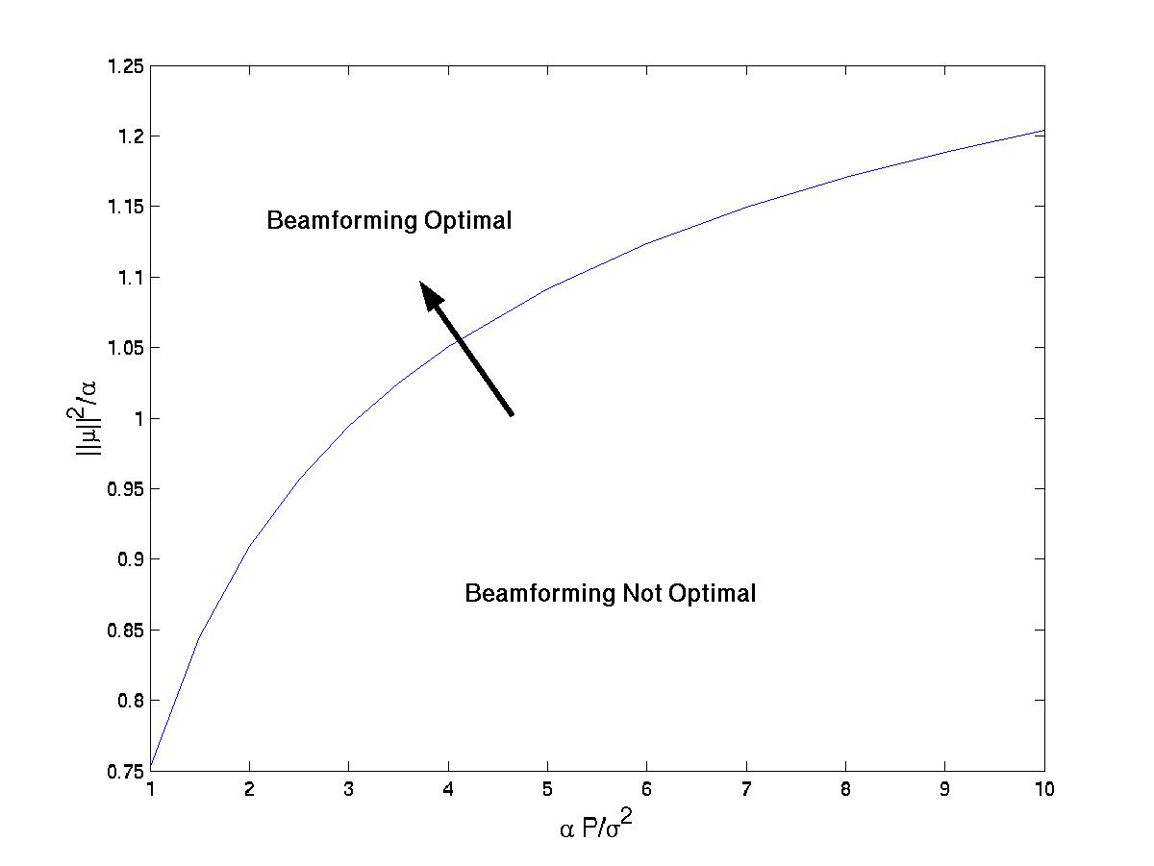
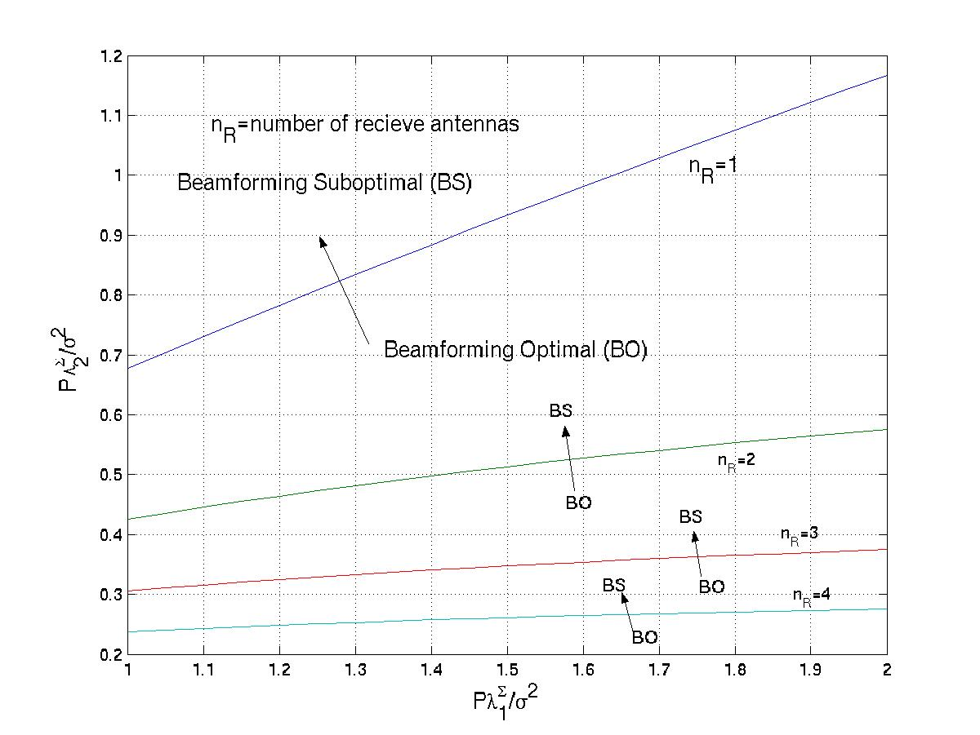
Optimality of Beamforming
Mean Information
Covariance Information

Slide 5
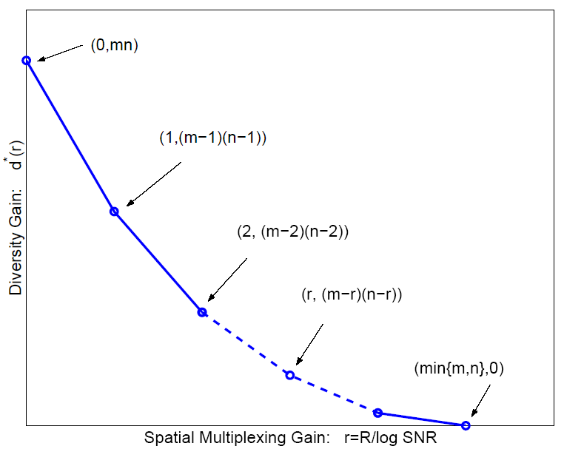
Diversity vs. Multiplexing
Use antennas for multiplexing or diversity
Diversity/Multiplexing tradeoffs (Zheng/Tse)
Error Prone
Low P_{e}

Slide 6

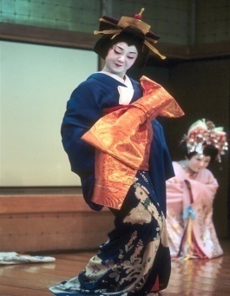

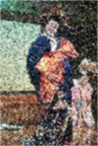
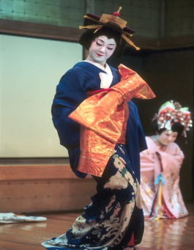
How should antennas be used?
Use antennas for multiplexing:
Use antennas for diversity
High-Rate
Quantizer
ST Code
High Rate
Decoder
Error Prone
Low-Rate
Quantizer
ST Code
High
Diversity
Decoder
Low P_{e}
Depends on end-to-end metric: Solve by optimizing app. metric

Slide 7
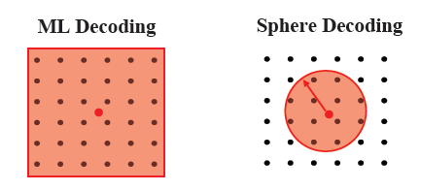
MIMO Receiver Design
Optimal Receiver:
  Maximum likelihood: finds input symbol most likely to have resulted in received vector
  Exponentially complex # of streams and constellation size
Decision-Feedback receiver
  Uses triangular decomposition of channel matrix
  Allows sequential detection of symbol at each received antenna, subtracting out previously detected symbols
Sphere Decoder:
  Only considers possibilities within a sphere of received symbol.
Space-Time Processing: Encode/decode over time & space

Slide 8
Other MIMO Design Issues
Space-time coding:
  Map symbols to both space and time via space-time block and convolutional codes.
  For OFDM systems, codes are also mapped over frequency tones.
Adaptive techniques:
  Fast and accurate channel estimation
  Adapt the use of transmit/receive antennas
  Adapting modulation and coding.
Limited feedback:
  Partial CSI introduces interference in parallel decomp: can use interference cancellation at RX
  TX codebook design for quantized channel

Slide 9
Main Points
MIMO introduces diversity/multiplexing tradeoff
  Optimal use of antennas depends on application
MIMO RX design trades complexity for performance
  ML detector optimal; exponentially complex
  DF receivers prone to error propagation
  Sphere decoders allow performance tradeoff via radius
  Space-time processing (i.e. coding) used in most systems
Adaptation requires fast/accurate channel estimation
Limited feedback introduces interference between streams: requires codebook design

