Slide 1
Chapter 8: Momentum
Thought for the Week
“No Pressure; No Diamonds”
Thomas Carlyle (19th Century)

Slide 2
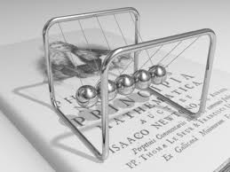
Newton’s Cradle
Pull back one ball and release
One ball flies off the other end
Why?
There are an infinite number of solutions that consehttp://www.youtube.com/watch?v=mFNe_pFZrsArve energy.
But momentum must also be conserved so only the last ball moves.
Giant Newton's Cradle
(YouTube Video)

Slide 3
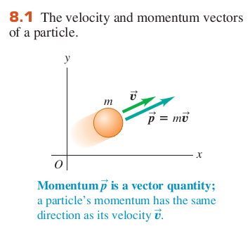
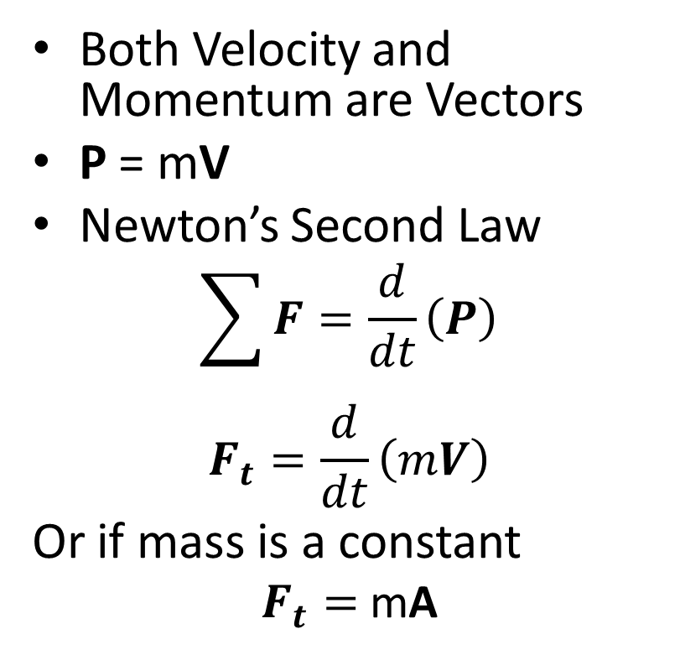
Mass, Velocity, and Momentum
Both Velocity and Momentum are Vectors
P = mV
Newton’s Second Law
$$\sum{F}=\frac{d}{dt}\left(P\right)$$
$$F_{t}=\frac{d}{dt}\left(mV\right)$$
Or if mass is a constant
$F_{t}=$ mA

Slide 4
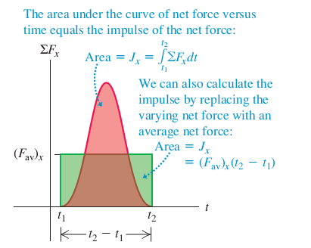
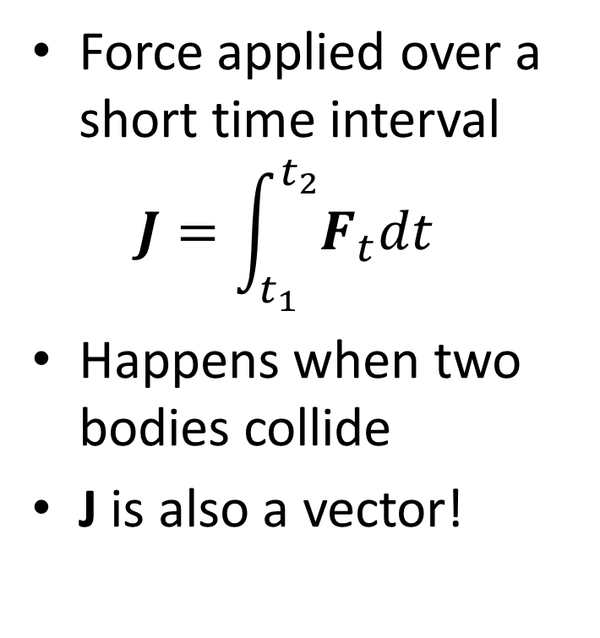
Impulse
Force applied over a short time interval
$J=\int_{t_{1}}^{t_{2}}{F_{t}dt}$
Happens when two bodies collide
J is also a vector!

Slide 5
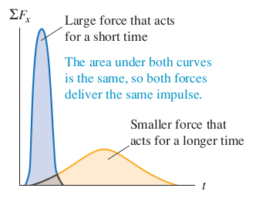
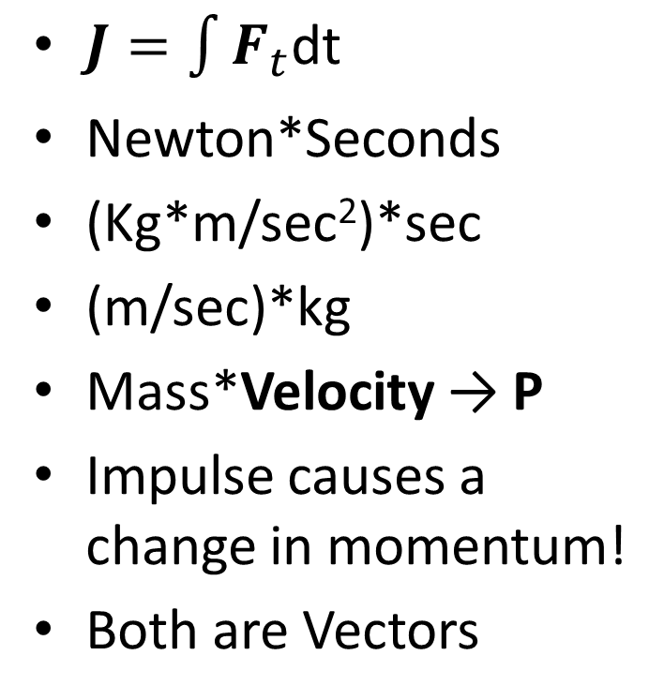
Impulse
Force over Time: Unit Analysis
$J=\int{F_{t}\text{dt} }$
Newton*Seconds
(Kg*m/sec²)*sec
(m/sec)*kg
Mass*Velocity → P
Impulse causes a change in momentum!
Both are Vectors

Slide 6
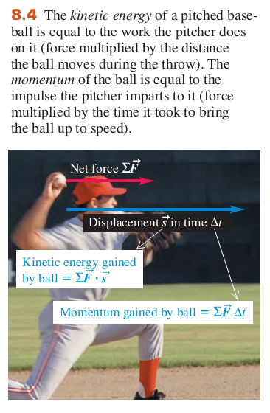
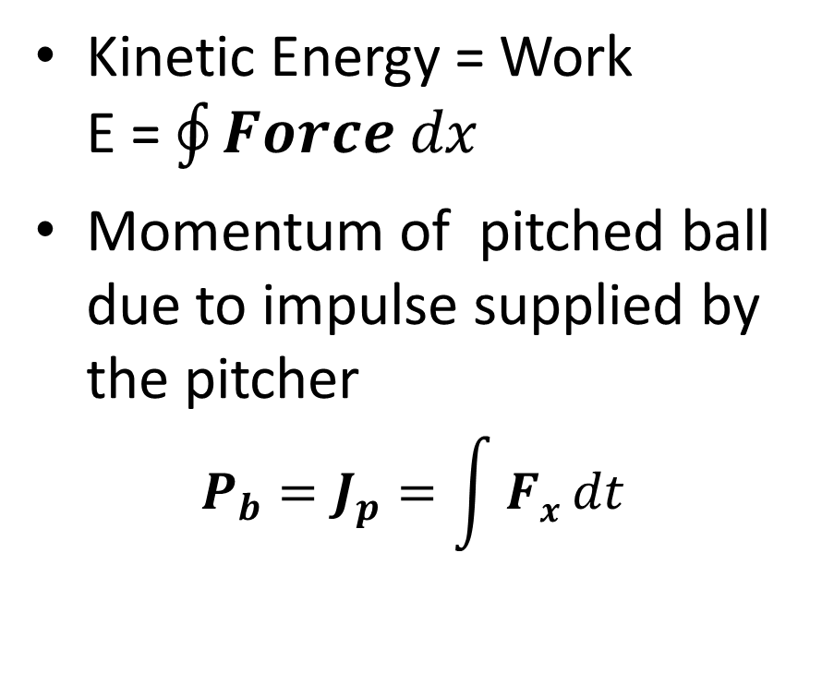
Baseball
Kinetic Energy = Work
E =$\oint{Force dx}$
Momentum of pitched ball due to impulse supplied by the pitcher
$$P_{b}=J_{p}=\int{Fx dt}$$

Slide 7
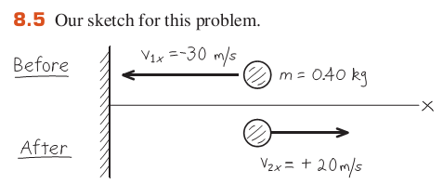
Rebounding Ball
Assume no gravity
Initial Momentum
P_{i} = 0.4kg*(-30 m/s)
= -12 Nt*s (The minus sign just acknowledges that the ball is traveling to the left)
Final Momentum
P_{f} = 0.4*20
= 8 Nt*s (going to the right)
Impulse
P_{f} - P_{i} = 20î Nt*s
Is energy conserved?
E = ½ m|v|²
E_{i} = ½*0.4*900 = 180 joules
E_{f} = ½*0.4*400 = 80 joules
What happened to the lost energy?

Slide 8
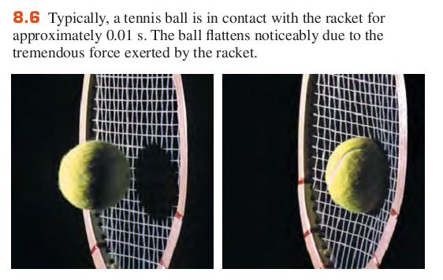
Tennis
The racket deforms
My elbow hurts

Slide 9
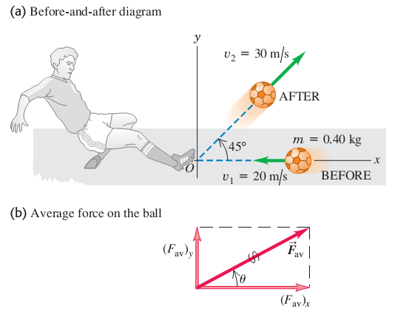
Soccer: Set Up
Kick provides an impulse
Ball changes direction and speed (new velocity)

Slide 10
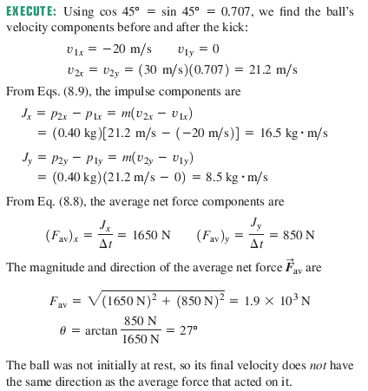
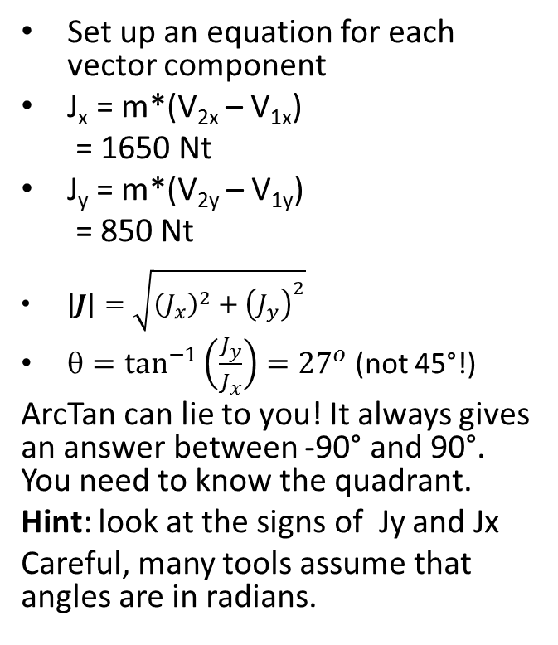
Soccer: Execute
Set up an equation for each vector component
J_{x} = m*(V_{2x} – V_{1x})
= 1650 Nt
J_{y} = m*(V_{2y} – V_{1y})
= 850 Nt
$\left|J\right|=\sqrt{{\left(J_{x}^{}\right)}^{2}+{\left(J_{y}^{}\right)}^{2}}$
${=tan}^{−1}\left(\frac{J_{y}^{}}{J_{x}^{}}\right)={27}^{o}$ (not 45°!)
ArcTan can lie to you! It always gives an answer between -90° and 90°. You need to know the quadrant.
Hint: look at the signs of Jy and Jx
Careful, many tools assume that angles are in radians.

Slide 11
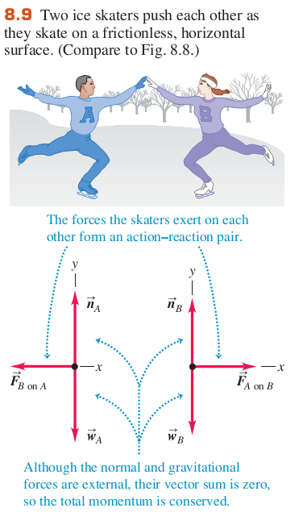
A Frictionless Interaction
If the vector sum of the external forces on a system is zero, the total momentum of the system is constant.
“Conservation of Momentum”

Slide 12
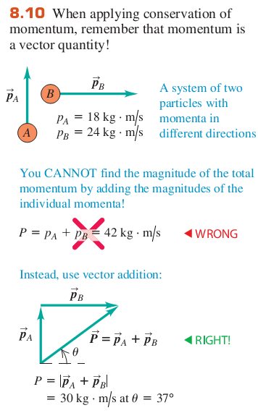
Remember: Momentum is a Vector!
Always remember to do vector addition!
Rewrite each vector in terms of it’s components (x, y, z)
Add the components to get the resultant

Slide 13
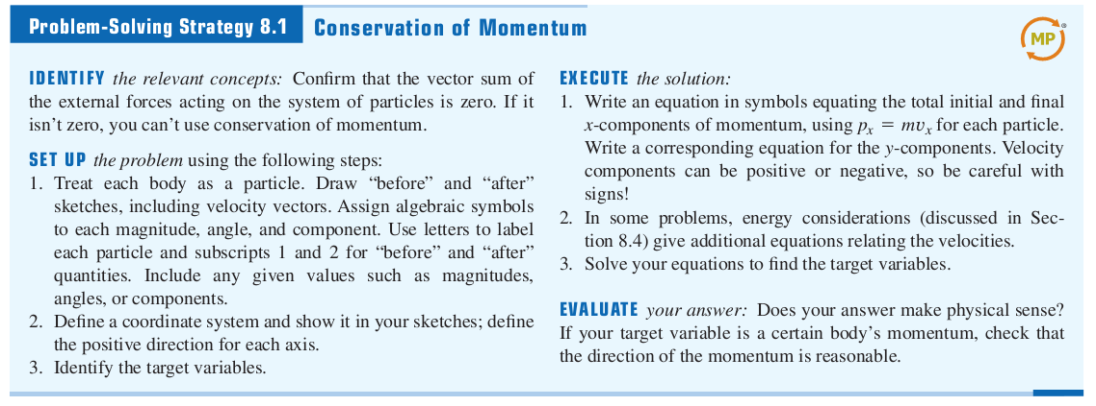
Problem Solving
Identify the concepts
Set up the Problem
  Simplify, draw a sketch, assign variable names – I can’t solve problems without pictures!
  Define coordinates
  Find the target variable(s)
Execute the solution
  Write the equations
  Add other equations where necessary
  Solve for the target variables
Evaluate your answer:
Use Your Real World Knowledge

Slide 14
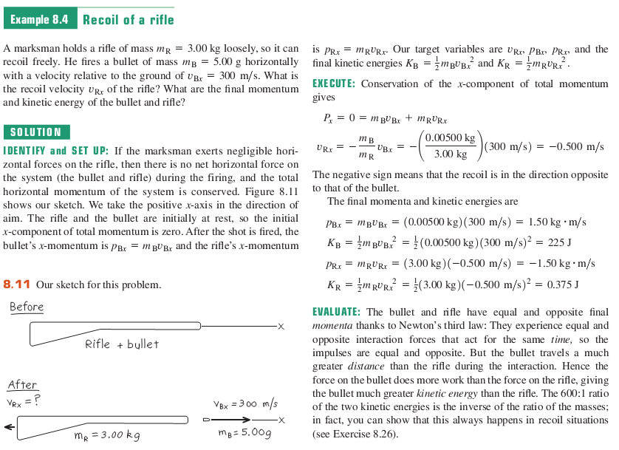

Slide 15
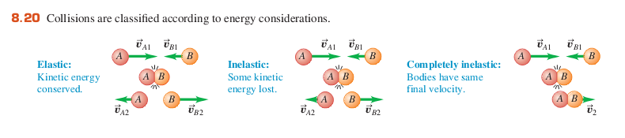
Collision Types
Elastic: No energy lost (Billiards, Air Hockey)
Inelastic: Some energy lost (ball hitting the wall)
Completely Inelastic
  Asteroid hitting earth
  Football: a tackle

Slide 16
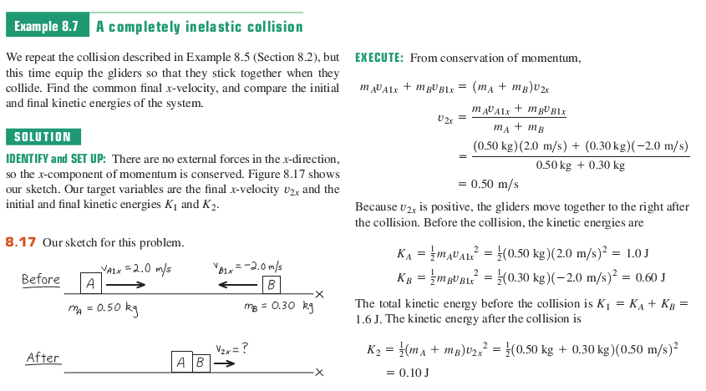
Completely Inelastic Collisions
(The masses combine)

Slide 17
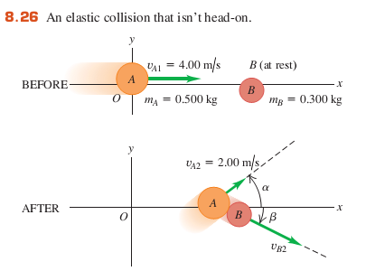
A Two Dimensional Elastic Collision
Assume no friction! So no spinning disks!
Think Air Hockey Table
What determines angle β? The point of contact!
Kinetic Energy Conserved: find |V_{B2}|
Set up conservation of x and y momentum components:
2 equations in 2 unknowns (α,β)

Slide 18
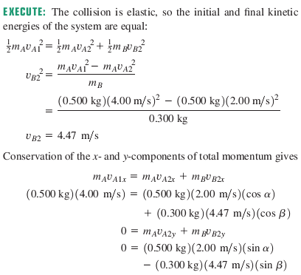
Execute!
To solve for α
Solve x-equation for cosβ
Solve y-equation for sinβ
Square each and add
Sin²β + cos²β = 1
This yields α = 36.9°
Substitution β = 26.6°
But we knew that from the point of contact. That is our confirmation that we did it correctly.

Slide 19
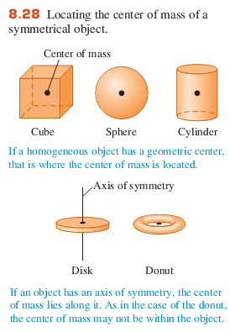
Center of Mass
If the object has symmetry, the center of mass is intuitive.
Sometimes you can find the “Balance Point” for the dimension lacking symmetry.
In other cases, you need calculus.

Slide 20
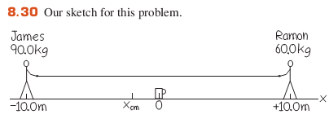
Tug of War on Ice
The center of mass doesn’t move.
Where is it before they pull on the rope? (-2 meters)
Ramon gets the cup.
Notes:
Find the center of mass – assume a stiff, mass free rod and determine the balance point
(10+x)*90*g = (10-x)*60*g note: g = 9.8 m/sec²
900 + 90x = 600 – 60x
-300 = 150x
X = -2 meters

Slide 21
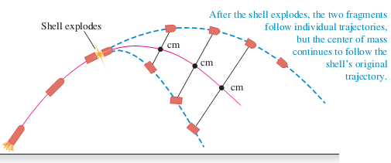
Explosive Impulse
Assume no air resistance

Slide 22
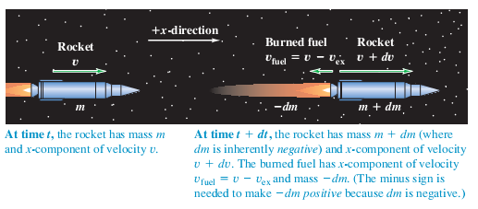
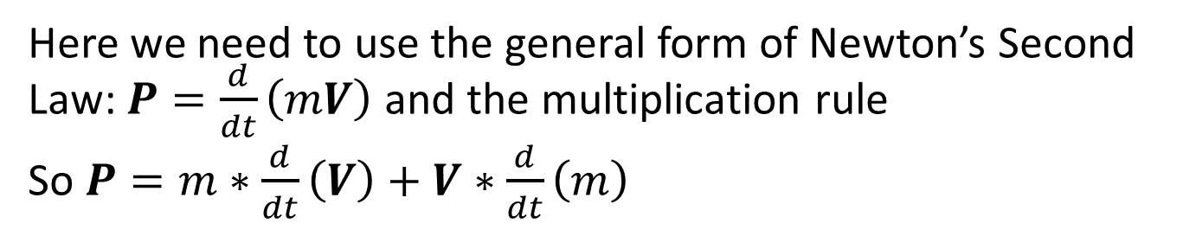
Rocket Propulsion
Here we need to use the general form of Newton’s Second Law: $P=\frac{d}{dt}\left(mV\right)$ and the multiplication rule
So $P=m∗\frac{d}{dt}\left(V\right)+V∗\frac{d}{dt}\left(m\right)$

Slide 23
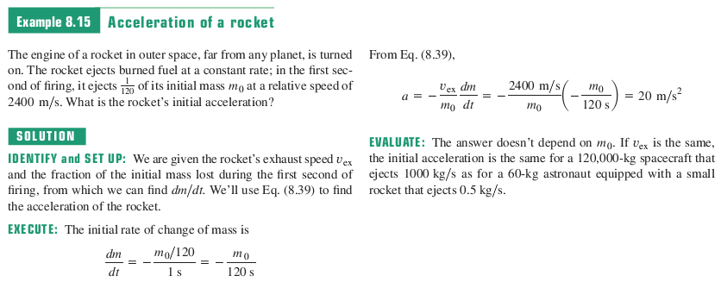
A Rocket in Deep Space
You need integral calculus to solve this problem! (from Calc 2)

Slide 24
Newton’s Cradle Revisited
Pull back one ball and release
That balls momentum becomes an impulse that goes from ball to ball until it gets to the last ball.
The last ball has no constraint so it gains the full momentum from the Impulse
How long does it take for the last ball to jump after the first ball hits?
Hint: What is the speed of sound in steel?

Slide 25
Chapter 8 Summary
Momentum
Impulses and Momentum
Conservation of Momentum: no external forces
Collisions: Elastic, Inelastic, Completely Inelastic
Center of Mass
Rocket Propulsion: Both mass and velocity are changing

