Slide 1
NPN Common Emitter Amplifier Example
Small Signal Analysis

Slide 2
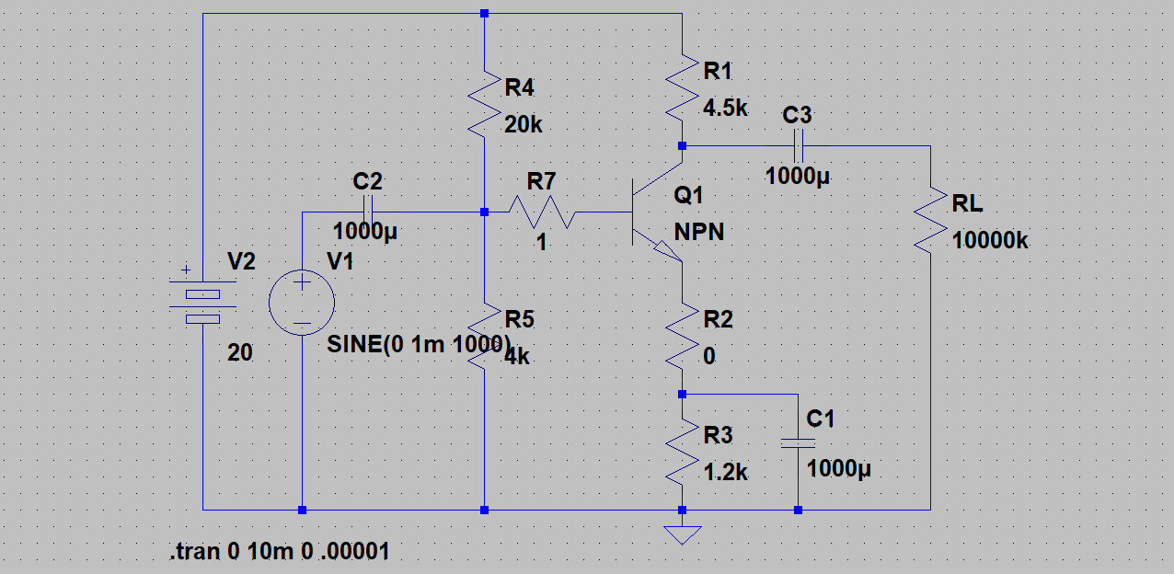
Our Amplifier Circuit
Remember the “Q” point for the NPN transistor is I_{c} ≈ 2 ma and
V_{c} ≈ 11 v and β= 100 for our generic NPN Transistor

Slide 3
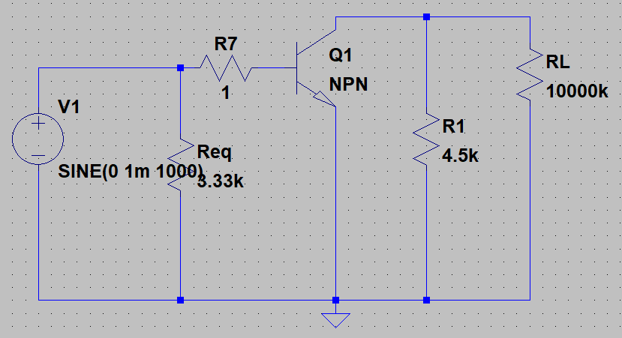
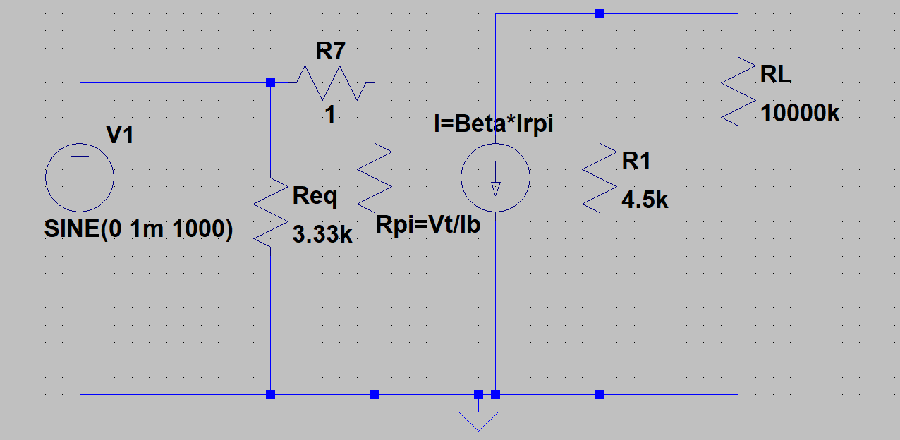
The AC Circuit
Short out DC supplies and capacitors, Replace Transistor with Small Signal Model
The “Q” point for the BE diode is I_{b} = 0.02 ma (I_{c}/100) and
V_{t} = 25 mv at room temperature so R_{π} = V_{t}/I_{b} (from Chapter 4)
R_{π} = 1.25 kΩ and β= 100 for our generic NPN Transistor

Slide 4
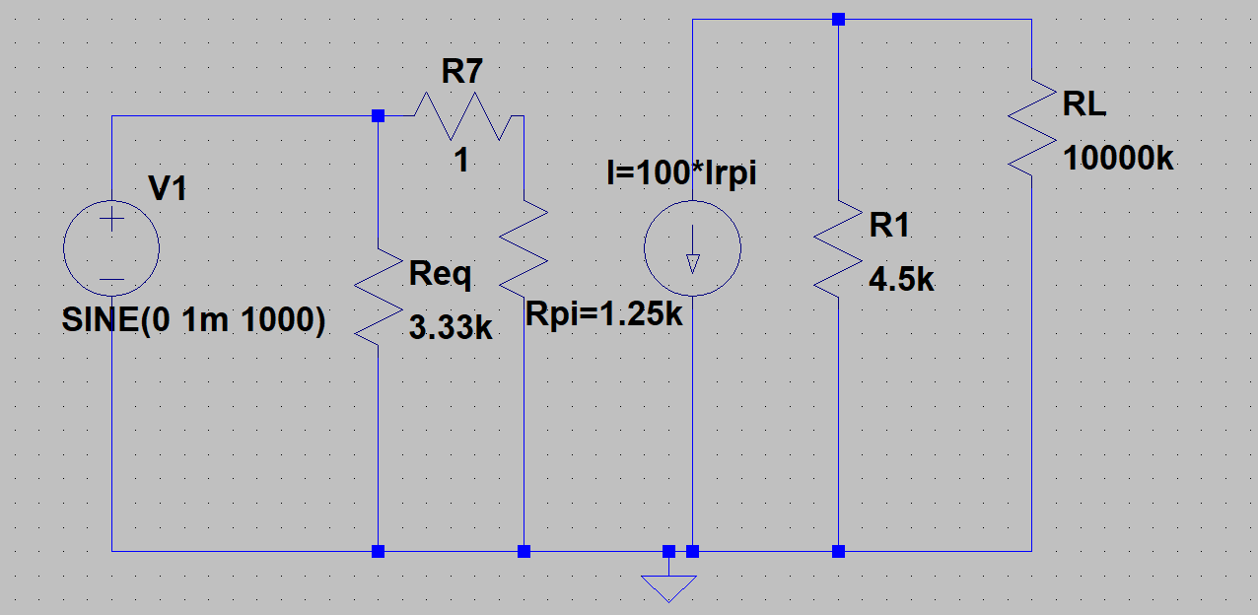
Our Small Signal Amplifier Model
I_{Rπ} = 1mv/1.25k = 0.8 μa so Ic = 80 μa and the
collector AC voltage = -80 μa * 4.5 kΩ = -360 mv
for an amplifier gain of -360

Slide 5
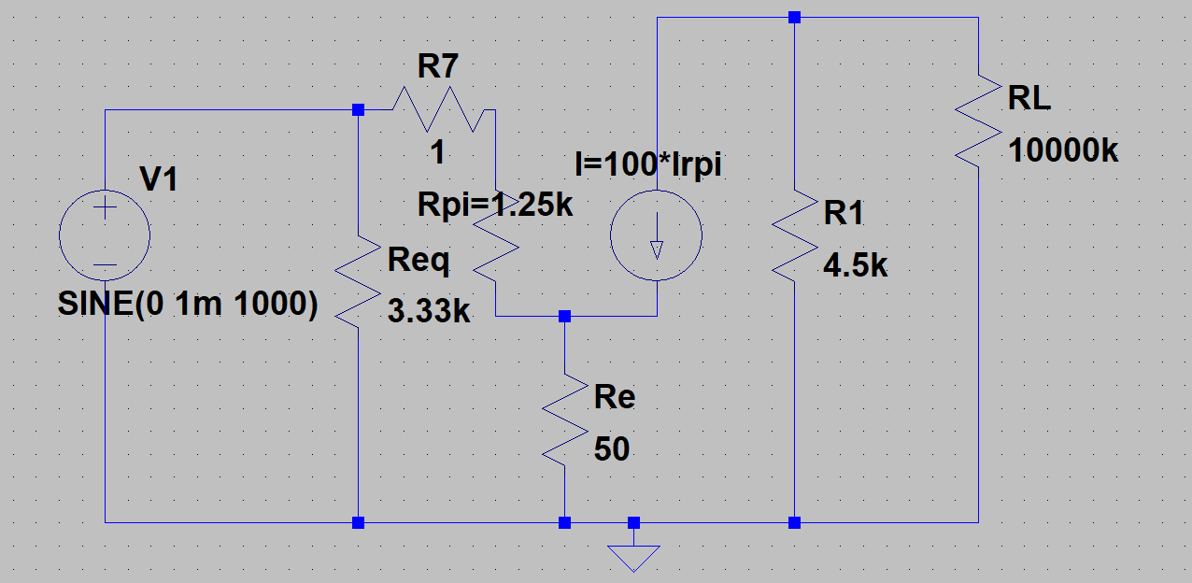
Now Add in a Small Unbypassed Emitter Resistor in our Small Signal AC Model
I_{Rπ}+β*I_{Rπ}= I_{re} or I_{Rπ}*(1+β) = I_{Re} and our Re looks like a much larger resistor in series with the transistor base. So now
I_{R π} = 1 mv/(1.25k+101*50) = 1mv/6.3k =.159μA and
I_{c} = -15.9μA which makes Vc = -71.4mv for an amplifier gain of -71.4

