Slide 1
Denoising ECG Using Wavelets

Slide 2
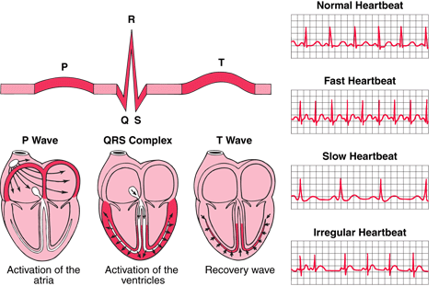
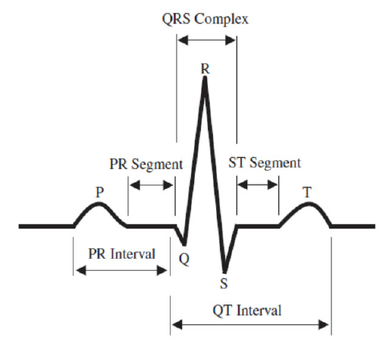
What is an ECG?
An Electrocardiogram illustrates as the heart undergoes depolarization and repolarization, the electrical currents that are generated spread not only within the heart, but also throughout the body. This electrical activity generated by the heart can be measured by an array of electrodes placed on the body surface.

Slide 3
What is a Wavelet?
Wavelets decomposition is an alternative analytical method that deals explicitly with time and frequency simultaneously.
Wavelets localize features in your data to different scales, preserving important signal or image features while removing noise.
The wavelet transform concentrates signal and image features in a few large-magnitude wavelet coefficients.
Wavelet coefficients which are small in value are typically noise and you can "shrink" those coefficients or remove them without affecting the signal or image quality.

Slide 4
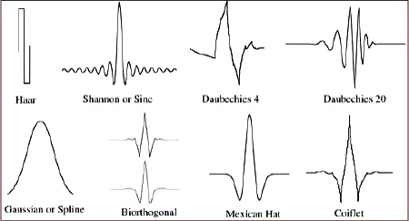
Wavelet Denoise Compared to Fourier Analysis
One of the problems with Fourier analysis is that the math assumes that the signal is stationary for all time.
Most of the time we can’t wait that long to do the analysis so we operate on a time window of the signal to represent the signal over all time. This introduces some artifacts in our results.
You define a basis wavelet (e.g. “Mexican Hat”): And you time shift this basis wavelet over the interval that your data exists and find a set of correlations.
Then you stretch the wavelet and do the correlations again.
Repeat until the wavelet length equals the data length.
This forms a decomposition of your signal in time

Slide 5
Steps for Denoising Signal Using Wavelet
Transform the noisy ECG signal to wavelet domain for finding DWT coefficients of each level (sub band).
Apply thresholding to obtain the estimated wavelet coefficients for each level. It is possible to use different thresholding functions.
Reconstruct the denoised ECG signal from the estimated wavelet coefficients by inverse DWT.

Slide 6
Complete Code
subplot(4,1,1);
plot(val); title('Original ECG Signal');
Noise = randn(3600,1);
FlipNoise=transpose(Noise);
subplot(4,1,2);
plot(FlipNoise); title('Noisy Signal');
x=val+25*transpose(Noise);
subplot(4,1,3);
plot(x); title('New ECG Signal With Noise');
xden = wdenoise(x);
subplot(4,1,4);
plot(xden); title('Denoised Signal Using Wavelets');

Slide 7
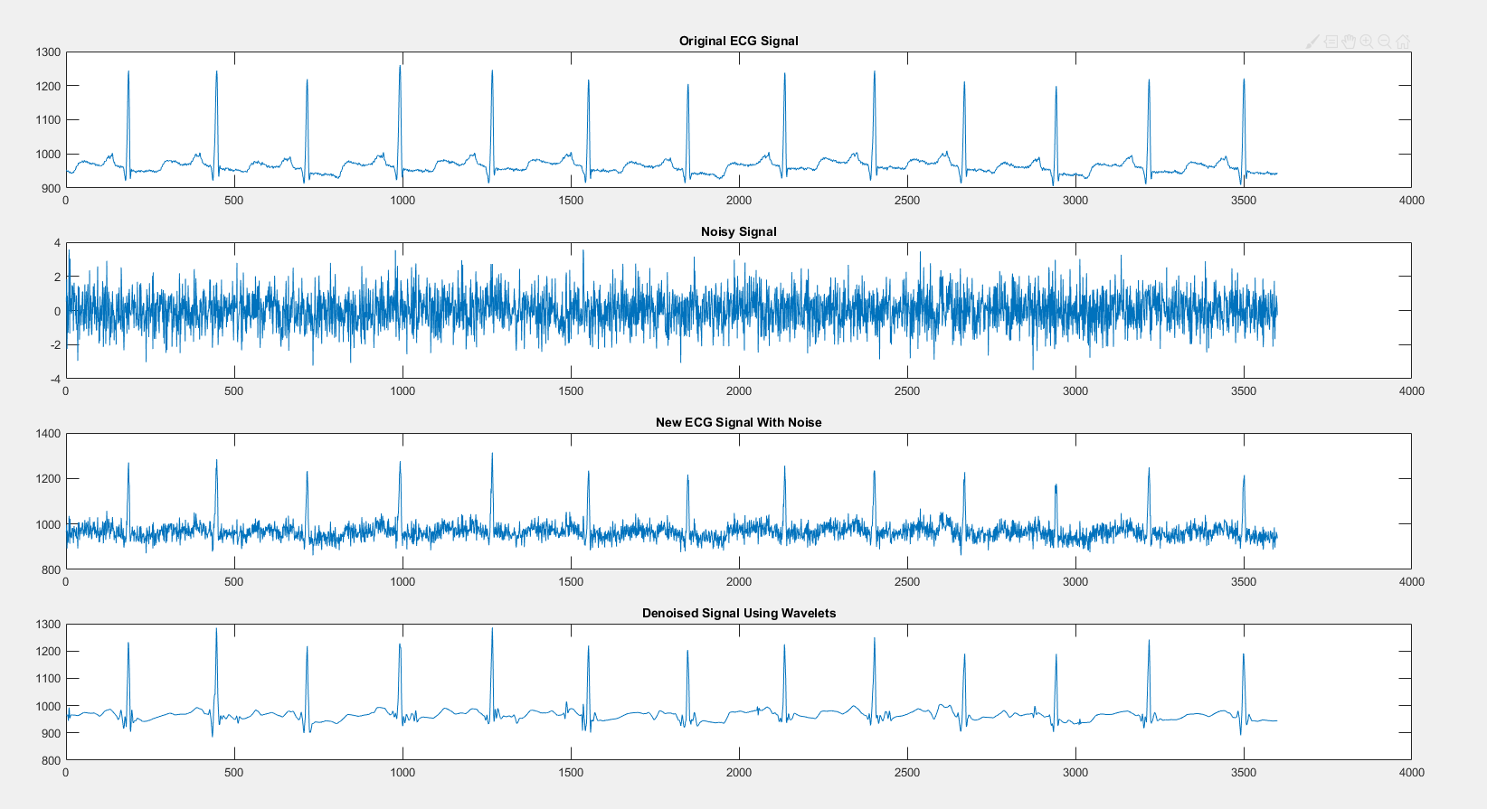
Graph:

Slide 8
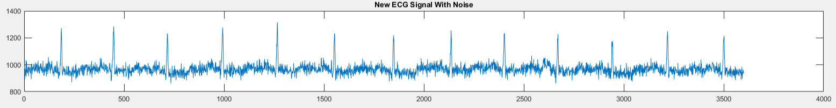
Original Noisy Signal:

Slide 9
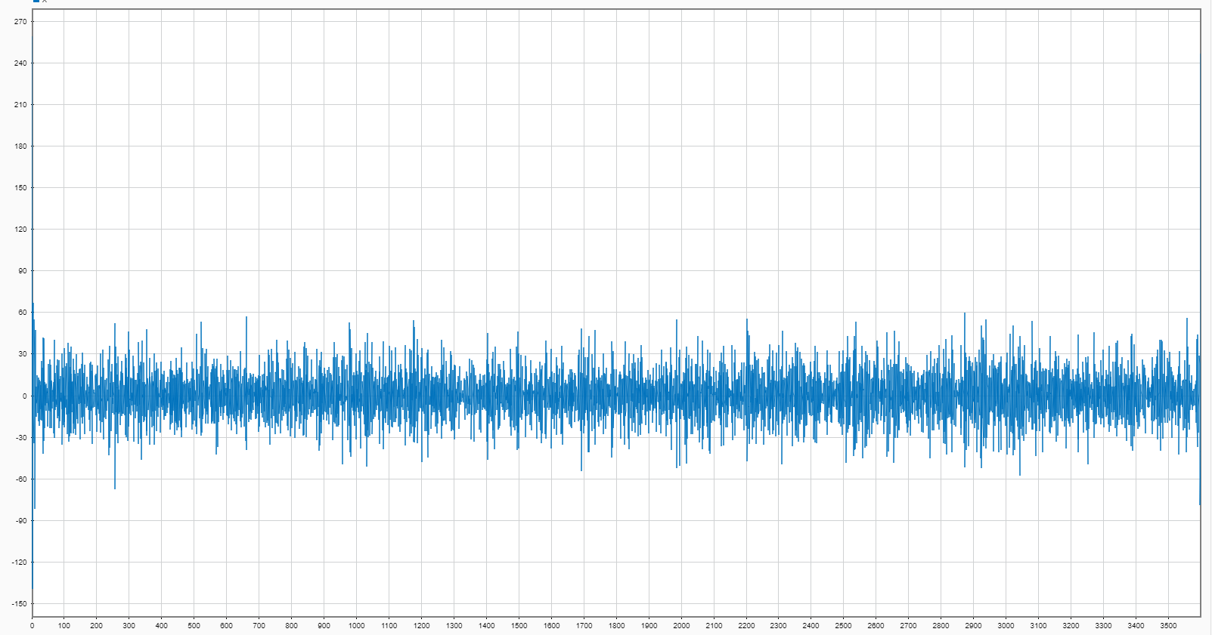

Compared to High Pass/Low Pass
HIGH Pass Filter of Signal X

Slide 10

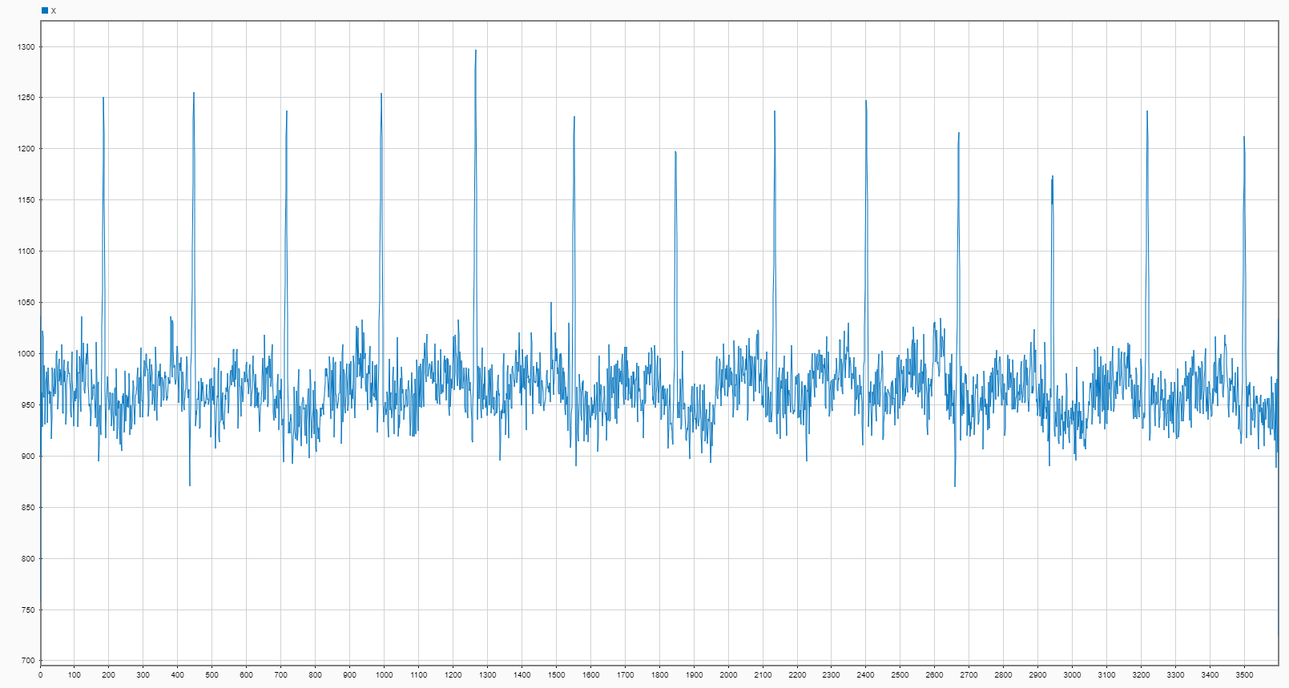
Compared to High Pass/Low Pass
Low Pass Filter

Slide 11
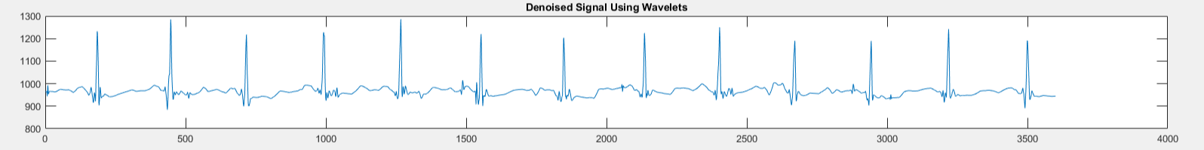
Denoising Signal with Wavelet

Slide 12
Next Steps:
Real life application of wavelets
-Trials with Mannequins in SimLab
-Trials on people

Slide 13
Works Cited:
https://www.mathworks.com/matlabcentral/answers/11685-adding-noise-to-an-ecg-signal
https://www.mathworks.com/help/comm/ref/awgn.html
https://www.mathworks.com/help/comm/ref/wgn.html

