Slide 1
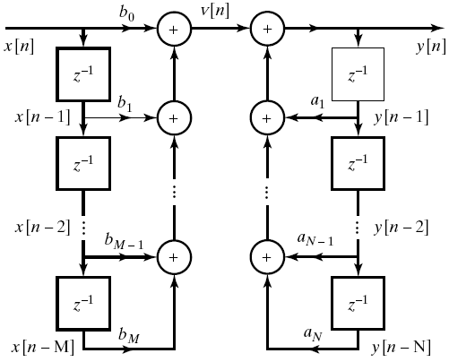
Digital Filter Structures
Direct Form I implementation

Slide 2
On the z-domain
or equivalently

Slide 3
By changing the order of H₁ and H₂, onsider the equivalence on the z-domain:
where
Let
Then

Slide 4
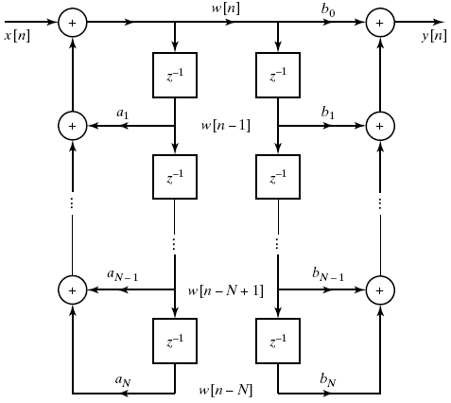
In the time domain,
We have the following equivalence for implementation:
We assume M=N here

Slide 5
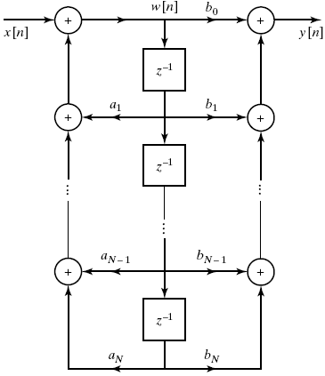
Note that the exactly the same signal, w[k], is stored in the two chains of delay elements in the block diagram. The implementation can be further simplified as follows:
Direct Form II (or
Canonic Direct Form) implementation

Slide 6
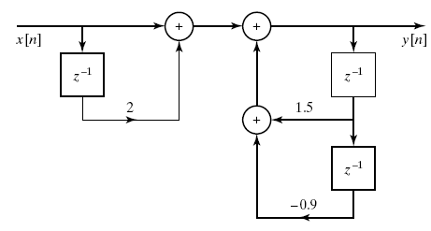
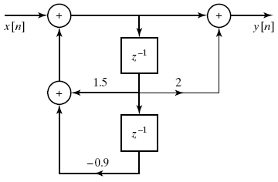
By using the direct form II implementation, the number of delay elements is reduced from (M+N) to max(M,N).
Example:
Direct form I implementation
Direct form II implementation

Slide 7
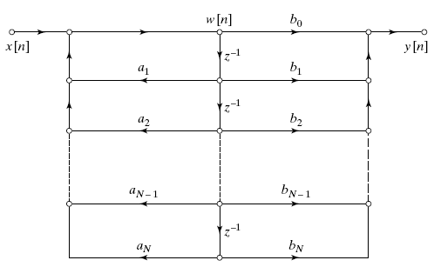
Representing by signal-flow graph
Example: the signal-flow graph of direct form II.

Slide 8
Cascade Form
If we factor the numerator and denominator polynomials, we can express H(z) in the form:
where M=M₁+2M₂ and N=N₁+2N₂, g_{k} and g_{k}* are a complex conjugate pair of zeros, and c_{k} and c_{k}* are a complex conjugate pair of poles.
It is because that any N-th order real-coefficient polynomial equation has n roots, and these roots are either real or complex conjugate pairs.

Slide 9
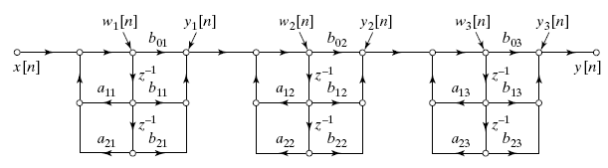
A general form is
where
and we assume that M≤N. The real poles and zeros have been combined in pairs. If there are an odd number of zeros, one of the coefficients b_{2k} will be zero.
It suggests that a difference equation can be implemented via the following structure consisting of a cascade of second-order and first-order systems:
cascade form of implementation (with a direct form II realization of each second-order subsystems)

Slide 10


Example:
Cascade structure: direct form I implementation
Cascade structure: direct form II implementation

Slide 11
Parallel Form
If we represent H(z) by additions of low-order rational systems:
where N=N₁+2N₂. If M≥N, then N_{p} = M−N.
Alternatively, we may group the real poles in pairs, so that

Slide 12
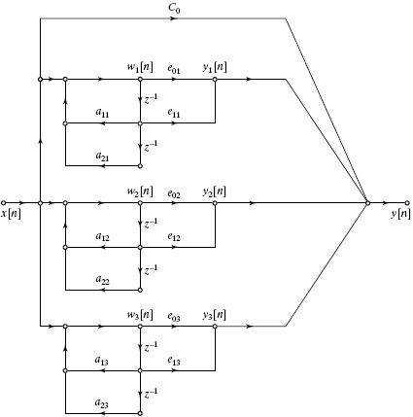
Illustration of parallel-form structure for six-order system (M=N=6) with the real and complex poles grouped in pairs.

Slide 13
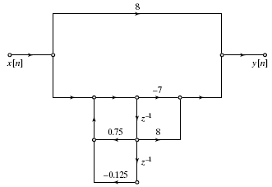
Example: consider still the same system

Slide 14
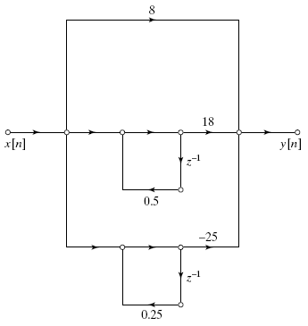
another alternation of the same system
Hence, given a system function, there are many ways to implement it.
There are equivalent when infinite-precision arithmetic is used. However, their behavior with finite-precision arithmetic can be quite different.

Slide 15
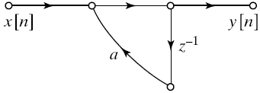
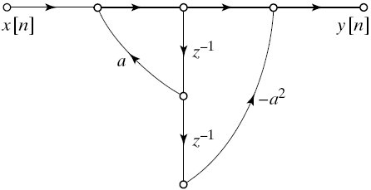

While the signal flow graph is an efficient way to represent a difference equation, not all of its instances are realizable:
If a system function has poles, a corresponding signal flow graph will have feedback loops.
A signal flow graph is computable if all loops contain at least one unit delay element. Eg.
A non-computable system
Computable systems

Slide 16
Circular Convolution (for DFT)
Time-domain convolution implies frequency domain multiplication. This property is valid for continuous Fourier transform, Fourier series, and DTFT, but is not exactly true for DFT.
The DFT pair considered hereafter (following Openheim’s book, where the 1/N is put on the inverse-transform side):
where W_{N} = e^{−j2π/N} is a root of the equation W^{N}=1.

Slide 17
Circular Convolution (for DFT)
For DFT, time domain circular convolution implies frequency domain multiplication, and vice versa.
  Consider a periodic sequence. Its DTFT is both periodic and discrete in frequency. Multiplication in the frequency domain results in a convolution of the two corresponding periodic sequences in the time domain. Now let’s consider a single period of the resulted sequence. Since the two sequences are both periodic, the convolution appears as ‘folding’ the rear of a sequence to the front one by one, and superimposing the inner products so obtained, in a single period.

Slide 18
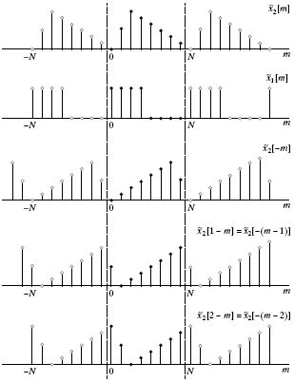
Convolution of two periodic sequences

Slide 19
Circular convolution (definition)
Symbol for representing circular convolution: ⊗ or N .
If the DFT of x₁[n], x₂[n], and x₃[n] are X₁[k], X₂[k], and X₃[k], respectively.
Time domain circular convolution implies frequency domain multiplication:
Time domain multiplication implies frequency domain circular convolution (with 1/N amplitude reduction):
circular convolution

Slide 20
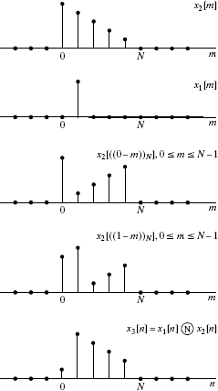
Example: circular convolution with a delayed impulse sequence

Slide 21
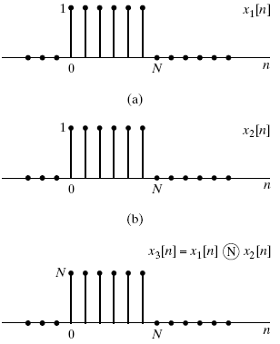
Example: circular convolution of two rectangular pulses
N-point circular convolution of two sequences of length N.

Slide 22
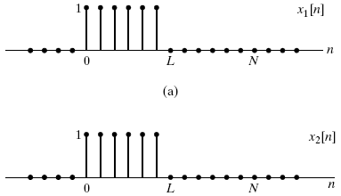
Example: circular convolution of two rectangular pulses (continue)
  Given two sequences of length L, assume that we add L zeros on its end, making an N=2L point sequence – referred to as zero padding
N-point circular convolution of two sequences of length L, where N=2L.

Slide 23
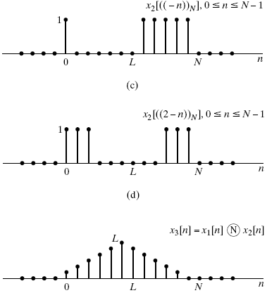
N-point circular convolution of two sequences of length L, where N=2L (continue).
Note that by zero padding, we can use circular convolution to compute convolution of two finite length sequences.

Slide 24
Some other properties involving circulation:
Time domain circular shift implies frequency domain phase shift:
Duality property of DFT:
Since DFT and IDFT has very similar form, we have a duality property for DFT:
If
Then

Slide 25
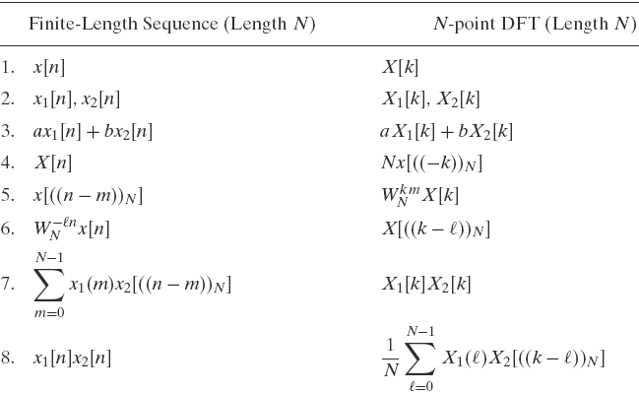
DFT Properties:

Slide 26
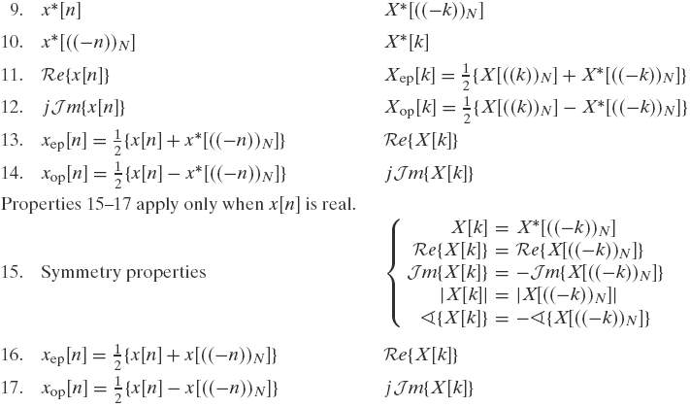

Slide 27
Sampling the DTFT spectrum
We have seen that, for an M-point sequence, if we uniformly sample M points in its DTFT spectrum within [0, 2π], we can equivalently obtain its DFT.
What happen when we sample N points in the frequency domain [0, 2π], instead of M points? Let the samples be
We will have the following property:
which means that “frequency-domain sampling implies time domain aliasing.”
when N ≥ M, no aliasing will happen, and particular when N=M, we obtain DFT.
when N < M, aliasing (of nonzero values) happens.

Slide 28
Linear Convolution Using DFT
Recall that linear convolution is
when the lengths of x1[n] and x2[n] are L and P, respectively the length of x3[n] is L+P-1.
Thus a useful property is that the circular convolution of two finite-length sequences (with lengths being L and P respectively) is equivalent to linear convolution of the two N-point (N ≥ L+P−1) sequences obtained by zero padding.
Another useful property is that we can perform circular convolution and see how many points remain the same as those of linear convolution. When P < L and an L-point circular convolution is performed, the first (P−1) points are corrupted by circulation, and the remaining points from n=p−1 to n=L−1 (ie. The last L−P+1 points) are not corrupted (ie., the last L−P+1 points remain the same as the linear convolution result).

Slide 29
Block convolution (for implementing an FIR filter)
FIR filtering is equal to the linear convolution of a (possibly) infinite-length sequence.
To avoid delay in processing, and also to make efficient computation, we would like to segment the signal into sections of length L. Each L-length sequence can then be convolved with the finite-length impulse response and the filtered sections fitted together in an appropriate way. – called block convolution.
When each section is sufficiently large, we usually use circular convolution (instead of linear convolution) to compute each section. (since it will be shown that there are fast algorithms, fast Fourier transform (FFT), to compute circular convolutions highly efficiently)
Two methods for circular-convolution-based block convolution:
Overlapping-add method and overlapping-save method.

Slide 30
Overlapping-add method (for implementing an FIR filter)
When segmenting into L-length segments, the signal x[n] can be represented as
where
Because convolution is an LTI operation, it follows that
where
Since x_{r}[n] is of length L and h[n] is of length P, each y_{r}[n] has length (L+P−1).
So, we can use zero-padding to form two N point sequences, N=L+P−1, for both x_{r}[n] and h[n]. Performing N-point circular convolution (instead of linear convolution) to compute y_{r}[n].

Slide 31
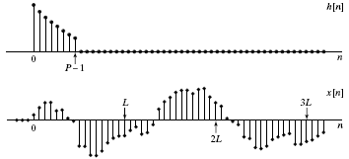
For example, consider two sequences h[n] and x[n] as follows.

Slide 32
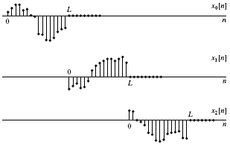
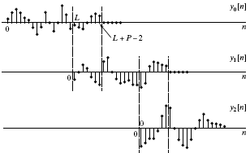
Segmenting x[n] into L-length sequences. Each segment is padded by P−1 zero values.
Fir filtering by using the overlapping-add method.

Slide 33
Overlapping-save method (for implementing an FIR filter)
Can we perform L-point circular convolution, instead of (L+P−1)-point circular convolution?
  If a P-point sequence is circularly convolved with a P-point sequence (P<L), the first (P−1) points of the result are incorrect, while the remaining points are identical to those that would be obtained by linear convolution.
Separating x[n] as overlapping sections of length L, so that each section overlaps the preceding section by (P−1) points.
Then

Slide 34
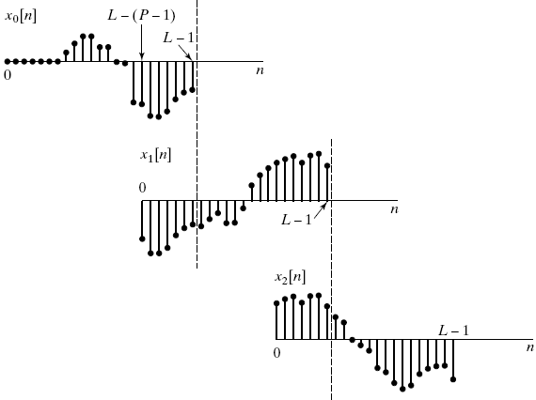
Example of overlapping-save method
Decompose x[n] into overlapping sections of length L

Slide 35
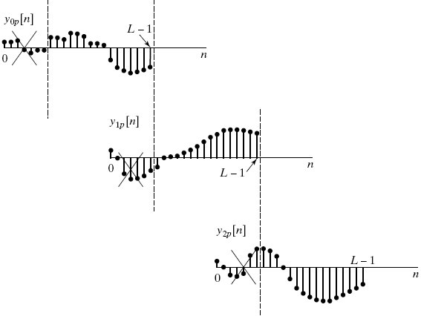
Example of overlapping-save method (continue)
Result of circularly convolving each section with h[n]. The portions of each filter section to be discarded in forming the linear convolution are indicated

Slide 36
See the following reference for the suggestion of L and P:
M. Borgerding, “Turning Overlap-Save into a Multiband Mixing, Downsampling Filter Bank,” IEEE Signal Processing Magazine, pp. 158-161, 2006.
Fast Fourier Transform (FFT)
DFT pairs:
W_{N} = e^{−j2π/N} is a root of the equation W^{N}=1.
It requires N² complex multiplications and (N−1)N complex additions for computation.
Each complex multiplication needs four real multiplications and two real additions, and each complex addition requires two real additions. It requires 4N² real multiplications and N(4N−2) real additions.

Slide 37
Goertzel algorithm
Since
Define
The above equation can be interpreted as a discrete convolution of the finite-duration sequence x[n], 0 ≤ n ≤ N−1, with the sequence , which is the impulse response of the LTI system.
Note that x[r] is nonzero only when 0 ≤ r < N. We can easily verify that

Slide 38
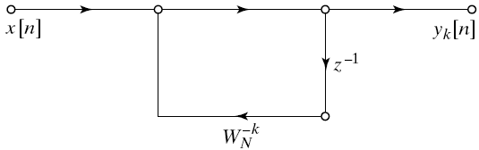
The Goertzel algorithm computes DFT by implementing the above LTI system. The system function is the z transform of
The signal-flow graph of the LTI system for obtaining y_{k}[n] is

Slide 39
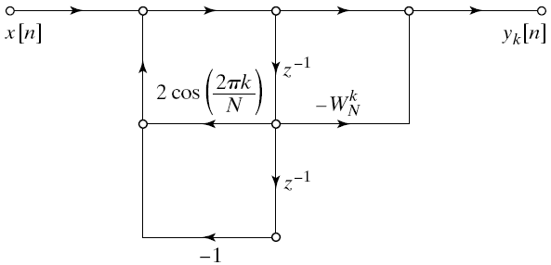
The implementation can be further simplified as
v_{k}[n]
Flow graph of second-order computation of X[k] (Goertzel algorithm)

Slide 40
Since we only need to bring the system to a state from which y_{k}[n] can be computed, the complex multiplication by −W_{n}^{k} required to implement the zero of the system need not be performed at every iteration, but only after the N-th iteration, by the following difference equation:
It requires 2 real multiplications and 4 real additions to compute v_{k}[n] (that may be a complex sequence). The multiplication by −W_{n}^{k} is performed only when n=N, which requires 4 real multiplications and 4 real additions. Finally, a total of 2N+4 real multiplications and 4N+4 real additions are required.
To compute all the X[k], k=0, …, N−1, we need 2N(N+2) real multiplications and 4N(N+1) real additions, where the number of multiplications are reduced by almost a half.
The Goertzel algorithm is usually used to compute X[k] for which only a single k or a small number of k values are needed.

Slide 41
Decimation-in-time FFT algorithm
Most conveniently illustrated by considering the special case of N an integer power of 2, i.e, N=2^{v}.
Since N is an even integer, we can consider computing X[k] by separating x[n] into two (N/2)-point sequence consisting of the even numbered point in x[n] and the odd-numbered points in x[n].
or, with the substitution of variable n=2r for n even and n=2r+1 for n odd

Slide 42
Since
That is, W_{N}² is the root of the equation W^{N/2}=1
Consequently,
Both G[k] and H[k] can be computed by (N/2)-point DFT, where G[k] is the (N/2)-point DFT of the even numbered points of the original sequence and the second being the (N/2)-point DFT of the odd-numbered point of the original sequence.
Although the index ranges over N values, k = 0, 1, …, N-1, each of the sums must be computed only for k between 0 and (N/2)-1, since G[k] and H[k] are each periodic in k with period N/2.

Slide 43
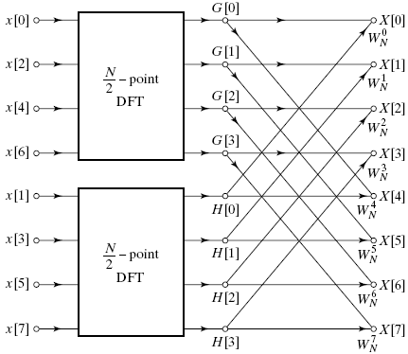
Decomposing N-point DFT into two (N/2)-point DFT for the case of N=8

Slide 44
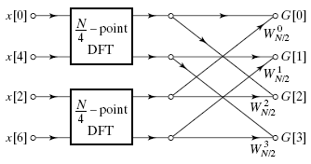
We can further decompose the (N/2)-point DFT into two (N/4)-point DFTs. For example, the upper half of the previous diagram can be decomposed as

Slide 45
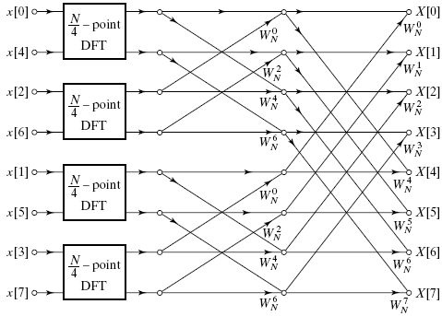
Hence, the 8-point DFT can be obtained by the following diagram with four 2-point DFTs.

Slide 46
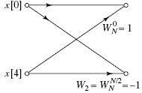
Finally, each 2-point DFT can be implemented by the following signal-flow graph, where no multiplications are needed.
Flow graph of a 2-point DFT

Slide 47
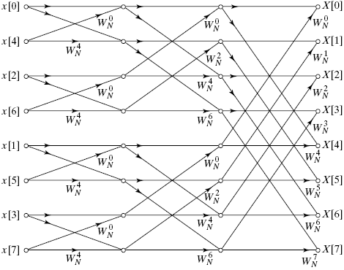
Flow graph of complete decimation-in-time decomposition of an 8-point DFT.

Slide 48
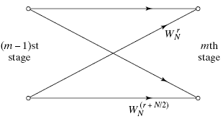
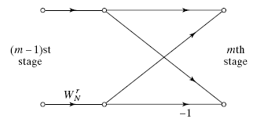
In each stage of the decimation-in-time FFT algorithm, there are a basic structure called the butterfly computation:
The butterfly computation can be simplified as follows:
Flow graph of a basic butterfly computation in FFT.
Simplified butterfly computation.

Slide 49
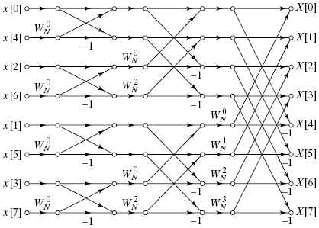
Flow graph of 8-point FFT using the simplified butterfly computation

Slide 50
In the above, we have introduced the decimation-in-time algorithm of FFT.
Here, we assume that N is the power of 2. For N=2^{v}, it requires v=log₂N stages of computation.
The number of complex multiplications and additions required was N+N+…N = Nv = N log₂N.
When N is not the power of 2, we can apply the same principle that were applied in the power-of-2 case when N is a composite integer. For example, if N=RQ, it is possible to express an N-point DFT as either the sum of R Q-point DFTs or as the sum of Q R-point DFTs.
In practice, by zero-padding a sequence into an N-point sequence with N=2^{v}, we can choose the nearest power-of-two FFT algorithm for implementing a DFT.
The FFT algorithm of power-of-two is also called the Cooley-Tukey algorithm since it was first proposed by them.
For short-length sequence, Goertzel algorithm might be more efficient.

Slide 51
Two-dimensional Fourier Transform
Two-dimensional transforms can be formulated by directly extending the one-dimensional transform. Eg.
DFT of two-dimensional signal (eg., an image):
Two-dimensional convolution (circular convolution):

Slide 52
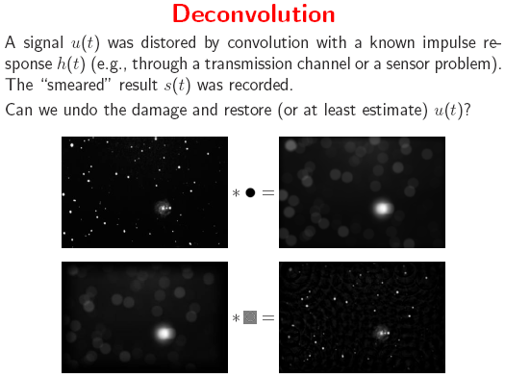

Slide 53
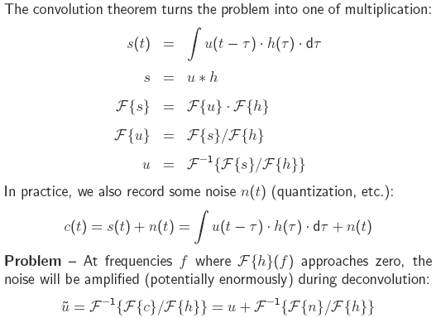

Slide 54
